Slide 1
Catchment Management Strategy
Stakeholder Consultation:
12 June 2013
Marcus Selepe

Slide 2
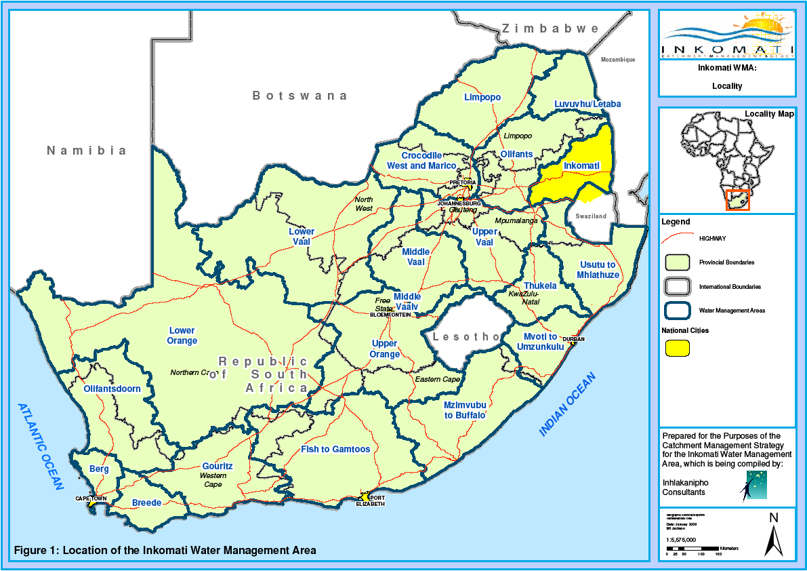

Slide 3
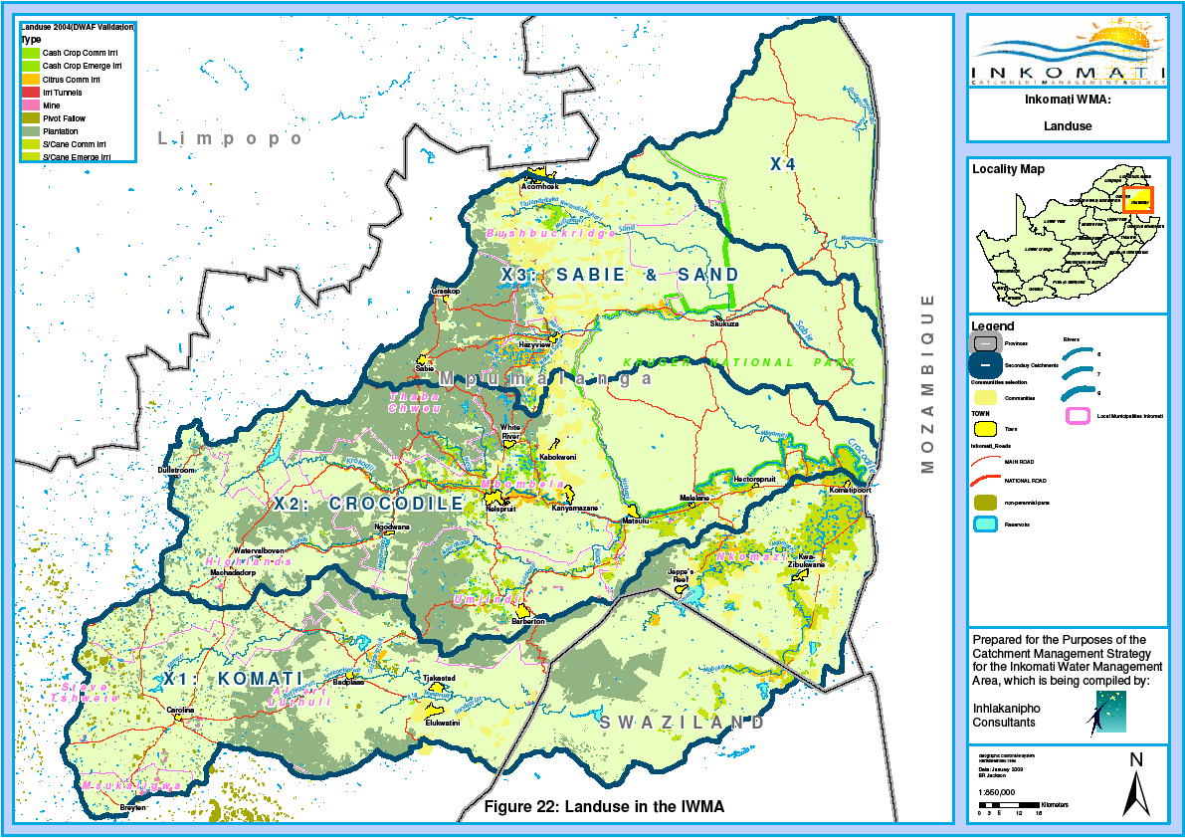

Slide 4
Strategic Adaptive Management Process
Values
Vital attributes
Threats
Context for the management of IWMA

Slide 5
Values
Acknowledge interdependence of responsibilities for caring for the resource
Decisions, actions and outcomes subject to evaluation against goals, indicators and timeframes
Management is adaptive, open to critique and outcomes driven.
Decisions within our mandate are justified on basis of best available social, technical, economic, environmental and governance knowledge

Slide 6
Vital Attributes of the WMA
Livelihood is linked to health of rivers and tributaries
Rainfall is variable in space and time
Rivers are important source of water for Swaziland and Mozambique
The catchment is a critical element of internationally renowned tourist attraction area
There are still large disparities in access to water and current water allocations do not meet domestic and economic needs.

Slide 7
Threats
Public discontent, scepticism
Poor land and water use planning
Non-compliance by developers and mining
Lack of enforcement
Non-implementation of the reserve
Insufficient water use charges
Shortage of skilled technical personnel

Slide 8
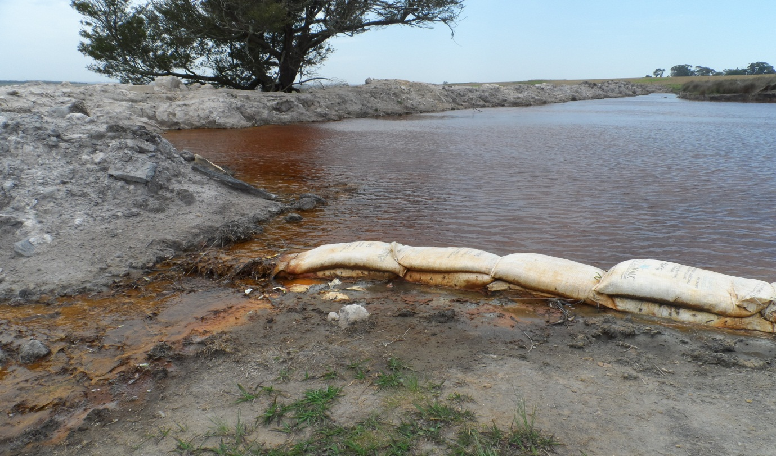
Threats

Slide 9
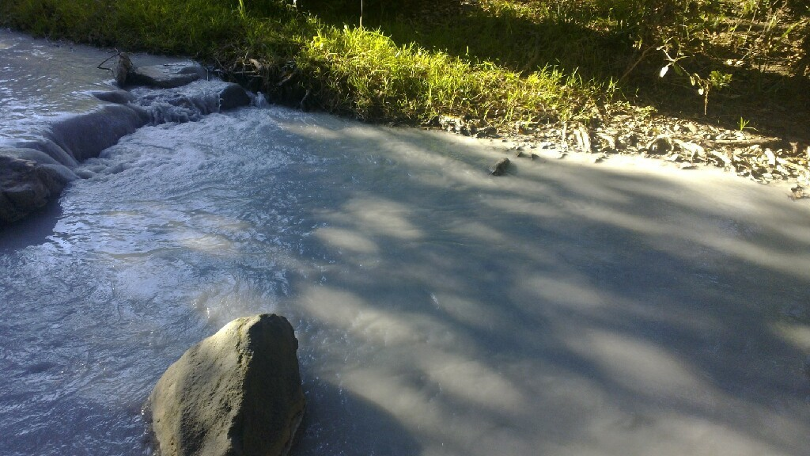
Threats

Slide 10
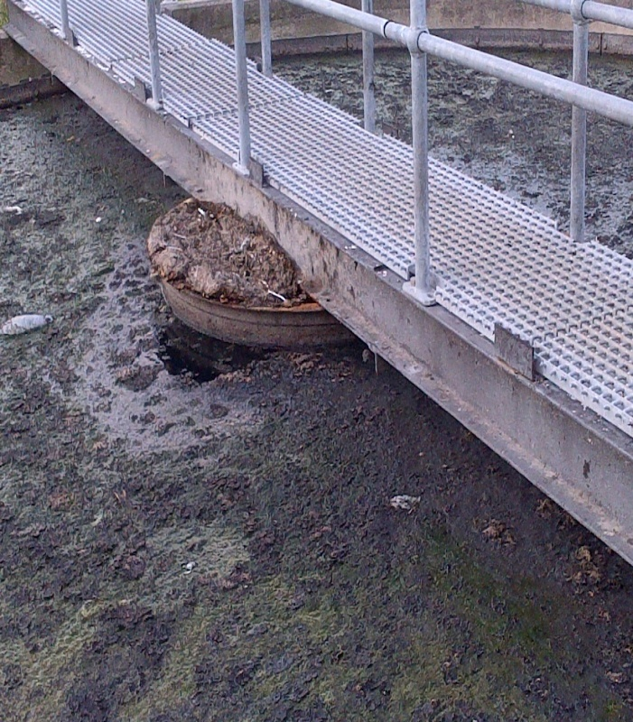
Threats

Slide 11
Context for management of the IWMA
Inkomati economy is highly dependent on water
Irrigation based agriculture and forestry provide most jobs in the catchment
Poor municipal waste management results in decreased water quality and fitness for use
Poorly managed mining activities impact on the quality of both ground and surface water
There is poor enforcement and variable monitoring of water quality, quantity and illegal use

Slide 12
Catchment Vision
We share the Inkomati water resources, and responsibility for their management, amongst ourselves and with our neighbours.
Our decision making environment, including delegated functions, enables collaborative action towards equity, sustainability and efficiency in a continually evolving socioeconomic system.
We manage the resource adaptively, co-operatively and progressively to achieve social, economic and environmental justice, and promote healthy living

Slide 13
Allocation Priorities
The Reserve - preliminary
International obligations
Strategic use
Inter-catchment transfers
Allocable water

Slide 14
Classification
Classification – determines the management class or level of protection
  Reserve
  RQO

Slide 15
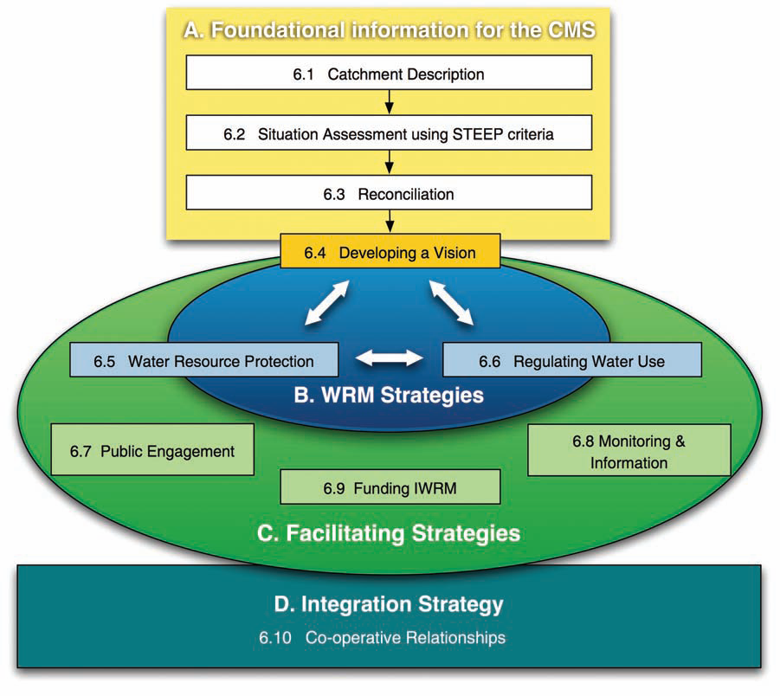

Slide 16
Thank you!!!

