Slide 1

TECHNICAL PROGRESS
Presented by:
Delana Louw
Rivers for Africa
31 October 2013

Slide 2
PROJECT PLAN & STUDY TASKS
Complete
In process
TECHNICAL STEPS
OTHER STEPS
1. Status quo, IUA delineation
3. Quantify EWRs & links to EGSA
2. Visioning
5. Stakeholder process
8. Gazetting
8. Capacity Building
4. ID & evaluate scenarios in IWRM
6. RQO

Slide 3
STEP 1: STATUS QUO & IUA DELINEATION
Task completed.
Purpose of task is to select homogenous areas that can be managed as an entity (IUA), and
to determine the status quo of the IUAs.
The output in essence is a sustainable base configuration that equates to the present state.
Changes in this status are measured when evaluating operational scenarios within IWRM (Step 4).
12 IUAs identified, each with nodes.

Slide 4
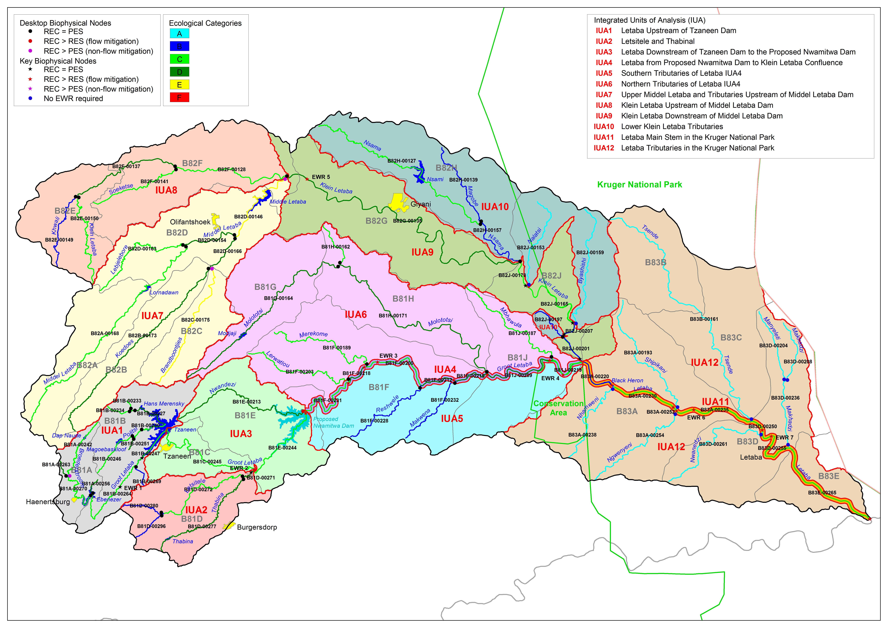

Slide 5
  STEP 3: QUANTIFY EWRS AND LINKS TO EGSA
Task complete apart from report
Purpose of task is to determine EWRs at each biophysical node.
EGSAs are identified and key EGSA that can change with changes with scenarios highlighted.
Output is EWRs as flow duration tables for each nodes and EGSAs identified

Slide 6
  STEP 4: ID AND EVALUATE SCs WITHIN IWRM
First task: Determine preliminary operational scenarios and test with stakeholders.
Tested at recon strategy meetings and now at NWRCS stakeholder meeting.
Next: Determining consequences of scenarios,
Ranking scenarios,
Make study team recommendation,
Take consequences and preliminary MC to stakeholders

Slide 7
  RECAP OF PROCESS TO DETERMINE MC
DETERMINE STATUS QUO
(ecology, economics, EGSA, water balance, quality)
ID range of OPERATIONAL SCENARIOS
PREDICT CONSEQUENCES
(ecology, economics, EGSA, water balance, quality)
Recommend future OPERATIONAL SCENARIO
SUMMARY
Translate consequences and derive MC

Slide 8
  RECAP OF PROCESS TO DETERMINE MC
Predict ECOLOGICAL consequences
NWRCS ecological guideline
MC 1.1
Specific ecological info
MC 1.2
ECONOMIC & EGSA consequences
MC 1.3
Consider trade-offs
Document reasoning & motivations

Slide 9
  RECAP OF PROCESS TO DETERMINE MC
STAKEHOLDER input
Draft MC
DWA RECOMMENDATION
Preliminary MC
GAZETTING PROCESS
MC (& catchment configuration) gazetted
GAZETTED MC (FINAL)

Slide 10
  END

