Slide 1

EWR SUMMARY
Presented by:
Delana Louw
Rivers for Africa
31 October 2013

Slide 2
Letaba NWRCS integrated steps
1: Delineate units of analysis and describe the status quo
2: Initiation of stakeholder process and catchment visioning
3: Quantify EWRs and changes in EGSA
7: Gazette class configuration
4: Identification and evaluation of scenarios within IWRM
5: Stakeholder process
6: Resource Quality Objectives (EcoSpecs & water quality (user))
EWR determination: Where does it fit in?

Slide 3
BACKGROUND AND CONTEXT
IUA: Homogenous area that can be managed as an entity.
RESOURCE UNITS: RUs require different EWRS (due to different flow patterns, reaction of habitat and biota to stress, management and operational structures).
BIOPHYSICAL NODES: A point in the river which can be a survey site or a hypothetical point (‘site’). Survey sites are EWR sites or KEY BIOPHYSICAL NODES. Hypothetical points are DESKTOP BIOPHYSICAL NODES.

Slide 4
BACKGROUND AND CONTEXT
Desktop RUs – Sub Quaternary reaches (SQ) based on hydrological inflows - act as surrogate RUs. Represented by DESKTOP BIOPHYSICAL NODES
Detailed MRUs – Assessed considering operation of the system, ecological state, geomorphic zones, land use etc. Represented by KEY BIOPHYSICAL NODES
NODES, RUS, IUAS – REPRESENT A CATCHMENT CONFIGURATION WHICH WILL DEFINE OR UNPACK THE MANAGEMENT CLASS FOR A SPECIFIC IUA

Slide 5
KEY BIOPHYSICAL NODES = EWR SITES
2004: Comprehensive EWR undertaken, but
hydrology that guides final outcome is out of date.
EcoClassification models etc did not exist or were in its infancy.
Steps during this study:
Where possible, populate and run updated EcoClassification models (require that to evaluate scenarios)
Recreate EWRs using new hydrology.
Adjust EWRs considering new present day hydrology

Slide 6
PURPOSE OF THIS PRESENTATION
Provide results at EWR sites (key biophysical nodes).
Provide preliminary results at desktop biophysical nodes.

Slide 7
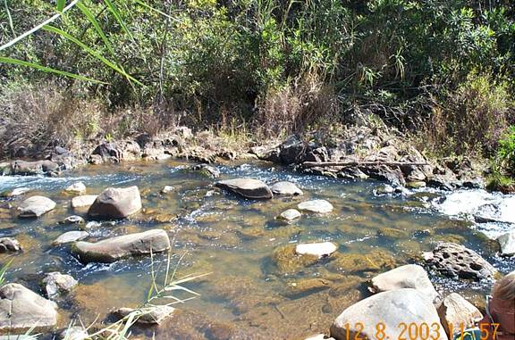
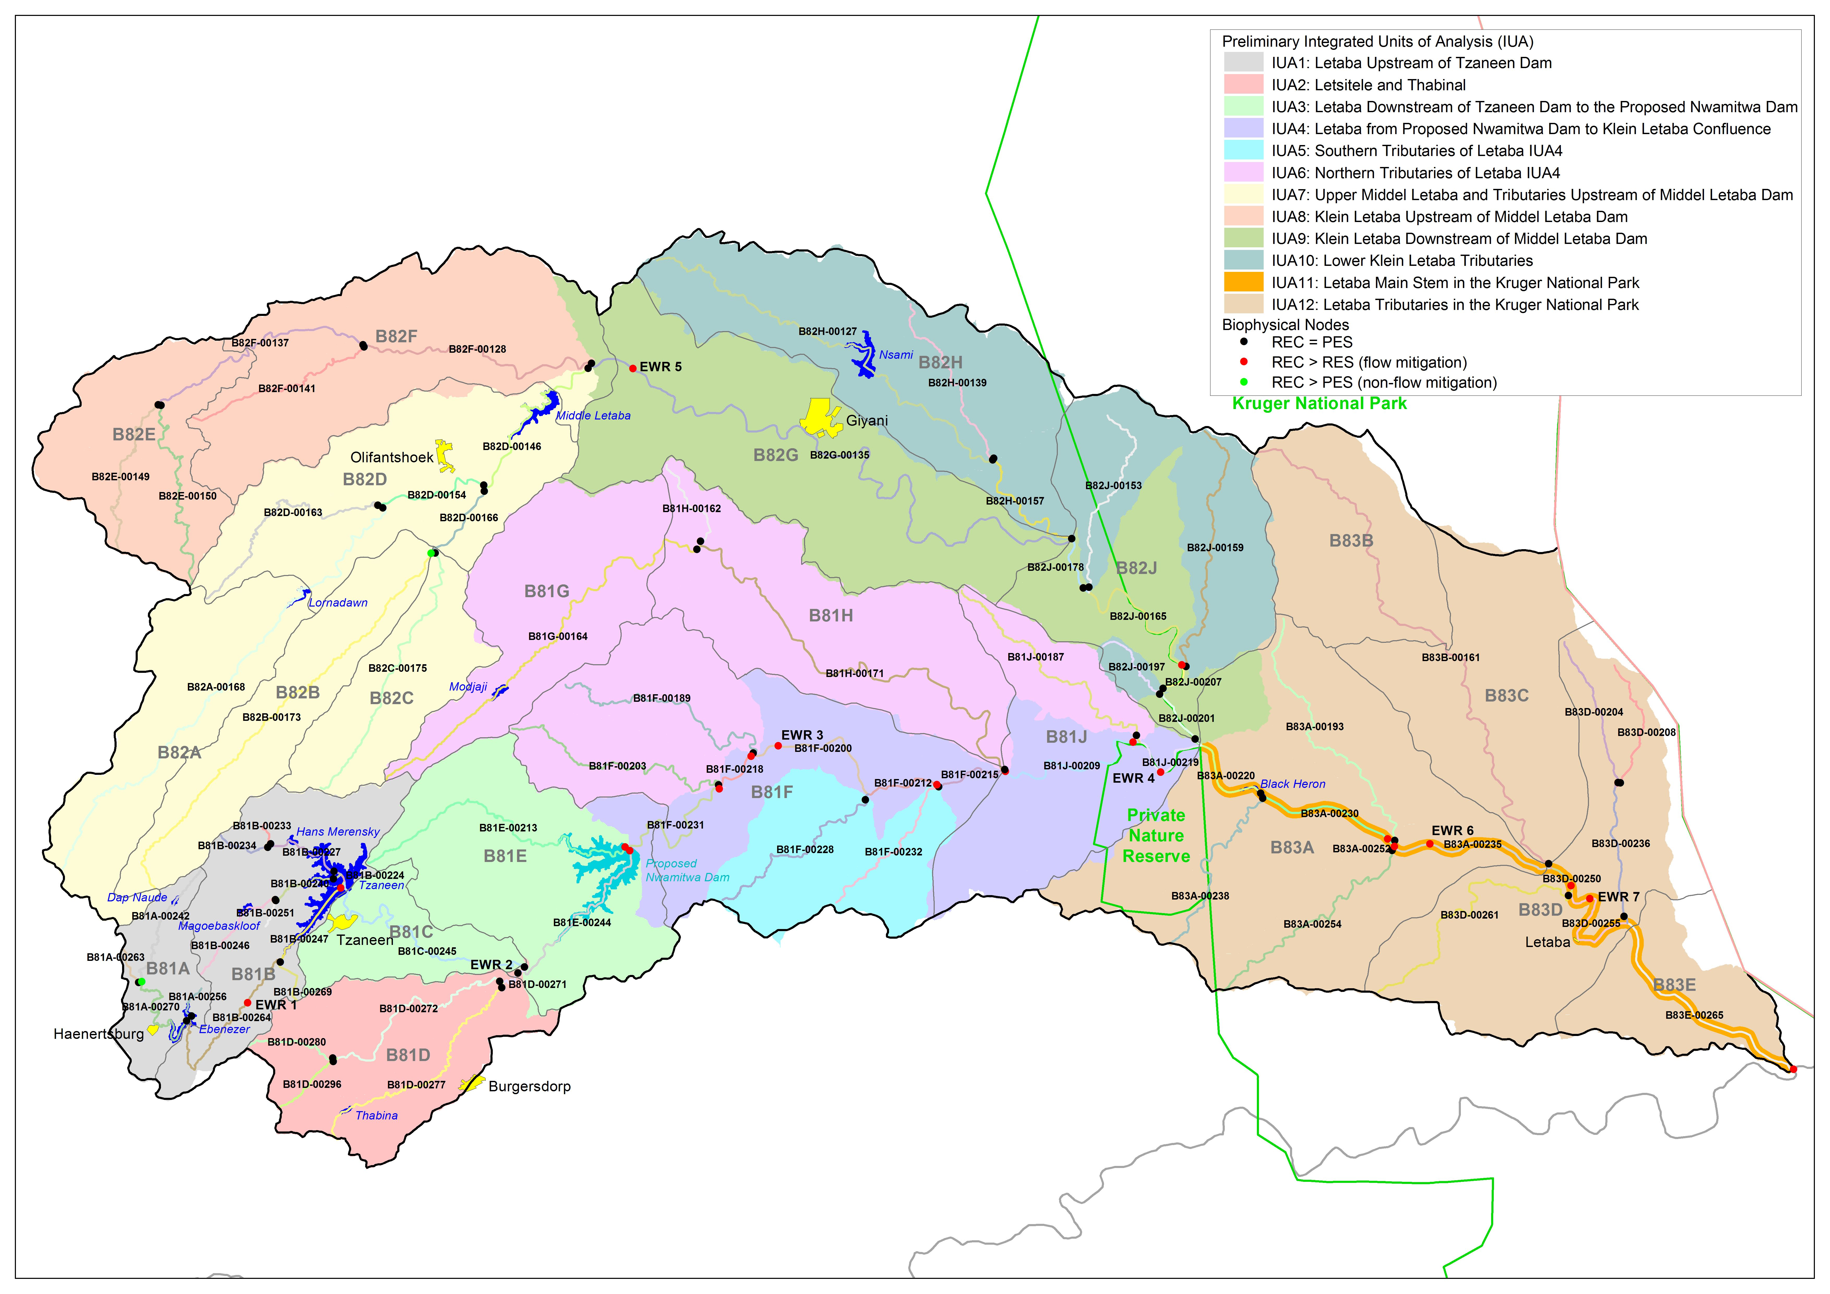
EWR 1: APPLE
PES | C
EIS | Moderate
REC | C
%MAR (low) | 11
%MAR (tot) | 20

Slide 8
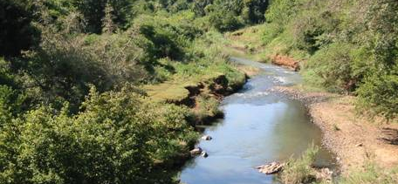
EWR 2: LETSITELE
PES | D
EIS | Moderate
REC | D
%MAR (low) | 14
%MAR (tot) | 21.2

Slide 9
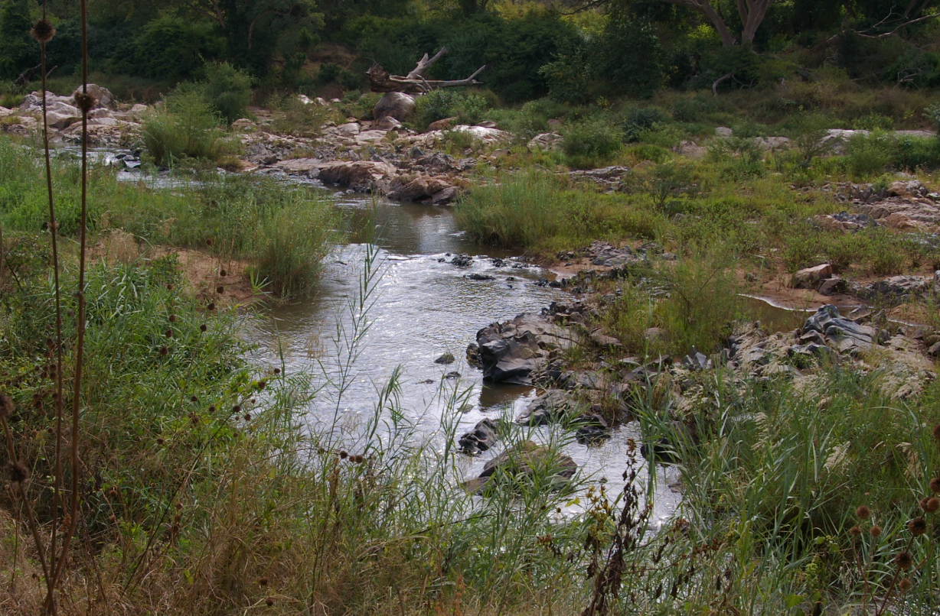

EWR 3: PRIESKA
PES | C
EIS | High
REC | B/C
%MAR (low) | 7.3 (PES)
%MAR (tot) | 13.8 (PES)

Slide 10
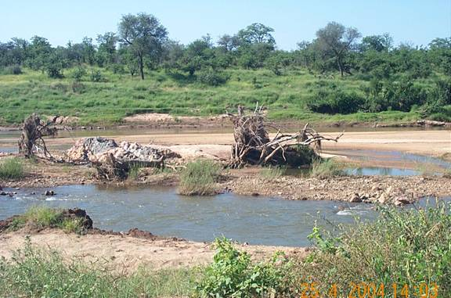
EWR 4: LETABA RANCH
PES | C
EIS | High
REC | B/C
%MAR (low) | 8.3
%MAR (tot) | 17.6

Slide 11
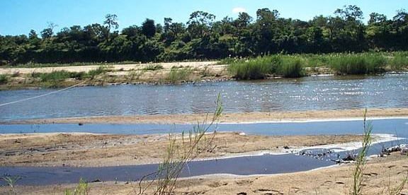

EWR 7: LETABA BRIDGE
PES | C
EIS | High
REC | B
%MAR (low) | 7
%MAR (tot) | 15.8

Slide 12

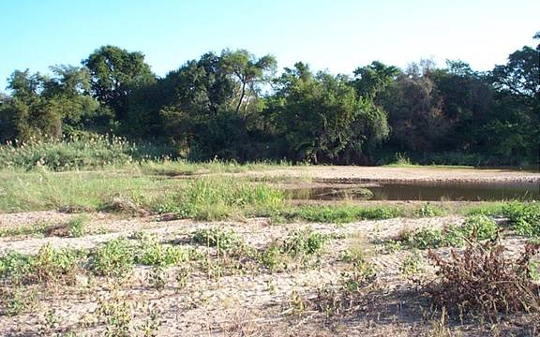
EWR 5: KLEIN LETABA
PES | C
EIS | Moderate
REC | C
%MAR (low) | 3.9
%MAR (tot) | 16

Slide 13
DESKTOP BIOPHYSICAL NODES
Consist of following nodes:
- those that cannot be extrapolated through yield modelling from the EWR sites.
- nodes that do not occur in its totality in the KNP
Methods used at the these nodes:
Determine the PES and REC (using PESEIS study results as base)
Determine whether reasons for change from natural is flow- or non-flow-related.
Use the Revised Desktop Ecological Reserve Model to determine EWRs

Slide 14
IUA 1 & 3: Desktop node EWR
NODE | REC | %nMAR (low) | %nMAR (tot)
B81A-00242 | C | 14 | 22
B81A-00256 | D | 15 | 22
B81A-00263 | D | 15 | 22
B81A-00270 | C | 19 | 27
B81B-00227 | D | 15 | 22
B81B-00233 | C | 19 | 27
NODE | REC | %nMAR (low) | %nMAR (tot)
B81E-00213 | C | 2 | 8
NODE | REC | %nMAR (low) | %nMAR (tot)
B81B-00234 | C | 21 | 30
B81B-00240 | C | 11 | 19
B81B-00246 | C | 10 | 18
B81B-00251 | D | 7 | 15
B81B-00269 | B | 24 | 35

Slide 15
IUA 2: Desktop node EWR
NODE | REC | %nMAR (low) | %nMAR (tot)
B81D-00272 | C | 15 | 22
B81D-00277 | D | 4 | 13
B81D-00280 | B | 20 | 29
B81D-00296 | B | 25 | 35

Slide 16
IUA 5 & 6: Desktop node EWR
NODE | REC | %nMAR (low) | %nMAR (tot)
B81F-00189 | C | 1.3 | 7.1
B81F-00203 | C | 2 | 9
B81G-00164 | D | 0.4 | 6.6
B81H-00162 | C |  | 10.4
B81H-00171 | D | 1 | 6.5
B81J-00187 | C | 0.5 | 9.8
NODE | REC | %nMAR (low) | %nMAR (tot)
B81F-00228 | B | 0.8 | 9.1
B81F-00232 | B |  | 13.5

Slide 17
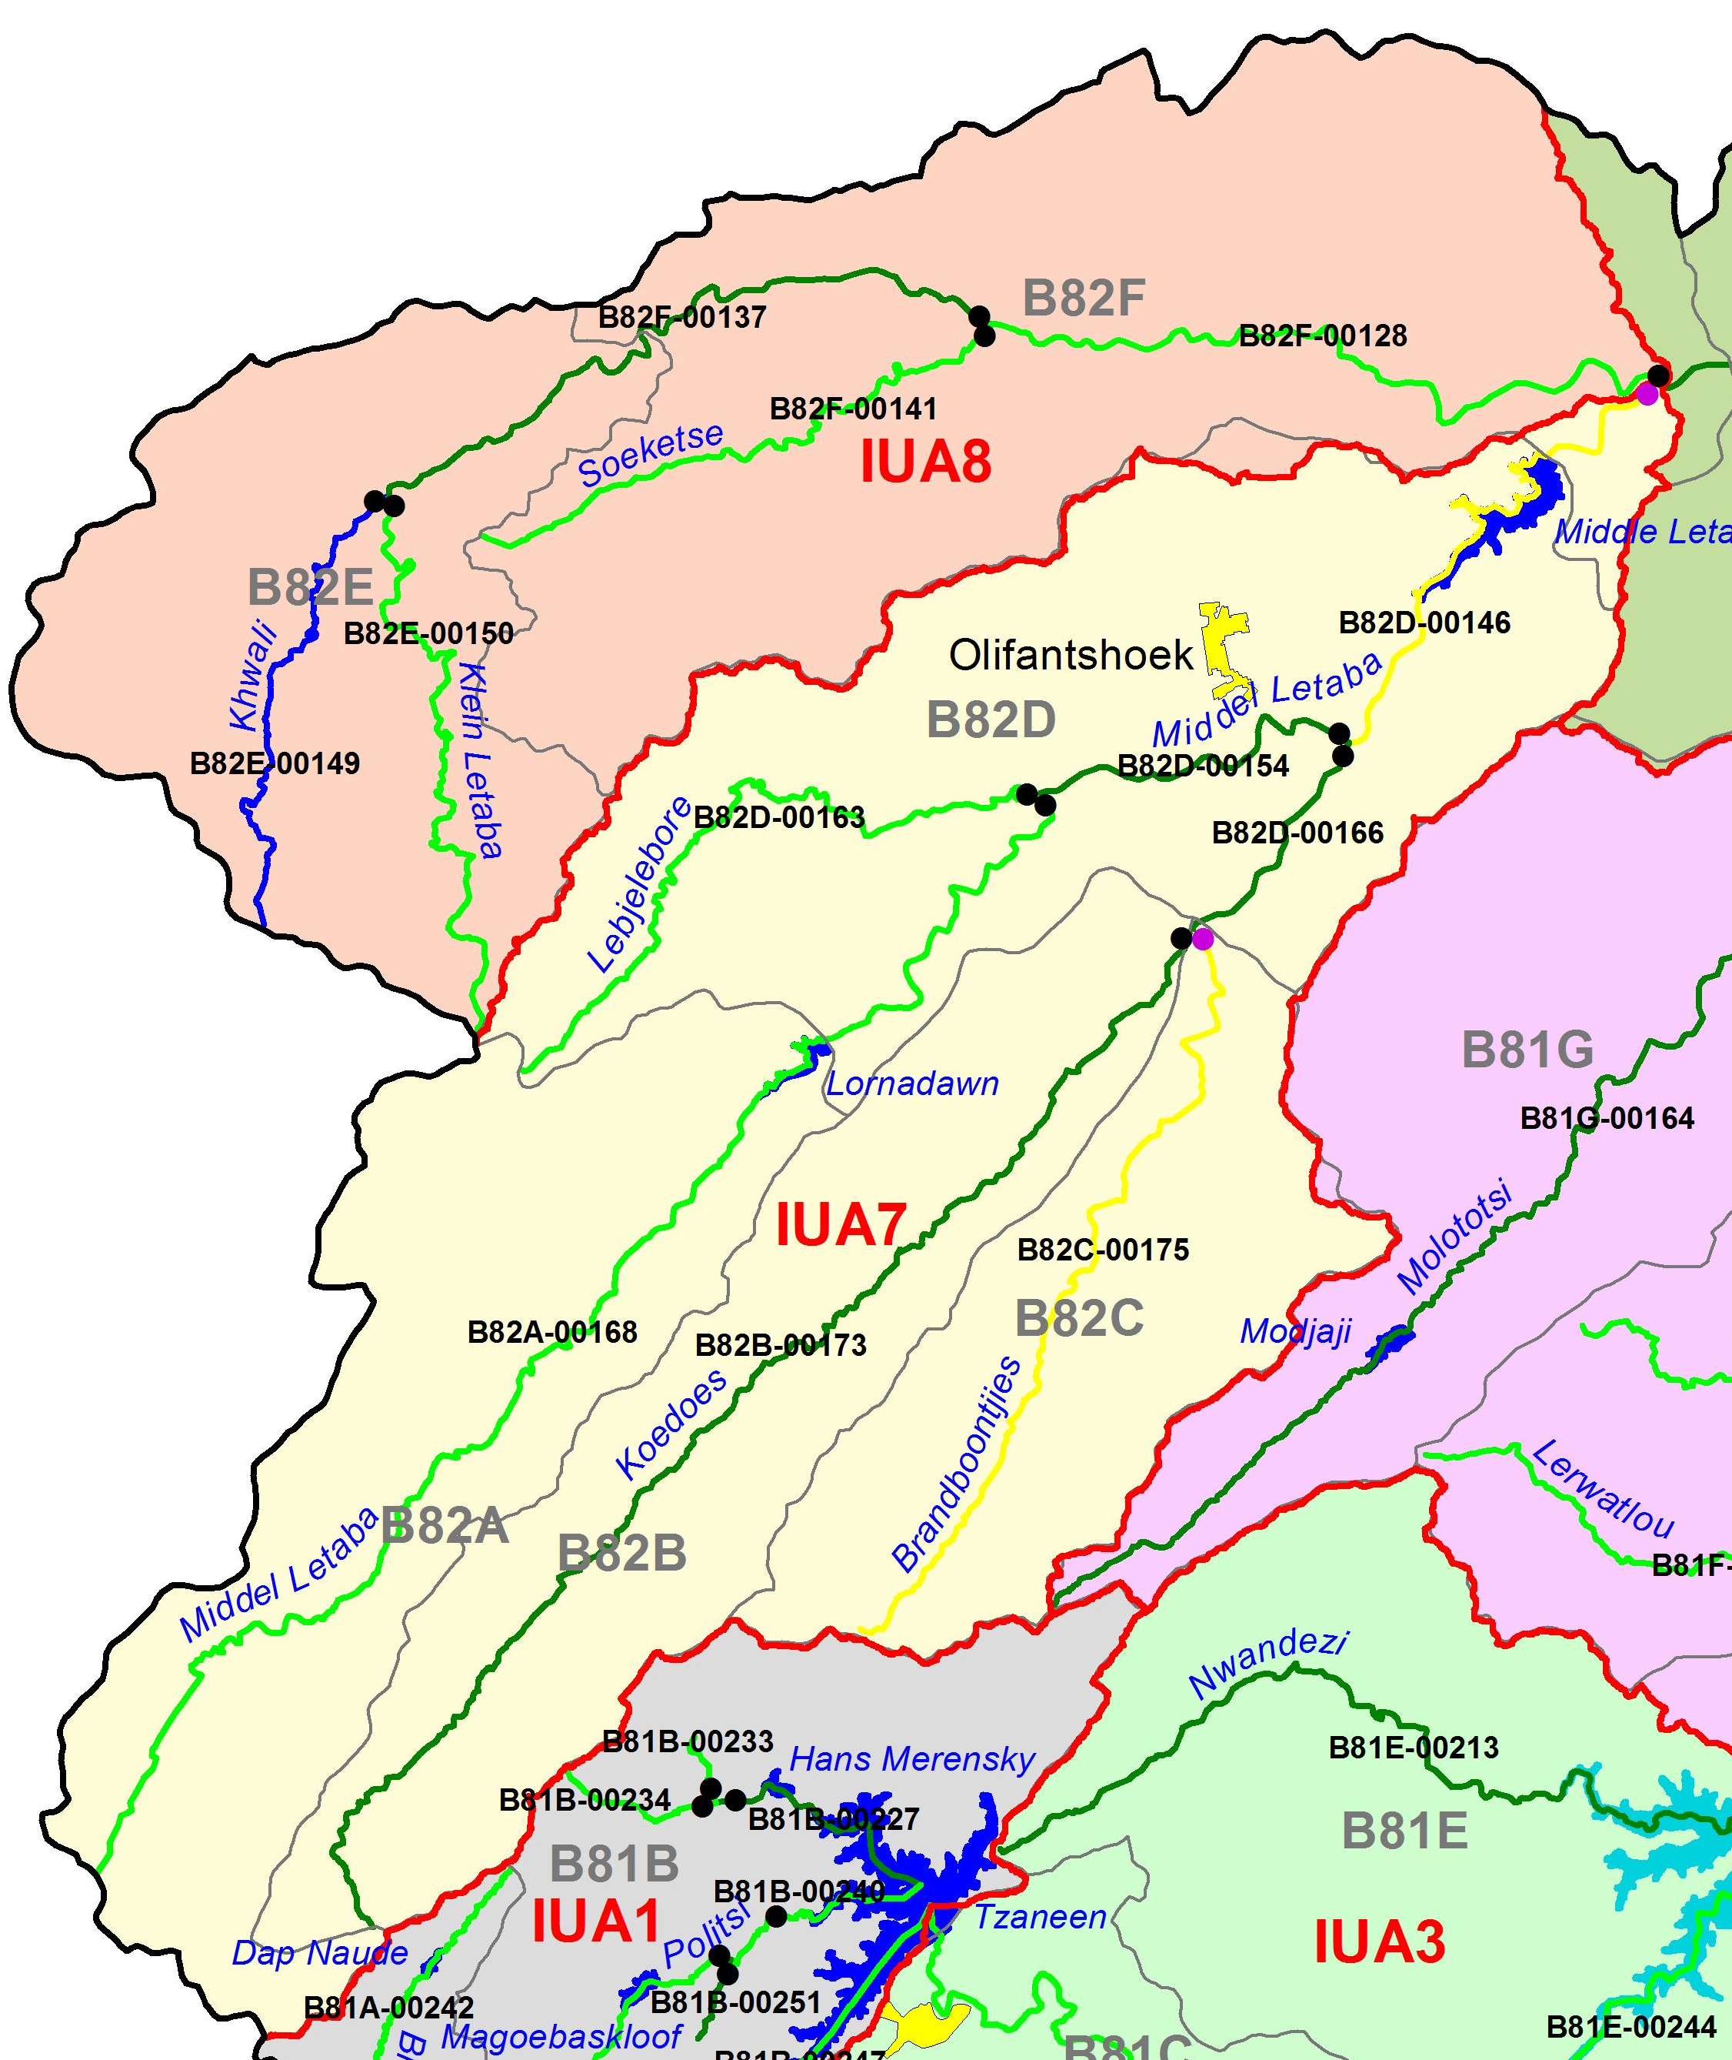
IUA 7&8: Desktop node EWR
NODE | REC | %nMAR (low) | %nMAR (tot)
B82E-00149 | B | 2.8 | 13.9
B82E-00150 | C | 1.1 | 16.0
B82F-00128 | C | 5.0 | 15.4
B82F-00137 | D | 0.5 | 9.7
B82F-00141 | C | 1.6 | 12.8
B82A-00168 | C | 13.9 | 24.3
B82B-00173 | D | 6.0 | 12.3
B82D-00154 | D | 8.7 | 17.3
B82D-00163 | C | 16.7 | 25.8
B82D-00166 | D | 4.2 | 10.2

Slide 18
IUA 10: Desktop node EWR
NODE | REC | %nMAR (low) | %nMAR (tot)
B82H-00127 | C | 1.0 | 10.6
B82H-00139 | B | 0.7 | 14.9
B82H-00157 | B | 1.7 | 14.4
B82J-00197 | B |  | 14.5

Slide 19
  END

