Slide 1

ECOLOGICAL CONSEQUENCES
Presented by: Delana Louw (Rivers for Africa)
3 April 2014

Slide 2
NWRCS integrated steps
1: Delineate units of analysis and describe the status quo
2: Initiation of stakeholder process and catchment visioning
3: Quantify EWRs and changes in EGSA
7: Gazette class configuration
4: Identification and evaluation of scenarios within IWRM
5: Draft Management Classes
6: Resource Quality Objectives (EcoSpecs & water quality (user))
ECOLOGICAL CONSEQUENCES TO SCENARIOS

Slide 3
Determining ecological consequences of scenarios
Need to answer the ‘what if’ questions
Express in terms of change in Ecological Category
Detailed process to predict changes in all the biophysical components per site and per scenario.
Then to integrate and demonstrate in systems context
Include in MC DSS process

Slide 4
Determining ecological consequences of scenarios
Geomorphology
Geomorphology
Geomorphology
AVERAGE SCORE FOR EACH SCENARIO & STANDARDISE TO 1
Physico-chemical
Physico-chemical
Physico-chemical
Fish
Fish
Fish
Macroinvertebrates
Macroinvertebrates
Macroinvertebrates
Riparian vegetation
Riparian vegetation
Riparian vegetation
Consequences
Consequences
Consequences
EC FOR PES & REC
EC FOR SC
COMPARE EC TO REC
Evaluate scenarios
Determine PES, REC and %
Predict EC and %
Determine degree to which REC is met
Rank Scenarios at each EWR site

Slide 5
Determining ecological consequences of scenarios
RELATIVE ECOLOGICAL IMPORTANCE OF SITES
PES
EIS
Locality in conservation areas
WEIGHT
Ecological ranking of scenarios per EWR site
APPLY WEIGHT
Ecological ranking of scenarios for the Letaba system

Slide 6
RESULTS PER EWR SITES: EWR 1 (LETABA)
Sc 3 is similar to the present day flows and therefore maintains the PES and REC.
Sc 5 and 6 have lower floods than present day as well as lower base flows. This results in decreased fast habitats impacting on instream habitat and increased stress on the biota. Vegetation is likely to encroach in lower and marginal zones.
, 10

Slide 7
RESULTS PER EWR SITES: EWR 3 (LETABA)
Sc 6: Decrease in EC due to reduced high flows. Reduce substrate quality and suitability and species with a preference in this type of habitat may deteriorate.
Sc 9: Almost all categories improve from Sc 6 due to the improvement in baseflows (positive for fish with a preference for fast habitat) as well as some smaller floods. Riparian vegetation improvement is in the marginal and lower zones as these floods will reduce encroachment on the macro-channel floor and promote zone health.
Sc 10: An improvement from Sc 9 due to the managed EWR floods included as a release.

Slide 8
RESULTS PER EWR SITES: EWR 4 (LETABA)
Sc 6: Reduced high flows will reduce substrate quality for instream biota. Lack of floods will promote marginal zone vegetation encroachment.
Sc 9 and 10: Improved baseflows are offset against decreased spills. The releases of small floods do improve these scenarios from Sc 6.
But, Sc 10 STILL worse than PES

Slide 9
RESULTS PER EWR SITES: EWR 7 (LETABA)
Sc 6: Impacts on floods and low flows during the wet season. Similar to Sc 3 but the emphasis will be on decreased floods with resulting decrease in riffle quality.
Sc 9 and 10. Impacts are similar than at EWR 3 and 4 with Scenario 10 showing the most improvement from Sc 6 due to the release of PES base flows and some EWR floods.
BUT, Sc 10 still worse than PES

Slide 10
RESULTS PER EWR SITES: EWR 2 (LETSITELE)
Sc 3: Similar to PD.
Sc 4: Lower flows during the wet season leading to some impact on the instream biota.
Sc 6: Lack of floods result in deterioration of substrate quality and loss of pools.
Sc 5: Decreased flows in wet seasons (severe) will result in impact on biota with preference for fast habitats and pools

Slide 11
RESULTS PER EWR SITES: EWR 5 (KLEIN LETABA)
Sc 4: Similar to PD flows.
Sc 6: Includes a dam with a low flow EWR release. Reduced flows in the wet season will reduce abundance and suitability of fast habitat. Vegetation encroachment expected.
Sc 5: Includes a dam - reduced flows in wet season and floods. Similar to Sc 6 with slightly worse conditions.

Slide 12
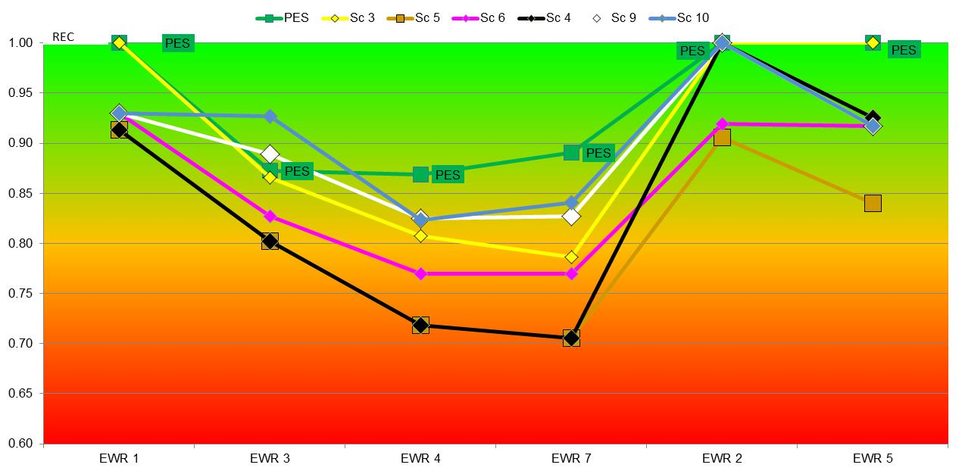
SUMMARY: RANKING ORDER PER EWR SITE

Slide 13
RELATIVE IMPORTANCE OF SITES
EWR site | PES | EIS | Locality in reserves | Weight | Order
EWR 1 | C | Moderate | 1 | 0.14 | 4
EWR 3 | C | High | 3 | 0.19 | 2
EWR 4 | C | High | 2 | 0.18 | 3
EWR 7 | C | High | 5 | 0.23 | 1
EWR 2 | D | Moderate | 1 | 0.13 | 5
EWR 5 | C | Moderate | 1 | 0.14 | 4

Slide 14
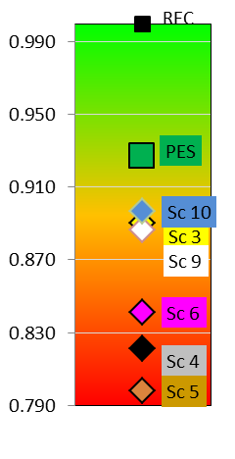
RANKING ORDER FOR SYSTEM
Ranking order
REC
PES
Sc 10
Sc 3
Sc 9
Sc 6
Sc 4
Sc 5

