Slide 1
Regulatory Watch Reports
Drinking Water (Blue Drop)
Wastewater (Green Drop)
Water Conservation and Demand Management (No Drop)
6 June 2023

Slide 2
Introduction

Slide 3
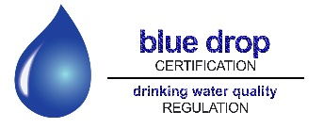
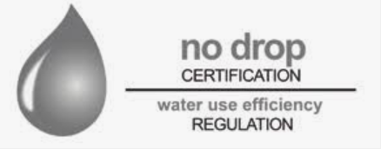
Introduction to the Drop Reports
In terms of the National Water Act and Water Services Act, DWS is the regulator of the water sector
The Green, Blue and No Drop Certification programmes are tools to provide regulatory information regarding water services, which are largely the Constitutional responsibility of municipalities
DWS introduced these incentive-based regulation programmes in 2008
In 2014 DWS stopped the programmes
Minister Mchunu reintroduced the programmes after being appointed as Minister in late 2021

Slide 4
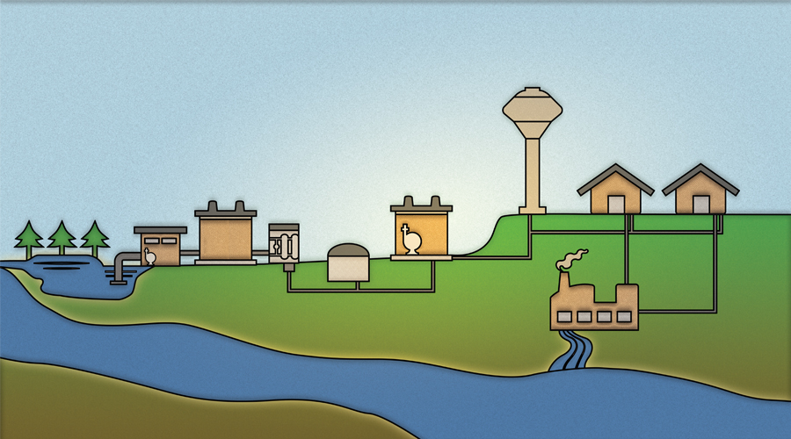
The domestic water cycle
Water for domestic use goes through a cycle.
Raw water is drawn from rivers and dams and treated in Water Treatment Works by either water boards or municipalities before it is supplied to households.
Treated water is required by law to meet drinking water standards set by the South African Bureau of Standards in South African National Standard (SANS) 241. Municipalities and water boards are also required to conduct regular tests on the treated water to ensure that it complies with the standard.
3. After the water has been used by households, it goes through the sewer system to municipal Waste Water Treatment Works. The Waste Water Treatment Works remove waste from the water and then return the water to the rivers. The effluent from Waste Water Treatment Works which goes into rivers is also required to meet minimum standards, set by the Department of Water and Sanitation.

Slide 5
What each Drop Report focuses on
Green Drop report is a comprehensive assessment of the state of all wastewater treatment systems in South Africa, including municipal, Department of Public Works and private wastewater treatment systems
Blue Drop report is a similar assessment of the state of all drinking water systems (including water treatment works and municipal water distribution systems) in the country
Both reports include assessments of the condition of the infrastructure; whether the capacity of the infrastructure is sufficient to deal with the demand; whether the required maintenance is being done on the infrastructure, whether the infrastructure is operated correctly; whether the proper treatment processes are followed; whether proper monitoring and controls are in place; and whether the staff have the necessary skills and qualifications
No Drop report is an assessment of the degree to which the drinking water distribution systems of municipalities supply water efficiently, without wasting water
No Drop assessment includes the levels of physical water losses in the system (for example through leaks in pipes); levels of non-revenue water; the amount of water used per customer per day; whether infrastructure is being maintained properly to minimise wastage; the existence of plans and strategies to reduce water losses; the effectiveness of metering, billing and revenue collection systems

Slide 6
Purpose of the Drop Reports
The aim of this uniquely South African regulatory tool is to improve municipal drinking water quality, wastewater management as well as water conservation and demand management
The reports keep the public and stakeholders informed and updated with credible data and information about the state of water and sanitation services in the country
The reports also recognise water services institutions that achieve compliance and excellence in providing such services. This serves as an incentive for water services institutions to improve their performance
The reports identify what needs to be done to address each of the identified shortcomings
In this regard, the reports are a support mechanism, in addition to being a regulatory mechanism, because they provide the owners of the infrastructure with advice and guidance as to how to improve their water and sanitation services

Slide 7
Release of the Green, Blue and No Drop Watch Reports
Each comprehensive drop report is released every two years, with interim report in alternate year
Full Green Drop was released in 2022, along with interim Blue Drop report
Interim Green Drop and full Blue Drop reports will be released in July 2023 respectively
Full No Drop report will be released in September
Department is now releasing Green, Blue and No-drop Watch reports, as a precursor to the releases of the reports in July
The three watch reports are now available on the DWS website

Slide 8
The Green, Blue and No Drop Watch Reports
Blue Drop Watch Report:
2023 Blue Drop Watch Report provides an assessment of the condition of water distribution infrastructure and drinking water quality of a sample of the drinking water supply systems in the country
Full Blue Drop report will cover all drinking water supply systems in the country and will also include non-technical aspects such as skills and qualifications of municipal staff
No Drop Watch Report:
2023 No Drop Watch Report is based on water conservation and demand management reports received from a sample of municipalities
Information was used to extrapolate projections regarding the extent of water losses and non-revenue water in the country
Full No Drop report will provide audited assessment of water losses and non-revenue water in all municipalities in the country
Green Drop Watch Report:
Provides information on what has been done to address wastewater systems of Water Services Authorities that scored less than 30% in the 2022 Green Drop Report

Slide 9
Summary of results

Slide 10
1. GREEN DROP WATCH REPORT: SUMMARY OF FINDINGS
2022 full Green Drop report released in April 2022 found 334 out of 850 (39%) municipal wastewater systems in 90 municipalities which are water services authorities (63% of the 144 water services authorities) to be in critical condition, receiving Green Drop scores of 30% and below
In 2013, when the last Green Drop assessment report was done, 248 out of 824 (30%) municipal wastewater systems were in a critical condition, indicating a decline between 2103 and 2022
Following the release of the 2022 Green Drop report, the Department issued non-compliance notices to these 90 municipalities, requesting the municipalities to submit corrective action plans to address the shortcomings identified in the Green Drop report
By March 2023, Department had received corrective action plans from municipalities for 168 of the 334 wastewater systems (i.e. a 50% response rate). 43 of the 90 municipalities requested support from the Department to develop corrective action plans
By March 2023, only 34 of the 168 plans submitted to the department were being implemented, with the balance being in planning phase or no progress reported
For those municipalities which did not submit corrective action plans, DWS has issued directives in terms of the National Water Act compelling them to submit such plans
Criminal charges have been laid against some of the municipalities which have not submitted corrective action plans

Slide 11
Municipal progress in addressing findings of 2022 Green Drop report
(wastewater treatment systems in a critical condition)
Province | No of Water Services Authorities with systems in a critical condition | No of wastewater treatment systems in a critical condition | No (%) of corrective action plans received by DWS | No of corrective action plans in implementation (31 March 2023)
Eastern Cape | 10 | 48 | 45 (94%) | 2
Free State | 17 | 64 | 10 (16%) | None
Gauteng | 4 | 9 | 8 (89%) | 2
KwaZulu Natal | 4 | 20 | 0 (0%) | None
Limpopo | 10 | 50 | 50 (100%) | None
Mpumalanga | 8 | 33 | 10 (30%) | None
Northern Cape | 23 | 59 | 14 (24%) | 8
North West | 7 | 33 | 13 (39%) | 9
Western Cape | 7 | 18 | 18 (100%) | 13
National Totals | 90 | 334 | 168 (50%) | 34 (10%)
Details of which municipalities were found to have wastewater systems in a critical condition are in the Watch report on the DWS
website. Details of which municipalities submitted corrective action plans are also in the Watch report.

Slide 12
2. BLUE DROP WATCH REPORT SUMMARY OF FINDINGS
151 out of 1035 water treatment systems in the country were sampled. All water service authorities were covered by the sample.
Infrastructure condition:
3% of the sampled systems were found to be in a critical infrastructural condition, 12% of the sampled systems were found to be in an poor infrastructural condition, 49% of the sampled systems were found to be in an average infrastructural condition, 31% in good condition, and 5% in an excellent condition
These findings were supported in the 2022 South African Institute of Civil Engineers Infrastructure Report Card
Water quality testing requirements in South Africa
In terms of SANS 241, municipalities are required to monitor the microbiological and chemical quality of the water provided to residents at specified intervals, including hourly, daily, weekly, fortnightly and monthly tests of various types

Slide 13
Microbiological and chemical water quality compliance:
Water quality tests carried out by the municipalities themselves during the 2021/2022 municipal financial year were assessed
39% of systems achieved excellent, 11% of systems achieved good, 9% achieved poor, and 41% achieved bad microbiological water quality compliance
17% of systems achieved excellent, 13% of systems achieved good, 15% achieved poor, and 55% achieved bad chemical water quality compliance
 | Status | Definition
 | Bad | < 95% of water quality tests meet SANS 241 standards
 | Poor | 95-97% of water quality tests meet SANS 241 standards
 | Good | 97-99% of water quality tests meet SANS 241 standards
 | Excellent | > 99% of water quality tests meet SANS 241 standards
Microbiological compliance measures how well the treatment process is removing harmful bacteria and other micro-organisms from the water
Chemical compliance measures the chemical suitability of the water for human consumption, as well as for protection of infrastructure and household equipment
SANS 241 is informed by World Health Organisation Guidelines, in terms of which at least 97% (i.e. good or excellent compliance) of tests for microbiological contaminants and chemical compliance conducted over a year should comply with water quality standards, for the water to be considered safe to drink
The number of samples to be tested in a specific water supply system is informed by the Water Safety Planning Requirements of the SANS 241

Slide 14
Non-provision of information on testing to DWS
During the audit period 11 municipalities did not report water quality data to the Department or provide any other evidence that they have been testing their water quality
The Department has issued non-compliance notices to those municipalities instructing them to issue advisory notices to their residents that their water might not be safe to drink if it has not been properly tested

Slide 15
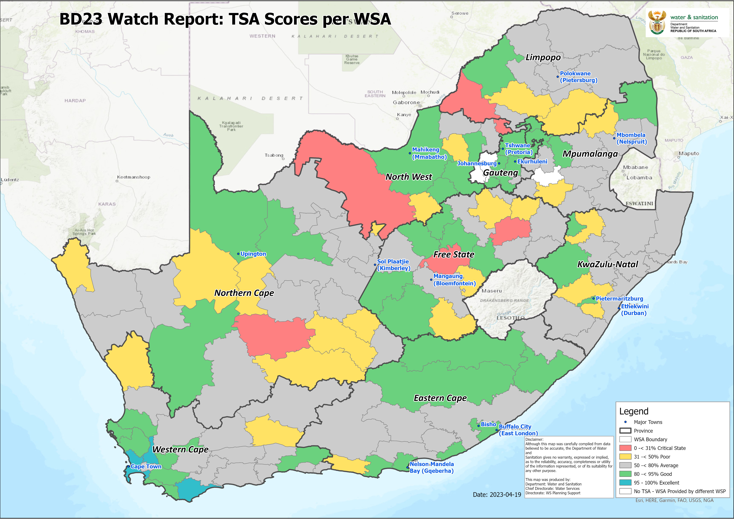
Blue Drop Watch report: drinking water infrastructure condition status
 | >95-100% | Excellent: Ideal performance and fully functional infrastructure and processes
 | >80-<95% | Good: Fully functional infrastructure and processes, with minor corrections to be made
 | >50-<80% | Average: Partially functional infrastructure and processes, and average performance
 | >31-<50% | Poor: Partial functionality and unsatisfactory performance, with major corrections to be made
 | 0-<30% | Critical: Partial functionality and unsatisfactory performance, with major corrections to be made
Details of which municipalities were found to have wastewater systems in a poor and critical condition are in the Watch report on the DWS website.

Slide 16
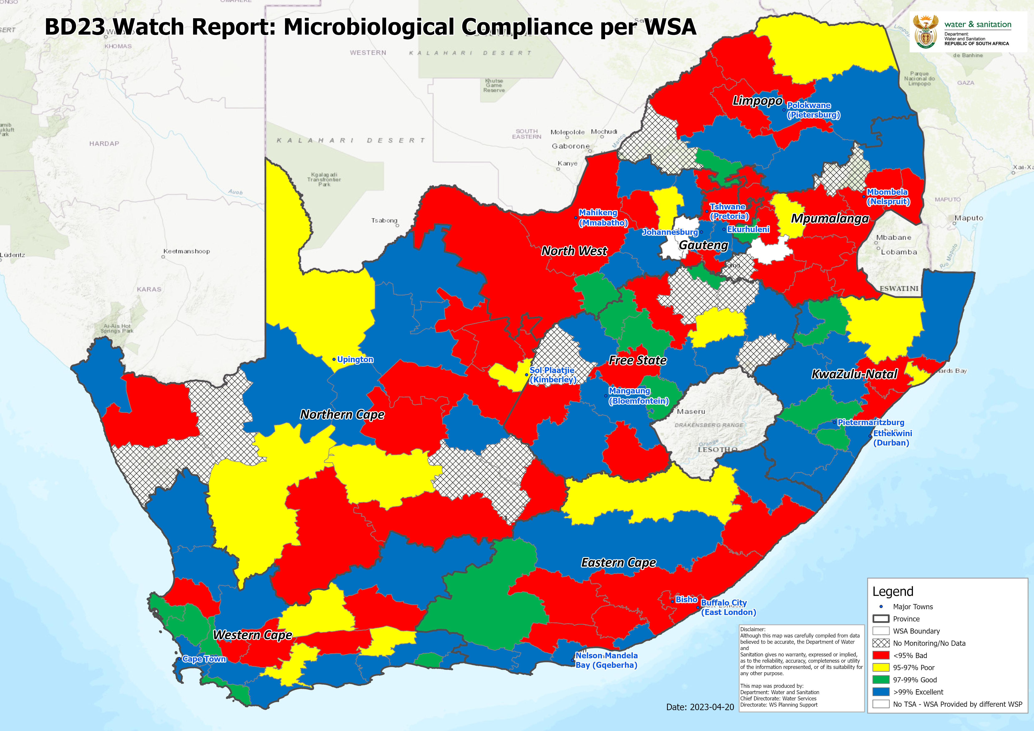
Drinking Water Quality : Microbiological Compliance

Slide 17
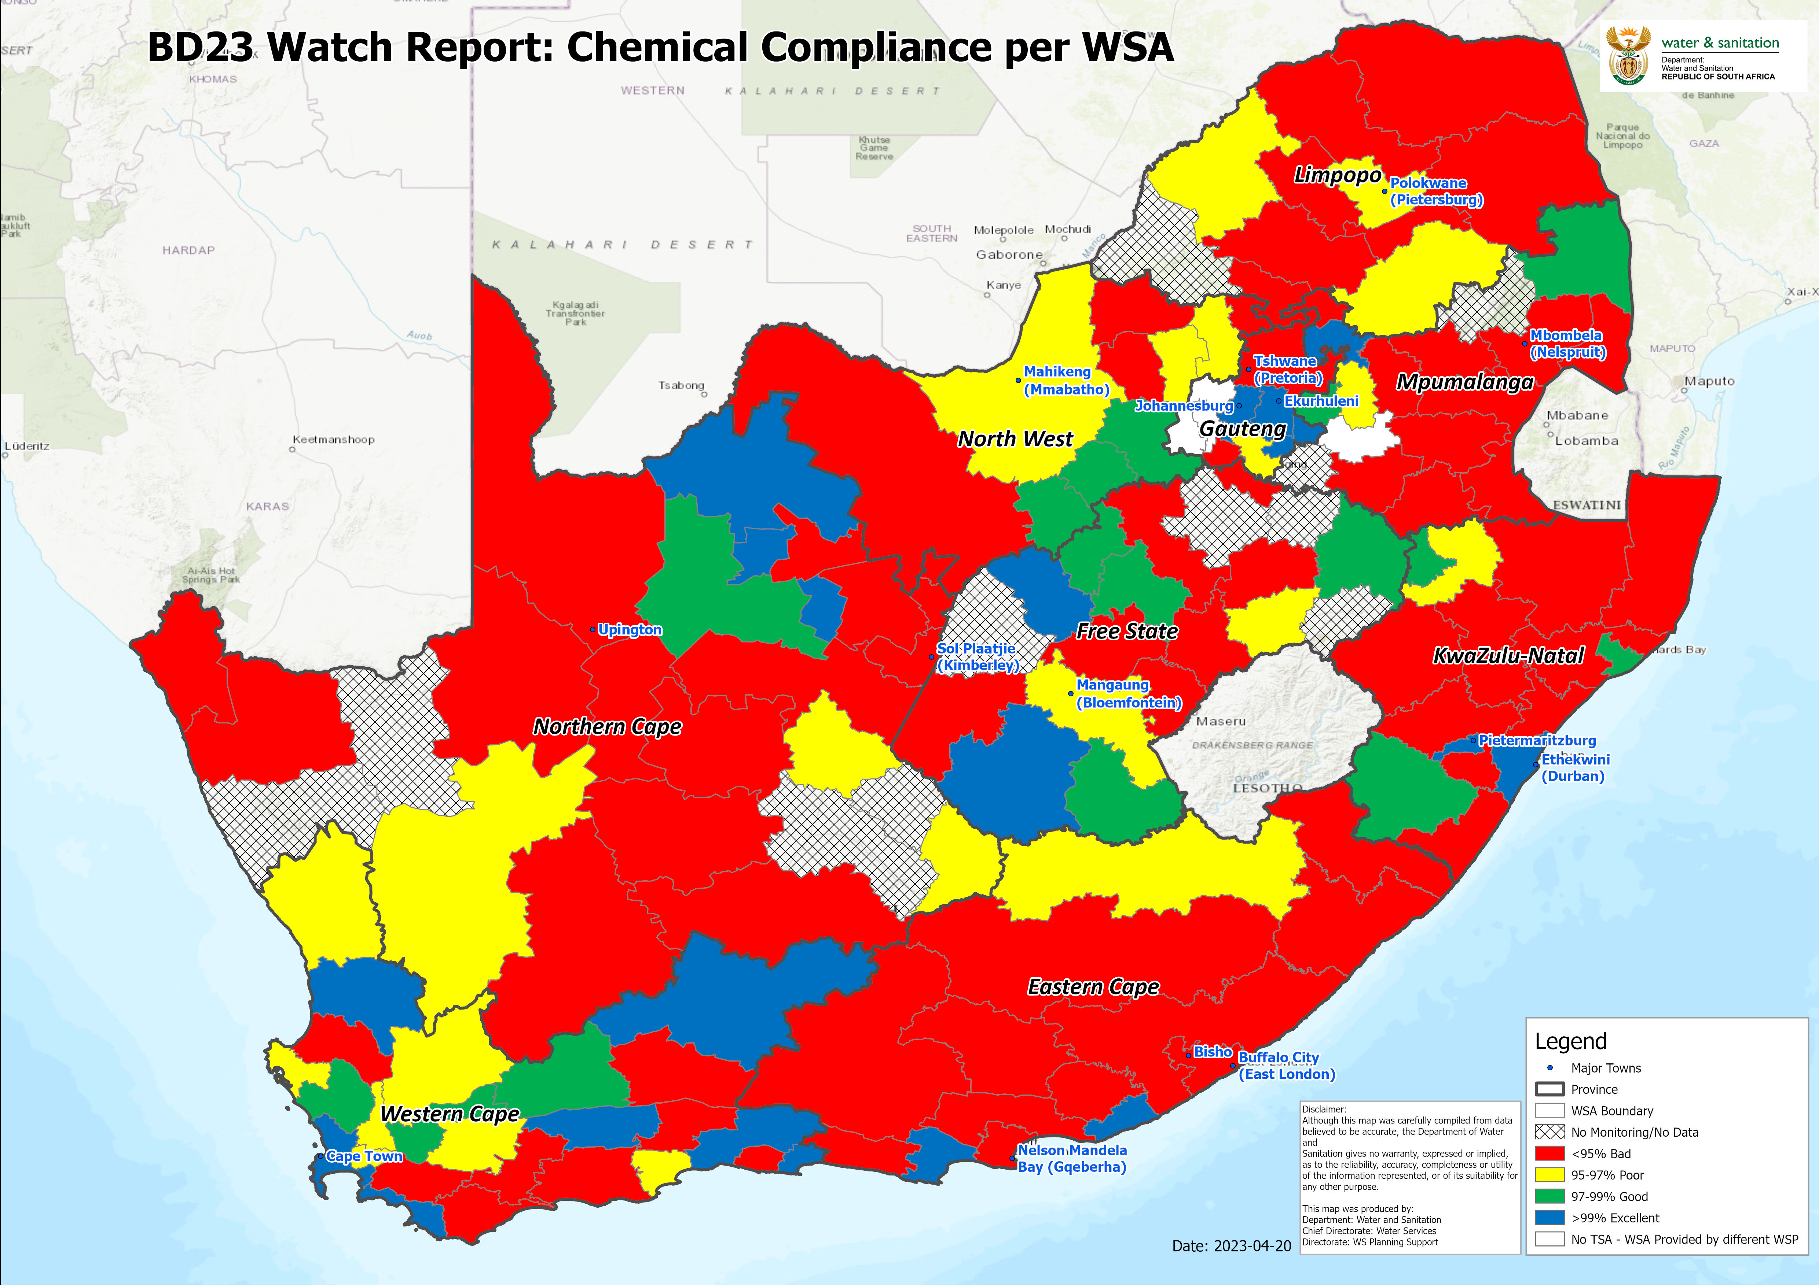
Drinking Water Quality: Chemical Compliance

Slide 18
BLUE DROP WATCH REPORT: DRINKING WATER QUALITY
Province | Total # water supply systems assessed | Microbiological Compliance |  |  |  | Chemical Compliance
 |  | # Excellent Status | # Good Status | # Poor Status | # Bad Status | # Excellent Status | # Good Status | # Poor Status | # Bad Status
Eastern Cape | 15 | 6 | 2 | 1 | 6 | 2 | 0 | 2 | 11
Free State | 21 | 7 | 5 | 1 | 8 (4*) | 2 | 6 | 2 | 11 (4*)
Gauteng | 8 | 5 | 0 | 0 | 3 | 5 | 0 | 1 | 2
KwaZulu Natal | 15 | 9 | 2 | 1 | 3 | 3 | 3 | 1 | 8
Limpopo | 11 | 5 | 1 | 1 | 4( 1*) | 0 | 1 | 3 | 7 (1*)
Mpumalanga | 17 | 2 | 1 | 1 | 13 (3*) | 2 | 2 | 1 | 12 (3*)
Northern Cape | 27 | 7 | 0 | 4 | 16 (3*) | 3 | 2 | 3 | 19 (3*)
North West | 10 | 4 | 1 | 1 | 4 | 0 | 3 | 3 | 4
Western Cape | 27 | 14 | 5 | 3 | 5 | 8 | 3 | 7 | 9
National totals | 151 | 59 | 17 | 13 | 62 | 25 | 20 | 23 | 83
*number of WTWs which did not provide information to DWS

Slide 19
IMPLICATIONS OF THE BLUE DROP WATCH REPORT FINDINGS
In the 2012 Blue Drop report, only 10% of municipalities had bad or poor microbiological water quality (as opposed to 50% in this sample)
This indicates that there has been a deterioration in drinking water quality since the last blue drop report was done
The 2023 blue drop watch report indicates that the drinking water produced from some municipal water treatment systems during the 2021/2022 municipal financial year did not meet the SANS 241 standard and could on occasion have posed a potential health risk
The report does not provide an indication of the current status of water quality in municipalities
In terms of SANS241 and the norms and standards issued by DWS under the Water Services Act, when the tests carried out by a municipality indicate that the water supplied poses a health risk, the municipality must inform its consumers that the quality of the water that it supplies poses a health risk
DWS has sent directives to the municipalities identified in the Watch Report as having systems with poor or bad compliance. The directives require the municipalities to inform their residents should they still have poor or bad compliance
The public can safely consume water from their taps if their municipalities indicate that the water being provided is being tested and meets the requirements of SANS 241. WSAs are responsible by law to inform affected constituencies as soon as there is any change in quality

Slide 20
3. NO DROP WATCH REPORT SUMMARY OF FINDINGS
Introduction
The No Drop Watch Report assesses the status of water losses and non-revenue water (NRW) in South Africa against regulatory compliance requirements and best management practices
The report is based on analysis of the water balance data submitted by municipalities for their financial year ending June 2022
The report is based on a sample of 42 datasets which were received from WSAs in 2022 (29% of 144 WSAs submitted data sets)
The national water balance presented in the Watch Report is extrapolated from the sample of datasets received from municipalities to provide an estimate of the water balance and non-revenue water for all 144 municipalities

Slide 21
Findings
The System Input Volume (meaning the total volume of water treated for municipal use) is estimated to be approximately 4.3 million m³/annum
Of this, 2 million m³/annum (46%) is estimated to be non-revenue water (NRW). This is the volume of water that municipalities are unable to collect revenue for
In 2015 when the last No Drop report was published, the national NRW figure was estimated to be 35%
Non-revenue water is made up of water losses and the unbilled component of authorised consumption
The international average for non-revenue water is below 30%
The national trends suggest that per capita consumption is approximately 216 litres/capita/day compared to the international average of 173 l/c/d
This is an anomaly given that South Africa is a water scarce county
The high levels of physical losses in municipal distribution systems is one of the main reasons for the relatively high level of per capita water consumption in South Africa
This indicates poor operation and maintenance of infrastructure leading to unacceptably high physical losses
Some municipalities have been able to reduce their non-revenue water. In order to reduce non-revenue water, municipalities need to improve operation and maintenance of their infrastructure; repair leaks; improve metering, billing, revenue collection, and debtor management; improve pressure management; and engage in community education and awareness; amongst other measures.
The final water balance will be obtained and confirmed through the full No Drop report that will be published in September 2023

Slide 22
Provincial benchmark for non-revenue water (m³/annum)
Region | System Input Volume | Revenue water | Non-revenue water (NRW) | % NRW | l/c/d
EC | 341 784 801 | 180 856 704 | 160 928 096 | 47.1% | 203
FS | 245 273 746 | 114 972 777 | 130 300 969 | 52.9% | 224
GT | 1 520 493 167 | 883 182 277 | 637 310 891 | 41.9% | 253
KZN | 816 349 522 | 379 242 693 | 437 106 828 | 53.5% | 224
LP | 297 623 119 | 128 801 298 | 168 821 821 | 56.7% | 210
MP | 287 781 407 | 140 491 650 | 147 289 757 | 51.2% | 186
NC | 108 607 828 | 47 554 453 | 61 053 374 | 56.2% | 250
NW | 232 123 394 | 114 267 940 | 117 855 454 | 50.8% | 176
WC | 430 141 867 | 302 936 992 | 127 204 875 | 29.6% | 161
National | 4 280 178 850 | 2 292 306 784 | 1 987 872 066 | 46.4% | 216

Slide 23
Municipal categories - benchmark summary
Category | System Input Volume | Revenue water | Non-revenue Water (NRW) | % NRW | l/c/d
A (metropolitan municipalities) | 2 255 411 972 | 1 318 024 060 | 937 387 912 | 41.6% | 244
B1 (secondary cities) | 742 194 333 | 366 223 214 | 375 971 119 | 50.7% | 236
B2 (large towns) | 183 919 744 | 113 756 273 | 70 163 470 | 38.1% | 200
B3 (small towns) | 286 374 783 | 140 402 768 | 145 972 014 | 51.0% | 173
B4 (mostly rural) | 112 492 833 | 52 810 993 | 59 681 841 | 53.1% | 151
C (district municipalities) | 699 785 185 | 301 089 476 | 398 695 710 | 57.0% | 186
National | 4 280 178 850 | 2 292 306 784 | 1 987 872 066 | 46.4% | 216

Slide 24
DWS actions to address the findings
Regulatory actions
In role of Regulator, Department issues non-compliance notices and directives in terms of the National Water Act to the relevant municipalities instructing them to correct the situation
Where the notices and directives are not acted upon, the Department institutes legal action against the municipality
The Department is in the process of strengthening its role as the regulator of water services. This includes developing more comprehensive and more stringent norms and standards for water services and standardising its regulatory processes so that it is more consistent with its regulatory actions
Support actions
National government is providing more than R60 billion per annum in grants and transfers to municipalities for water and sanitation services
Minster has crisscrossed the country visiting those municipalities with severe challenges with water and sanitation services. In many of the worst performing municipalities, Minister and municipal leadership have agreed on improvement plans
DWS contribution is in form of grants (R12 billion per annum from Regional Bulk Infrastructure Grant and Water Services Infrastructure Grant), and technical advice and management support from DWS and water boards

Slide 25
Legislative reform
There are limits to which support and intervention by the national government can address the decline in the reliability and quality of water and sanitation services
The cause of the decline is poor maintenance and operation by municipalities – which must be funded by revenue from the sale of water by municipalities to customers
DWS is repeatedly providing municipalities with grants to repair infrastructure, which is not maintained by the municipalities, deteriorates again rapidly, and then funding needs to be provided again
The high levels of support and intervention by the national government are slowing the decline in water and sanitation services, not arresting or reversing it
Legislative reforms may also be required to ensure that water service providers are professionally managed, capable, efficient and financially viable institutions that deliver water services to the required standards
Water Services Act differentiates between Water Services Authorities and Water Services Providers
Role of WSA is to ensure that water services are provided to required standard
Role of WSP is to provide the services
DWS is consulting with water sector stakeholders regarding reforms to Water Services Act to strengthen role of municipalities as Water Services Authorities to ensure that competent Water Services Providers are in place and to enable Minister to intervene more effectively as the Regulator

Slide 26
Drinking Water Quality – sampled systems in Eastern Cape (see slide 13 for definitions of colour coding)
# | Municipality (WSA) | Water Supply System (WSS) assessed | Water Treatment Works (WTW) assessed | Microbiological compliance | Chemical compliance
1 | Alfred Nzo DM | Mount Ayliff | Mount Ayliff | >99.90% | 94.08%
2 | Amathole DM | Morgans Bay | Morgans Bay | 86.67% | 91.57%
3 | Blue Crane LM | Somerset East | Orange Fish | 80.95% | 82.14%
4 | Buffalo City MM | Mdantsane | Nahoon | 82.14% | 95.44%
5 | Buffalo City MM | Umzonyana | Umzonyana | 98.85% | 90.18%
6 | Chris Hani DM | Intsika Yethu | Tsomo | 99.90% | 91.07%
7 | Dr Beyers Naude LM | Graaf Reinet | Graaf Reinet | 97.96% | 87.14%
8 | Joe Gqabi DM | Barkley East | Barkley East | 95.20% | 96.25%
9 | Kouga LM | Jeffreys Bay | Jeffreys Bay | >99.90% | 99.90%
10 | Koukamma LM | Kareedouw | Kareedouw | >99.90% | 80.00%
11 | Makana LM | Grahamstown | James Kleynhans | 82.55% | 80.96%
12 | Ndlambe LM | Cannon Rocks | Cannon Rocks/Boknes | >99.90% | >99.90%
13 | Nelson Mandela Bay MM | Nelson Mandela Bay | Linton | >99.90% | 87.20%
14 | OR Tambo DM | Thornhill | Thornhill | 91.19% | 89.71%
15 | Sundays River LM | Addo | Addo Nomathamsanqa | 60.42% | 68.06%

Slide 27
Drinking Water Quality – sampled systems Free State
# | Municipality (WSA) | Water Supply System (WSS) assessed | Water Treatment Works (WTW) assessed | Microbiological compliance | Chemical compliance
1 | Metsimaholo LM | Deneysville | Deneysville | 98.78% | 87.85%
2 | Ngwathe LM | Parys | Parys | NI | NI
3 | Dihlabeng LM | Fouriesburg | Fouriesburg | >99.90% | 97.29%
4 | Setsoto LM | Ficksburg | Ficksburg | >99.90% | 85.06%
5 | Maluti-a-Phofung LM | Harrismith | Wilge-Harrismith | NI | NI
6 | Moqhaka LM | Vijoenskroon | Vijoenskroon | 62.18% | 85.95%
7 | Kopanong LM | Bethulie | Bethulie | >99.90% | >99.90%
8 | Mangaung MM | Bloemfontein, Dewetsdorp, Wepener | Welbedacht | >99,90% | 97.39%
9 | Matjhabeng LM | Virginia | Virginia | 98.77% | 98.45%
10 | Nala LM | Balkfontein | Balkfontein | 98.17% | 98.25%
11 | Nketoana LM | Reitz | Reitz | 96.47% | 93.31%
12 | Dihlabeng LM | Clarens | Clarens | >99.90% | 95.28%
13 | Letsemeng LM | Jacobsdal | Jacobsdal | 57.50% | 92.25%
14 | Mantsopa LM | Ladybrand | Genoa | 97.22% | 76.80%
15 | Masilonyana LM | Winburg | Winburg | 57.14% | 80.00%
16 | Mohokare LM | Zastron | Zastron | 67.09% | 97.65%
17 | Mangaung MM | Bloemfontein | Maselspoort | 98.26% | 95.32%
18 | Tswelopele LM | Hoopstad | Hoopstad | >99.90% | 99.30%
19 | Mafube LM | Frankfort | Frankfort | NI | NI
20 | Phumelela LM | Vrede | Vrede | >99.90% | 97.81%
21 | Tokologo LM | Hertzogville | Hertzogville | NI | NI
NI No Information

Slide 28
Drinking Water Quality – sampled systems Gauteng
# | Municipality (WSA) | Water Supply System (WSS) assessed | Water Treatment Works (WTW) assessed | Microbiological compliance | Chemical compliance
1 | City of Ekurhuleni MM | Ekurhuleni | Impala Park Reservoirs | 99.66% | 99.46%
2 | Lesedi LM | Lesedi Main | Heidelberg Command Reservoirs | >99.90% | 99.51%
3 | City of Johannesburg MM | Greater Johannesburg | Illovo Command Reservoirs | 99.43% | 99.54%
4 | City of Tshwane MM | Pretoria Temba | Temba | 85.15% | 80.20%
5 | Emfuleni LM | Emfuleni WSS | Vereeniging | 99.90% | 99.91%
6 | Emfuleni LM | Vaaloewer | Vaaloewer | 0.00% | 0.00%
7 | City of Tshwane MM | Cullinan | Cullinan | >99.90% | 99.30%
8 | Midvaal LM | Vaal Marina | Vaal Marina | 90.43% | 95.88%
Note that only one water supply system was tested in the City of Tshwane – the Temba WTW, which supplies Hammanskraal, for which Tshwane has issued a ‘do not drink’ notice
The other water supply systems in the City of Tshwane were not tested – the Watch Report only sampled one system per WSA
The Full Blue Drop report to be issued in July will cover all the water supply systems of Tshwane and other municipalities in Gauteng

Slide 29
Drinking Water Quality – sampled systems KZN
# | Municipality (WSA) | Water Supply System (WSS) assessed | Water Treatment Works (WTW) assessed | Microbiological compliance | Chemical compliance
1 | Harry Gwala DM | Kokstad | Kokstad | >99.90% | 98.88%
2 | Umgungundlovu DM | Impendle Spring | Impendle Spring Protection | 97.96% | 94.24%
3 | uMkhanyakude DM | Mtubatuba | Mtubatuba | >99.90% | 94.12%
4 | uThukela DM | Ladysmith | Ladysmith | >99.90% | 69.77%
5 | Zululand DM | Ulundi Nkonjeni | Ulundi | 96.86% | 85.31%
6 | Amajuba DM | Durnacol | Durnacol | 97.59% | 96.80%
7 | Mhlathuze LM | Mzingazi | Umzingazi | 92.82% | 97.33%
8 | King Cetshwayo DM | Greater Mthonjaneni | Greater Mthonjaneni | 90.74% | 92.78%
9 | Mhlathuze LM | Nsezi | Nsezi | >99.90% | 99.88%
10 | Newcastle LM | Newcastle | Ngagane | >99.90% | 98.91%
11 | Umzinyathi DM | Nqutu | Vants Drift | 99.07% | 94.24%
12 | Msunduzi LM | Umsunduzi | Midmar | >99.90% | 99.93%
13 | Ugu DM | Bhobhoyi | Bhobhoyi | >99.90% | 86.89%
14 | iLembe DM | Sundumbili | Sundumbili | 88.05% | 91.67%
15 | eThekwini MM | eThekwini Main (Umgeni, Kloof, Mdhloti) | Kloof | >99.90% | 99.77%
The

Slide 30
Drinking Water Quality – sampled systems Limpopo
# | Municipality (WSA) | Water Supply System (WSS) assessed | Water Treatment Works (WTW) assessed | Microbiological compliance | Chemical compliance
1 | Capricorn DM | Mogwadi | Mogwadi | 85.71% | 74.07%
2 | Polokwane LM | Mankweng | Ebenhezer | 99.29% | 96.94%
3 | Lephalale LM | Zeeland | Zeeland | 77.27% | 95.12%
4 | Mogalakwena LM | Mokopane Mahwelereng | Dooringdraai | 94.57% | 89.63%
5 | Mopani DM | Giyani | Giyani | >99.90% | 90.38%
6 | Polokwane LM | Molepo | Molepo | >99.90% | 97.04%
7 | Sekhukhune DM | Groblersdal | Groblersdal | >99.90% | 95.65%
8 | Bela Bela LM | Bela Bela/Magalies Water | Bela Bela | 97.37% | 94.86%
9 | Modimolle-Mookgophong LM | LIM365: Modimolle/Magalies Water | Donkerpoort | >99.90% | 81.82%
10 | Thabazimbi LM | The Greater Thabazimbi-Magalies | Thabazimbi Chlorination Plant | NI | NI
11 | Vhembe DM | Nzhelele | Khalavha | 96.43% | 91.12%
NI No Information

Slide 31
Drinking Water Quality – sampled systems Mpumalanga
# | Municipality (WSA) | Water Supply System (WSS) assessed | Water Treatment Works (WTW) assessed | Microbiological compliance | Chemical compliance
1 | City of Mbombela | Nelspruit | Nelspruit New | >99.90% | 99.30%
2 | City of Mbombela | White River Country Estate | White River Country Estate | NI | NI
3 | Dipaleseng LM | Greater Dipaleseng LM | Fortuna | NI | NI
4 | Victor Khanye LM | Victor Khanye | Delmas | 97.55% | 98.12%
5 | Chief Albert Luthuli LM | Carolina | Carolina | 39.66% | 76.54%
6 | Dr Pixley Ka Isaka Seme LM | Volksrust | Volksrust | 70.37% | 93.50%
7 | Emakhazeni LM | Belfast | Belfast | 92.65% | 80.15%
8 | Emalahleni LM | Witbank | Witbank | 93.28% | 95.70%
9 | Msukaligwa LM | Douglas dam | Ermelo North | 66.15% | 87.12%
10 | Nkomazi LM | Driekoppies/ Shoemansdal/ Buffelspruit/ Shongwe | Driekoppies | 91.67% | 86.23%
11 | Lekwa LM | Standerton | Standerton | 54.03% | 71.50%
12 | Mkhondo LM | Mkhondo | New Mkhondo Piet Retief | 94.19% | 94.21%
13 | Bushbuckridge LM | Inyaka | Inyaka | >99.90% | 98.17%
14 | Thaba Chweu LM | Lydenburg | Lydenburg | NI | NI
15 | Dr JS Moroka LM | Weltevreden | Weltevreden | 82.09% | 80.96%
16 | Thembisile Hani LM | Bomandu previously known as Machipe (Goederede) | Bundu | 31.25% | 99.58%
17 | Steve Tshwete LM | Middelburg/Mhluzi | Vaalbank | 96.22% | 87.74%
NI No Information

Slide 32
Drinking Water Quality – sampled systems North-West
# | Municipality (WSA) | Water Supply System (WSS) assessed | Water Treatment Works (WTW) assessed | Microbiological compliance | Chemical compliance
1 | Madibeng LM | Hartbeespoort | Schoemansville | >99.90% | 95.19%
2 | Rustenburg LM | Rustenburg North | Bospoort | 95.29% | 95.96%
3 | City of Matlosana LM | City of Matlosana | Midvaal | 99.03% | 98.74%
4 | Kgetlengrivier LM | Koster | Koster | 90.48% | 93.31%
5 | Maquassi Hills LM | Leeudoringstad-Witpoort | Leeudoringstad Reservoir and Pumpstation | 97.81% | 98.48%
6 | Moretele LM | Temba | Mothibestad Booster Pumpstation and command reservoir | 86.20% | 84.15%
7 | JB Marks LM | Potchefstroom | Potchefstroom | 99.22% | 98.30%
8 | Moses Kotane LM | Madikwe | Madikwe | >99.90% | 86.59%
9 | Ngaka Modiri Molema DM | Mafikeng | Mmabatho | 48.89% | 95.70%
10 | Dr Ruth S Mompati DM | Bogosing | Bogosing | 93.75% | 82.18%

Slide 33
Drinking Water Quality – sampled systems Northern Cape
# | Municipality (WSA) | Water Supply System (WSS) assessed | Water Treatment Works (WTW) assessed | Microbiological compliance | Chemical compliance
1 | iKheis LM | Groblershoop | Groblershoop | >99.90% | 92.92%
2 | Dikgatlong LM | Barkley West | Barkley West | 87.80% | 74.56%
3 | Ga-Segonyana LM | Kuruman-Wrenchville | Kuruman (Old Reservoir System) | 90.84% | 97.78%
4 | Ga-Segonyana LM | Mothibistad-Mapoteng | Mothibistad | 91.30% | 90.94%
5 | Joe Morolong LM | Hotazel | Hotazel | >99.90% | 99.03%
6 | Khai Ma LM | Onseepkans (Melkbosrand) | Onseepkans/ Melkbosrand WTW | NI | NI
7 | Sol Plaatje LM | Ritchie | Ritchie | 96.39% | 85.38%
8 | Phokwane LM | Hartswater | Hartswater | 70.00% | 74.85%
9 | Hantam LM | Calvinia | Calvinia | 96.47% | 95.90%
10 | Kamiesberg LM | Garies | Garies | 0.00% | 0.00%
11 | Richtersveld LM | Port Nolloth-Alexander bay-Aftmyl | Aftmyl borehole system | >99.90% | 81.25%
12 | Karoo Hoogland LM | Sutherland | Sutherland Desalination Plant | 92.86% | 85.00%
13 | Nama Khoi LM | Vioolsdrift | Vioolsdrift | 83.33% | 80.25%
14 | David Kruiper LM | NC083: AH September (Upington) | AH September | 96.40% | 86.96%
15 | ! Kai! Garib LM | Kakamas Bulk Water | Kakamas | >99.90% | 67.86%
NI No Information
Northern Cape sampled systems continues on next page

Slide 34
Drinking Water Quality – sampled systems Northern Cape (2)
# | Municipality (WSA) | Water Supply System (WSS) assessed | Water Treatment Works (WTW) assessed | Microbiological compliance | Chemical compliance
16 | Renosterberg LM | Vanderkloof | Vanderkloof | NI | NI
17 | Siyathemba LM | Prieska | Flippie Holtzhausen | 80.77% | 90.56%
18 | Umsobomvu LM | Colesberg | Colesberg | 94.20% | 95.71%
19 | Emthanjeni LM | De Aar | De Aar Borehole | NI | NI
20 | Kareeberg LM | Carnarvon | Carnarvon Borehole | 96.00% | 88.14%
21 | Ubuntu LM | Victoria West | Victoria West Borehole/ Chlorine Dispenser | 78.57% | 83.05%
22 | Kgatelopele LM | Danielskuil | Danielskuil Borehole/ Reservoir | 90.54% | 99.24%
23 | Gamagara LM | Kathu | Kathu | >99.90% | >99.90%
24 | Magareng LM | Warrenton | Warrenton | 86.36% | 70.13%
25 | Siyancuma LM | Douglas | Douglas | 75.00% | 85.29%
26 | Thembelihle LM | Hopetown | Hopetown | >99.90% | 96.97%
27 | Tsantsabane LM | Postmasburg | Vaal Gamagara | >99.90% | 97.55%
NI No Information

Slide 35
Drinking Water Quality – sampled systems Western Cape
# | Municipality (WSA) | Water Supply System (WSS) assessed | Water Treatment Works (WTW) assessed | Microbiological compliance | Chemical compliance
1 | Beaufort West LM | Beaufort West | Beaufort West | >99.90% | 99.23%
2 | Kannaland LM | Ladismith | Ladismith | 92.31% | >99.90%
3 | Knysna LM | Knysna and Desal | Knysna | 98.44% | 91.97%
4 | Laingsburg LM | Laingsburg Main Reservoir | Laingsburg Main Reservoir | 95.65% | 97.78%
5 | Mosselbay LM | Mosselbaai/ Grootbrak/ Kleinbrak | Kleinbrak | 99.72% | 95.09%
6 | Oudtshoorn LM | Dysselsdorp | Dysselsdorp | 96.04% | 88.25%
7 | Prince Albert LM | Prince Albert | Prince Albert | 94.32% | 87.52%
8 | Bitou LM | Plettenberg Bay | Plettenberg Bay | >99.90% | >99.90%
9 | George LM | George | George New | >99.90% | 99.22%
10 | Cederberg LM | Citrusdal | Citrusdal | >99.90% | 99.73%
11 | Hessequa LM | Riversdale | Riversdale | >99.90% | 88.12%
12 | Langeberg LM | Riversdale/ Ashton | Ashton | 92.19% | 95.85%
13 | Witzenberg LM | Citrusdal/ Ceres | Ceres | >99.90% | 95.26%
14 | Saldanha Bay LM | Saldanha Bay | Withoogte | 97.86% | 96.55%
15 | Cape Agulhas LM | Bredasdorp | Bredasdorp | >99.90% | 94.97%
Western Cape sampled systems continues on next page

Slide 36
Drinking Water Quality – sampled systems Western Cape (2)
# | Municipality (WSA) | Water Supply System (WSS) assessed | Water Treatment Works (WTW) assessed | Microbiological compliance | Chemical compliance
16 | Breede Valley LM | De Koppen (Fairyglen) | De Koppen | 94.68% | 97.47%
17 | Swellendam LM | Swellendam | Swellendam | 96.00% | 86.29%
18 | Matzikama LM | Vredendal | Vredendal | >99.90% | 95.67%
19 | Stellenbosch LM | Stellenbosch CBD | Paradyskloof | 99.22% | 96.08%
20 | Bergrivier LM | Piketberg | Piketberg | 90.29% | 93.52%
21 | City of Cape Town MM | Cape Town | Faure | 99.69% | 99.33%
22 | City of Cape Town MM | Cape Town | Steenbras | 99.69% | 99.33%
23 | Drakenstein LM | Drakenstein (Paarl Mountain & Cape Town) | Welvanpas | 98.73% | 96.65%
24 | Theewaterskloof LM | Caledon | Ruensveld West | >99.90% | 91.65%
25 | Overstrand LM | Greater Hermanus | Preekstoel | 98.53% | 99.68%
26 | Theewaterskloof LM | Grabouw | Grabouw | >99.90% | 88.05%
27 | Swartland LM | Swartland | Swartland | 98.25% | 97.39%

Slide 37
THANK YOU

