Slide 1
Water Management System – WMS (2007)
What is the Water Management System?
The Water Management System is a computer system designed to support the water resource management function of DWAF with emphasis on water and environmental quality
The WMS system consist of three sub-systems:
MM is used to manage resource quality operational monitoring on a National basis in an effective and efficient manner
WRM is used to achieve the sustainable use of water and the protection of the quality of the water resource
GIS is used to geographically display Water Resource information in order to assist in interpreting and determining the quality and the status of the water resource

Slide 2
Supported Business Functions 1
WMS is an inter-directorate initiative and support, or will support the following business functions directly or indirectly:
Maintain a national water and environmental quality database
Manage national and regional operational monitoring
Effluent discharge impacts
Compliance to license conditions

Slide 3
Supported Business Functions 2
WMS is an inter directorate initiative and support, or will support the following business functions directly or indirectly:
Compliance to goals and objectives
Trend determination
Status of water resources
Fitness of water for human health
Incident management
Catchments management

Slide 4
Supported Business Functions 3
WMS is an inter directorate initiative and supports, or will support, the following business functions directly or indirectly:
Toxicity assessments
Reserve determination
Future possibilities:
  What if scenarios
  Modelling

Slide 5
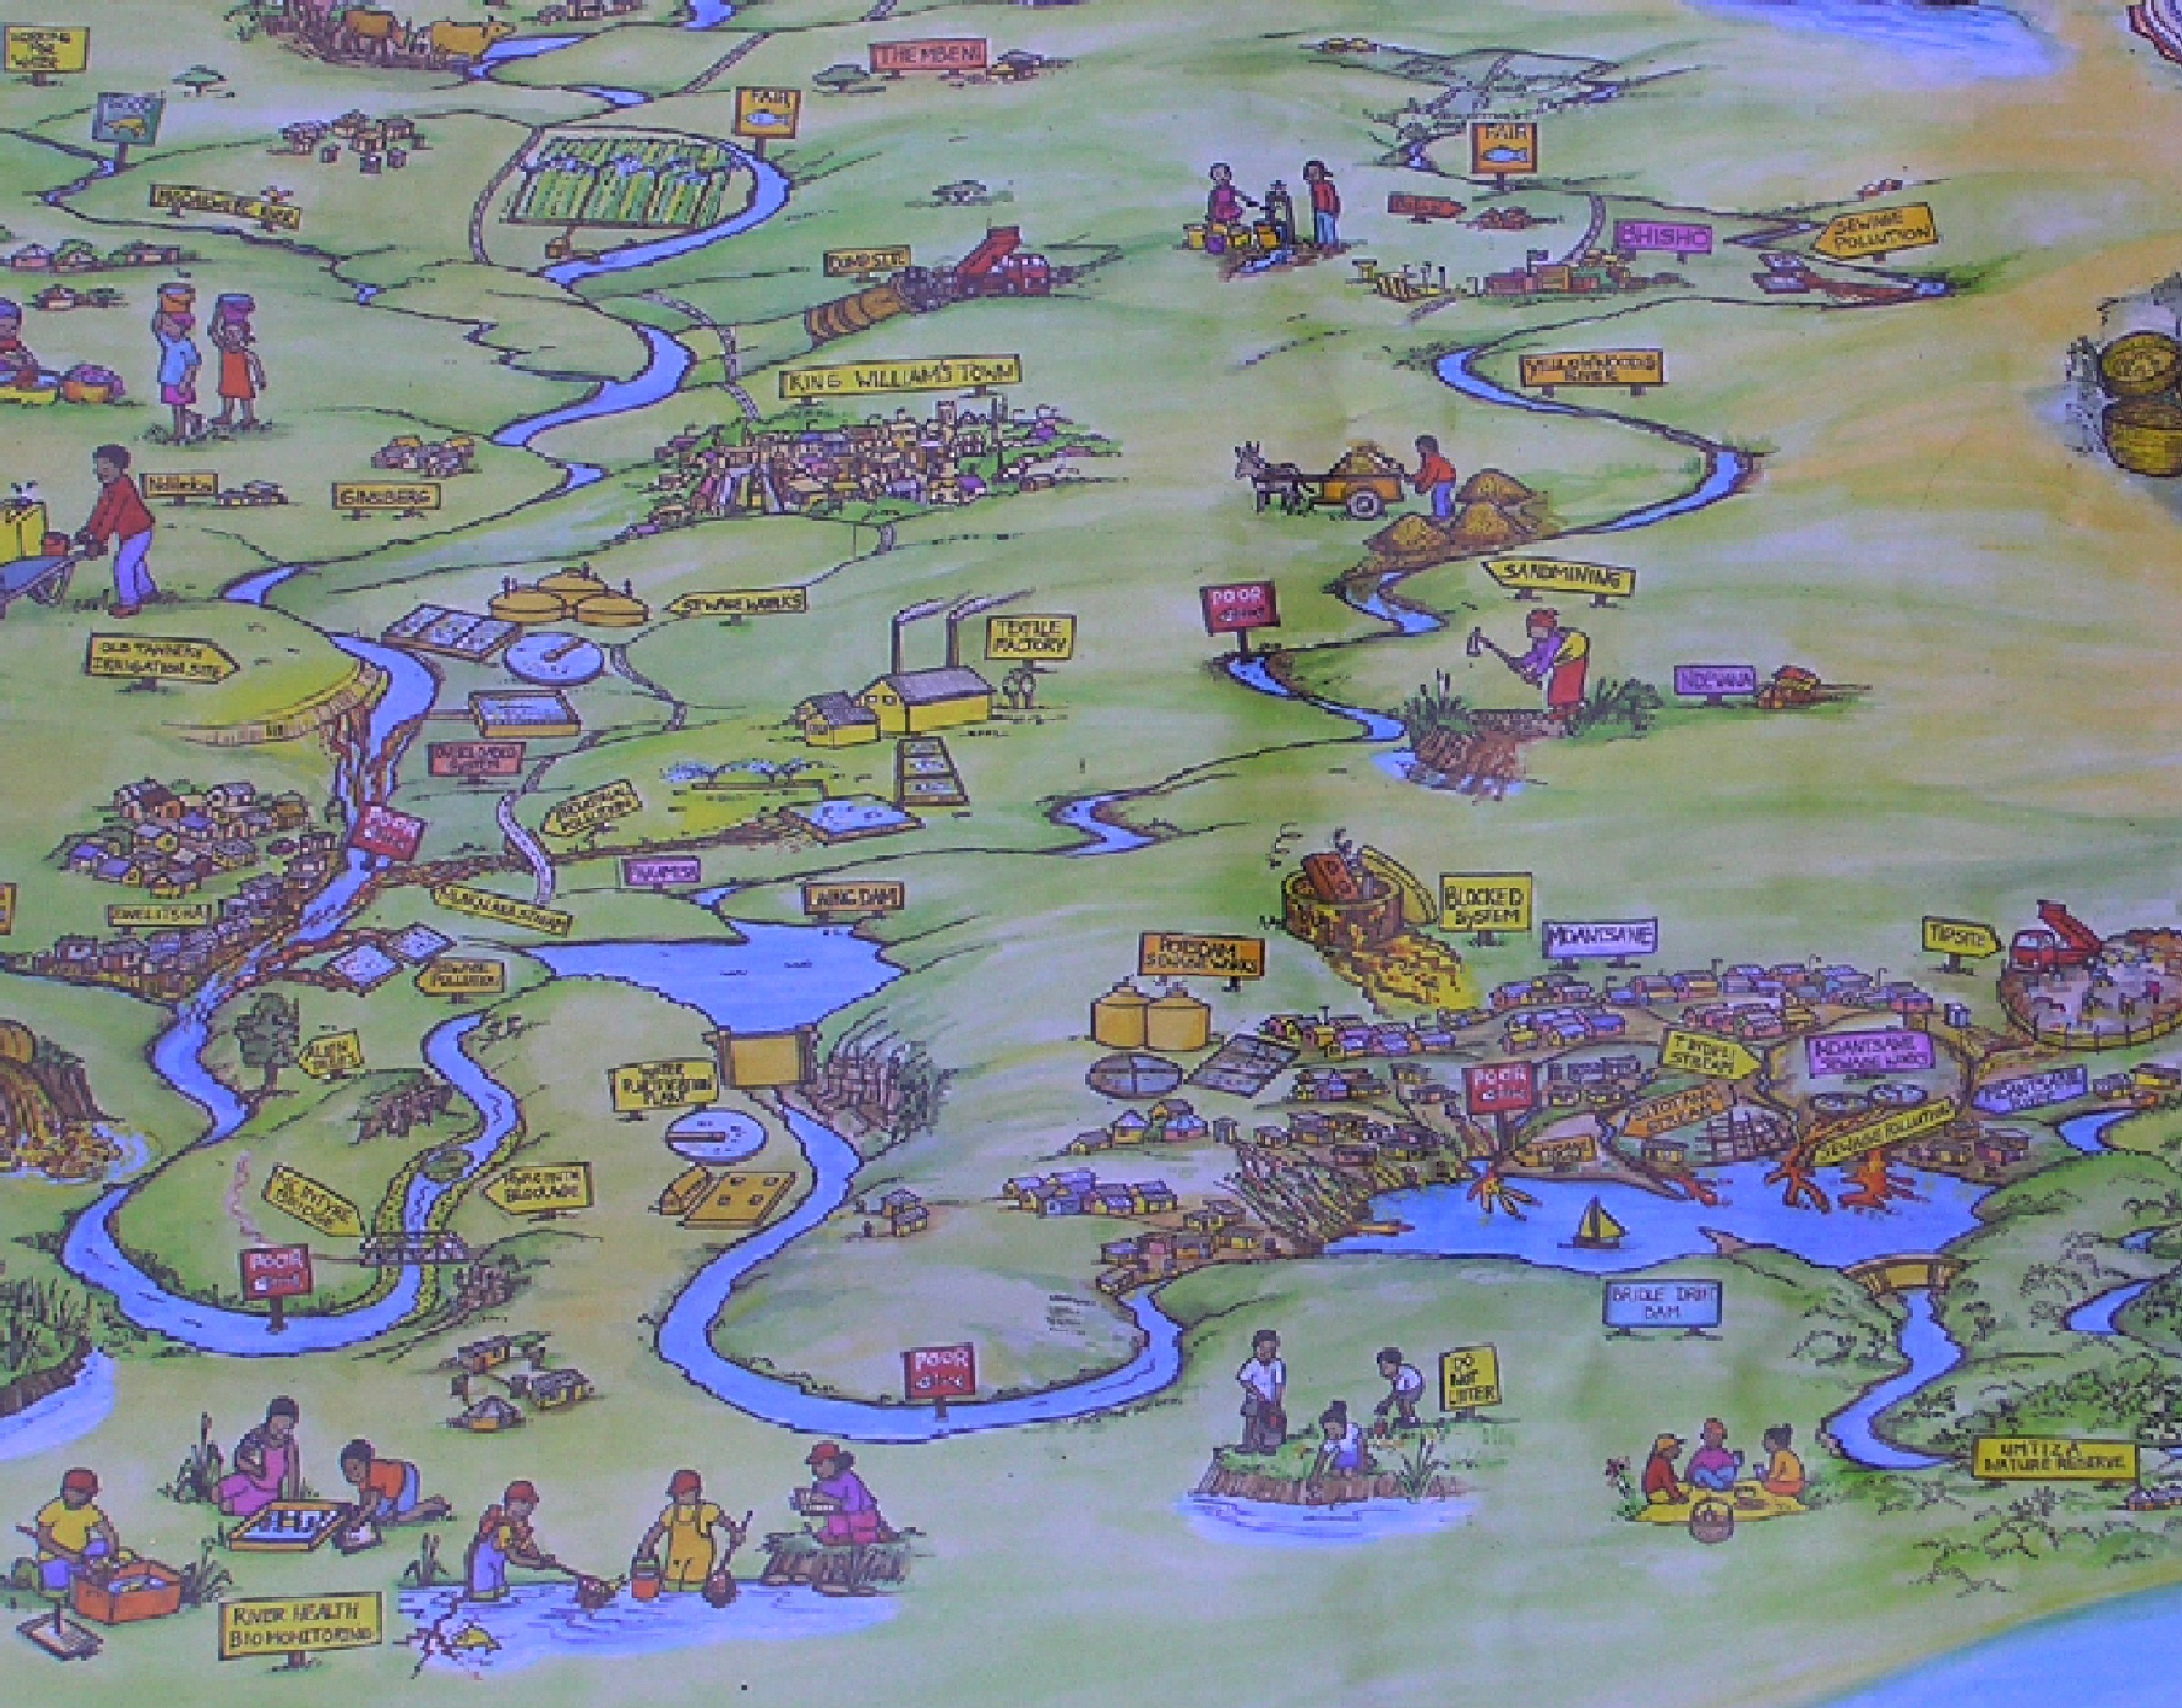
How? - Water Network
Define the Geographical Features relevant for water resource management
Resources:
Rivers
Water Bodies
Dams/Reservoirs
Estuaries
Wetlands
Groundwater Features
What impact on resources?
Water-use Sites
Industries
Mines
Other Sites
How do they affect each other?
Water flow association
Rivers - Rivers
Source – Resource
Discharge
Extraction
Monitoring points/sectors
Status
Impact Auditing
Geographical Areas:
Management Areas - WMA
Provinces
Drainage Regions
Local Authorities
Land-use, etc

Slide 6
How? - Water Management
Define the stakeholders relevant for water resource management
Monitoring resources
Laboratories
Monitoring Program owners
Water-use site ownership
Water management structures Clusters
CMAs
Public participation structures Forums
Contact Details:
Addresses
Postal
Electronic
Telephonic
Contact Persons
Water management structures:
Monitoring structures
Laboratory structures
Waste & waste discharge Management

Slide 7
How? - Monitoring Variables
Define the constituents-determinants relevant for water resource management
Biota
Habitat
Morphology
The variables are determined through:
Laboratory analysis
Field measurements
On-site observations
Derived from measured values.
Vegetation
Morphology
Chemical
Water quality & quantity determinant types:
Chemical,
Physical
Organic
Biological
Microbiology
Flow
Radioactivity.
Physical
Organic
Biological

Slide 8
How? - Operational Monitoring
Define monitoring programs
Update resource base:
Monitors & laboratories
Variables & methods
Monitoring Actions & frequencies
Equipment to use
Transport and packaging methods
State monitoring program requirements:
Monitoring Point
Monitoring Action
Frequency of monitoring
Analysis or Field measurement requirements
State monitoring program resources to be used:
Monitoring office
Laboratory
Analysis method
Containers
Preservatives
Schedule monitoring:
Consolidate all requirements
Schedule sampling & analysis
Provides equipment support
Audit monitoring compliance

Slide 9
How? - Data Capture Processes
Program related sampling
Sampling Registration
Not program related sampling
Sampling Quality Assurance
Make available for Assessment and Reporting
Electronic supplied results
Analysis Registration
Laboratory result transfers
Analysis Quality Assurance
Notes:
Several data capture techniques are available i.e. manually for program related and ad hoc sampling, Electronically supplied information from systems not linked to WMS or by laboratory transfers.
Laboratory transfers are currently in development. This method requires registration of samples on WMS. Sample and results templates (analysis requirements) are send to laboratories. Laboratories enter the required information and send the information back to WMS where it is electronically captured.
Requirements from the laboratory is to write and update interface between the laboratory system and the requirements interface provided by WMS.
Analysis statuses must be updated by laboratories.

Slide 10
How? Compliance Management
Identify Geographical Features
Set waste standards
Set resource objectives
Run compliance
Report compliance
Implement corrective measures

Slide 11
How? - Compliance Management
Identify geographical feature – monitoring points
Run compliance
Report compliance
Set waste standards
Graphical Display
Set resource objectives

Slide 12
How? - Reporting
Standard raw data
Standard External System Export
Graphs
Descriptive statistics
CSV (spreadsheet) format
Analysis Status
DBF GIS Format
Word format
Others

Slide 13
How? – Multimedia Library
Documents
Multi Media Library
Photographs
Water Network
Sound clips
Video clips
Correspondence Management
Stakeholders
References

Slide 14
WMS System Functions - MM
Monitoring Management
Subsystem
Auditing of the Monitoring Process
Data Capture and Quality Assurance
Monitoring Programs and Scheduling
Analysis Requirements
Monitoring Requirements
Water Network

Slide 15
WMS System Functions - WRM
Water Resource Management
Sub- system
Reporting & Data Supply
Compliance
Objectives & Standards
Stakeholders & Management Structures
Flow Association & Impact
Water Network

Slide 16
WMS System Functions
Reporting & Data Supply
Data Capture and Quality Assurance
Compliance
Monitoring Programs and Scheduling
Stakeholders & Management Structures
Water Network

Slide 17
WMS Infrastructure Distribution
Terminal Emulation Connection
Terminal Emulation Connection
KwaZulu Natal
Mpumalanga
Erwat Laboratories
Limpopo
North West
Buffalo City
Northern Cape
External
Users
Western Cape
RQS
HQ
Gauteng
Freestate
Notes:
WMS configuration is a mix between a distributed and centralized configuration.
Database servers presenting a distributed configuration are located at Western Cape, RQS, HQ, Gauteng and Freestate. Database replication transfer data between servers.
Terminal Emulation presenting centralized configuration link Kwa-Zulu Natal, Mpungalanga, Limpopo, North Wets and Northern Cape to the server at HO.
Terminal Emulation connections are provided to external organizations via a database server situated at SITA.
The most successful configuration are the distributed model with database replication.
Terminal Emulation poses speed and connection problems due to inefficient infrastructure.
Both configurations will be utilized in future because many offices serves one region. It is advisable for cluster management to increase the efficiency of their IT infrastructure by implementing the necessary database servers. Terminal emulation connections utilizing local servers may alleviate some speed problems.

Slide 18
WMS Infrastructure - Local Server
Client – Server Configuration – Office with Local Server
User PC
Local Area Network with Front end Software
Remote
Database Server
Database Server
Remote
Database Server
Notes:
At offices with database servers, the LAN is utilized for distribution of WMS software.
Database replication between servers are automated and takes place without user interaction.
Replication takes place per transaction committed.

Slide 19
WMS Infrastructure – Remote Server
Client – Server Configuration – Office with Terminal Emulation
User PC with Terminal Emulation
Terminal Server
Local Area Network
Remote
Database Server
Database Server
Remote
Database Server
Notes:
Terminal emulation implementation within the Department takes place via a Windows terminal server.
Users have licenses and accounts on a terminal server.
WMS software is located on the terminal server.
The terminal server is linked to a database server and data is replicated between database servers.
A terminal connection can be done through Internet or by dialing directly to the terminal server

Slide 20
WMS Infrastructure – External Server
Client – Server Configuration – External office with Terminal Emulation
User PC with Terminal Emulation
Terminal Server
OPENNET
Local Area Network
Remote
Database Server
Database Server
Remote
Database Server
Notes:
Terminal emulation implementation is the same as for DWAF with the exception that it has to go through Opennet and the necessary firewalls to protect DWAF data.
Erwat Laboratories is the only working office currently linked.
Many problems are experienced that makes such an configuration impractical.
There is currently no solution to the problems or another option.

