Slide 1
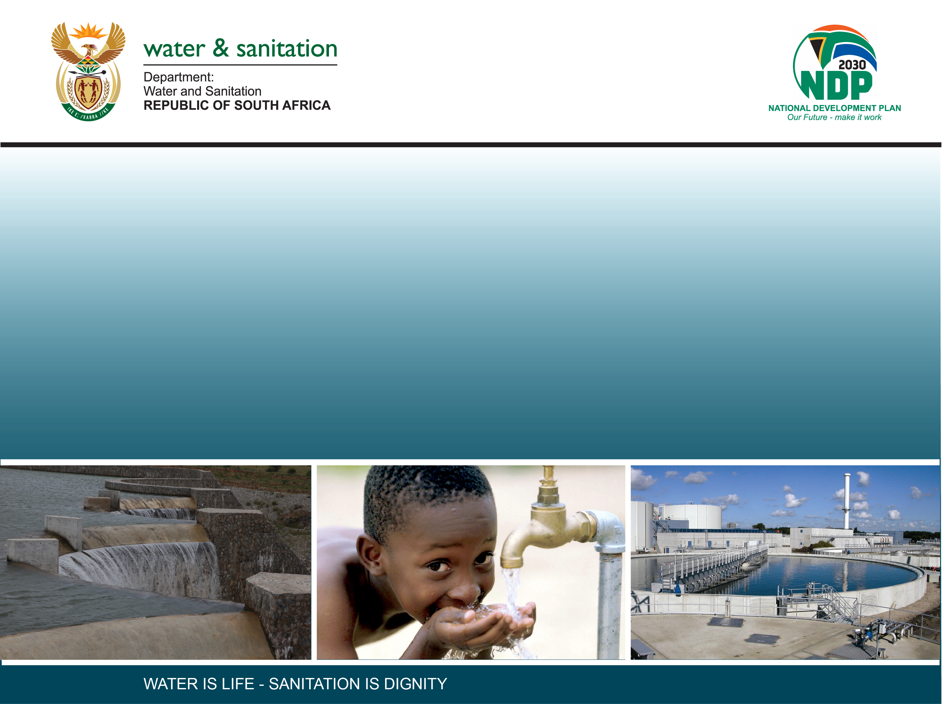
PUBLIC MEETING
DETERMINATION OF WATER RESOURCE CLASSES, RESERVE AND RESOURCE QUALITY OBJECTIVES IN THE KEISKAMMA AND FISH TO TSITSIKAMMA CATCHMENTS WITHIN THE MZIMVUBU-TSITSIKAMMA WATER MANAGEMENT AREA (WP11354)
20 and 21 April 2022

Slide 2
Study objectives
The main objectives of the study are to determine and gazette
  (i) the Water Resource Classes,
  (ii) the Reserve and
  (iii) associated Resource Quality Objectives (RQOs)
Rivers, wetlands, estuaries and groundwater will be assessed and where applicable, integration between these components will be considered.
A consultative process, with continual communication and liaison, with the various stakeholders in the study area will ensure the successful determination of the Water Resource Classes, Reserve and RQOs.
Skills development and transfer through a number of workshops, training days, in-field surveys and day-to-day management of the study will be undertaken as part of the capacity building programme.

Slide 3
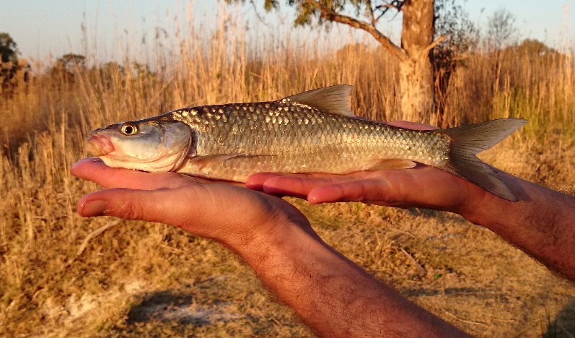
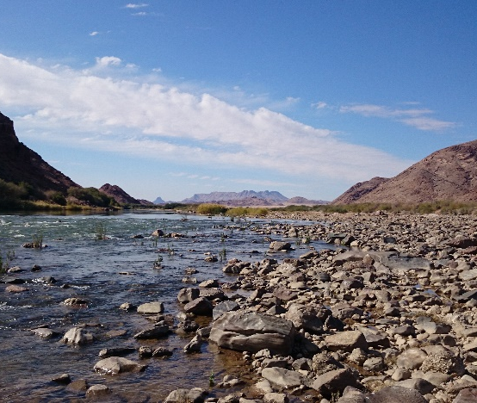
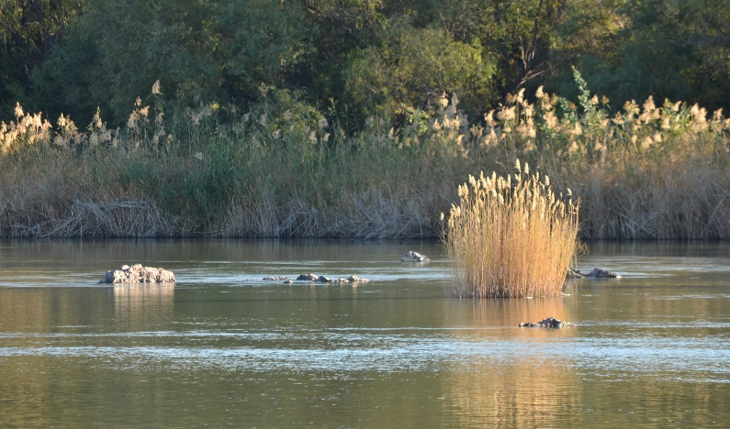
Studies In tandem
    Current studies:
  (i) Algoa West WAAS study (Kouga, Baviaans, Gamtoos and Kromme Rivers) in catchments L10-L90 and K90
  (ii) Development of a reconciliation strategy (Algoa & Amathole systems) for S60 (Kubusi), R20 (Buffalo), R30E & R30F (Nahoon), K80, K90 Krom and Tsitsikamma, M10, M20,M30 (Koega and Swartkops), N40(Lower Sundays d/s Darlington Dam)
    Both studies will update the hydrology, setting up WRYM & WRPM, scenario assessments
  (iii) Developing a National Wetland Management Framework for SA

Slide 4
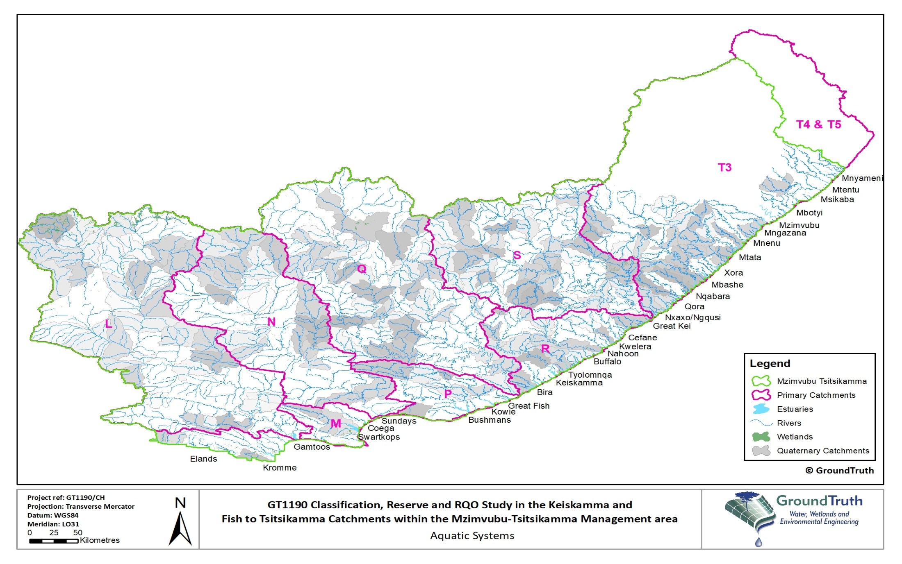
Study Area
WMA 7, excluding Mzimvubu (T3)
T60
T10, T20, T70, T80&T90
K80&K90

Slide 5
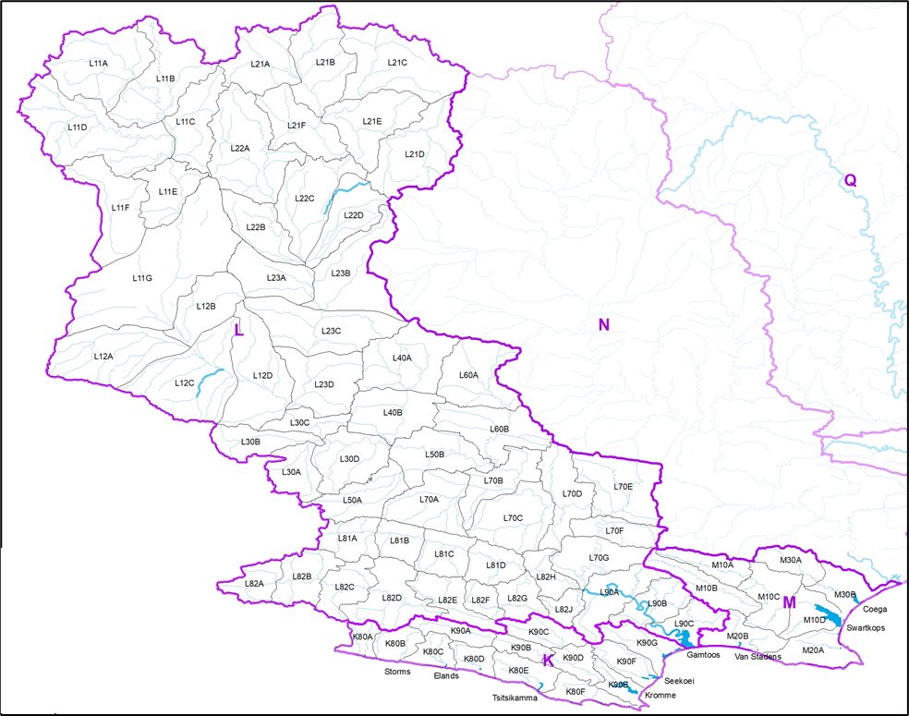
Study Area: Rivers (Drainage Regions: K, L and M)
L10 to L90
Main river/s | Gamtoos, Kouga, Groot
Tributaries | Sout, Buffels, Kariga, Plessis, Heuningklip, Baviaanskloof
Main dams | Kouga and Haarlem
Estuaries | Gamtoos
Biodiversity importance | Baviaanskloof Nature Reserve
Transfers | Transfers to Gqeberha
Main impacts | Agriculture
M10, M20 and M30
Main river/s | Swartkop. Koega
Smaller systems | Van Stadens, Maitland, Bakens, Papkuils, Coega
Main dams | Groendal, Bulkrivier, Sand River, Van Stadens
Estuaries | Van Stadens, Swartkops, Coega
Biodiversity importance | Groendal Nature reserve
Transfers | None
Main impacts | Domestic
K80 and K90
Main river/s | Tsitsikamma and Krom
Smaller systems | Elandsbos, Kleinbos, Storms, Elands, Groot, Klasies, Klipdrift and Seekoei, Kabeljous
Main dams | Impofu and Kromriver (Churchill)
Estuaries | Tsitsikamma, Kromme, Seekoei
Biodiversity importance | Tsitsikamma Nature Reserve, Formosa Provincial Nature Reserve
Transfers | None
Main impacts | Agriculture

Slide 6
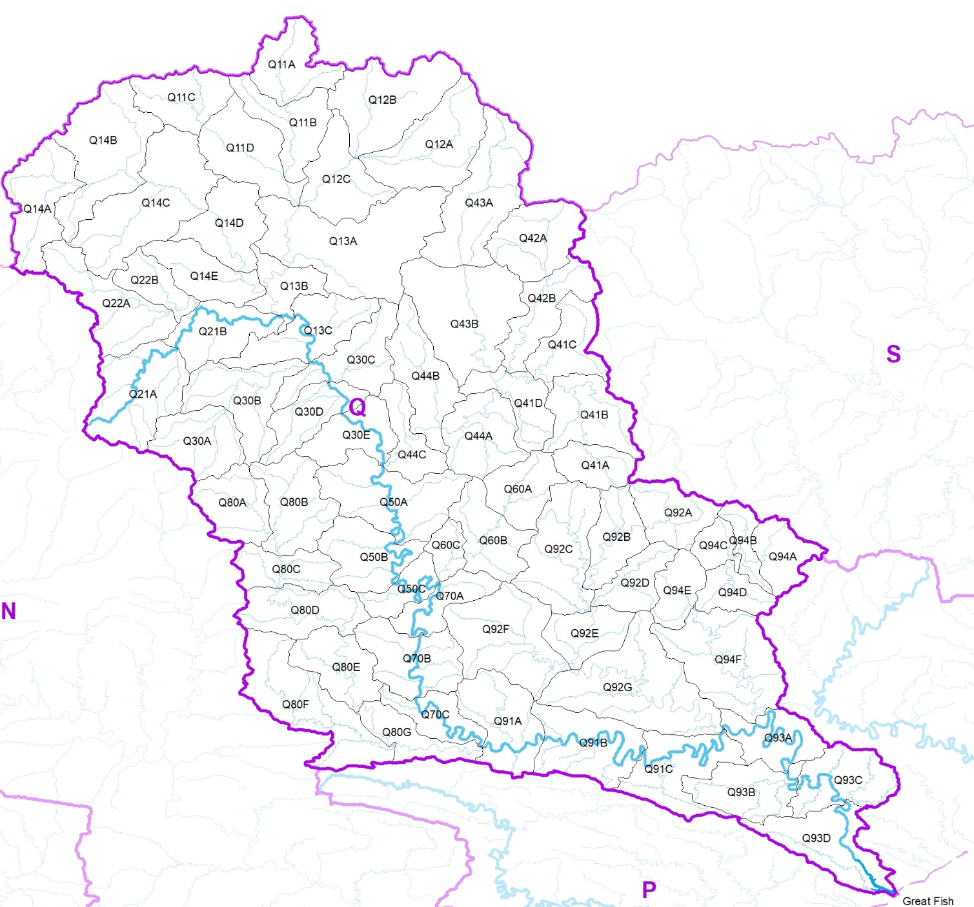
Study Area: Rivers (Drainage Region Q)
Q10 - Q90
Main river/s | Great Fish
Tributaries | Groot-Brak, Pauls, Tarka, Baviaans, Koonap, Little Fish, Kat
Main dams | Grassridge, Lake Arthur, Kommandodrift, Elandsdrift, De Mistkraal, Katrivier, Glen Melville
Estuaries | Great Fish
Biodiversity importance | Mount Zebra National Park Renosterberg Nature Reserve The Great Fish Nature Reserve Commandodrift nature reserve
Transfers | Major transfer from the Gariep Dam (Upper Orange) to the upper reaches of the Great Fish River (Grassridge Dam)
Main impacts | Agriculture

Slide 7
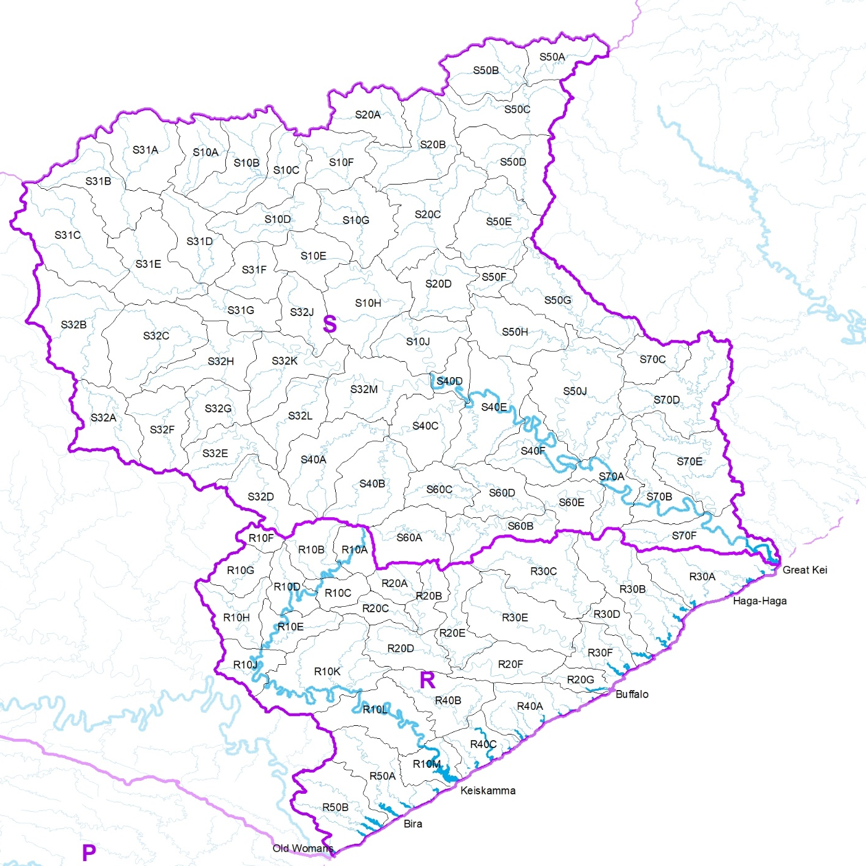
Study Area: Rivers (Drainage Regions R &S)
R10 – R50
Main river/s | Keiskamma, Buffalo, Nahoon
Smaller systems | Tyume, Qinira, Gqunube, Kwelera, Kwenxura, Quko, Tyolomnqa, Gxulu, Bhirha, Mgwalana
Main dams | Sandile, Cata, Binfield, Laing, Rooikrantz, Bridle Drift, Nahoon
Estuaries | Bira, Keiskamma, Buffalo, Haga-Haga, Nahoon
Biodiversity importance | Amathole marine protected area Nahoon nature reserve
Transfers | Wriggleswade Dam (Kei system) to the Buffalo and Nahoon Rivers
Main impacts | Domestic, irrigation
S10, S20, S31, S32, S40 – S70
Main river/s | Great Kei
Tributaries | White-Kei, Indwe, Klipplaat, Klaas Smit, Black-Kei, Tsomo, Kubusi, Gcuwa
Main dams | Xonxa, Lubisi, Doringrivier, Waterdown, Bonkolo, Oxkraal, Ncora, Tsojana, Gubu, Wriggleswade, Gcuwa, Xilinxa
Estuaries | Great Kei
Biodiversity importance | Qacu nature reserve and other small nature reserves
Transfers | Ncora Hydropower (generates up to 2MW of peaking power) and transfers to upper Mbashe River Transfer of water from Wriggleswade Dam to R2 (Buffalo) catchment for domestic use
Main impacts | Agriculture, domestic, irrigation

Slide 8
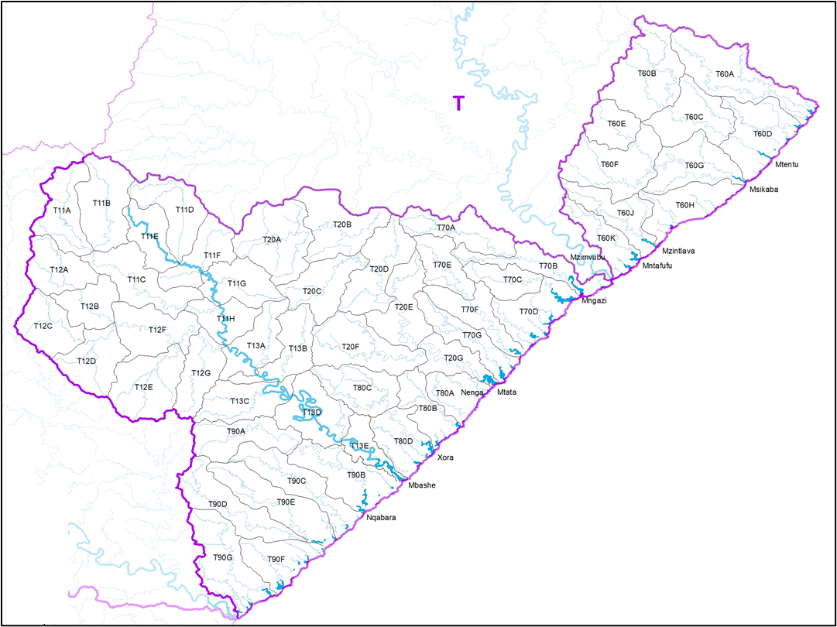
Study Area: Rivers (Drainage Region T)
T11 – T13, T20, T60 – T90
Main river/s | Mbashe, Mthatha
Other systems | Xuka, Mgwali, Mzamba, Mtentu, Msikaba, Mzintlava, Mntafufu, Mngazi, Mngazana, Mtakatye, Mdumbi, Nenga, Mncwasa, Xora, Nqabarha, Shixini, Qhorha, Kobonqaba
Main dams | Umtata, Mabeleni, Corana, Mlanga,Magwa
Estuaries | Nqabara, Mbashe, Xora, Mtata, Mngazi, Mntatutu, Mzintlava, Msikaba, Mtentu
Biodiversity importance | Dwesa-Cwebe marine protect area Pondoland protected area
Transfers | Colly Wobbles Hydropower scheme (generates up to 42MW of power) Flows in the Mbashe are supported through releases from the Ncora Dam (that are transfers from the Kei system to the Mbashe catchment) (T13) 1st and 2nd Falls hydropower (Mthatha River, generates up to 6 and 11M of power respectively) (T20)
Main impacts | Afforestation, domestic

Slide 9
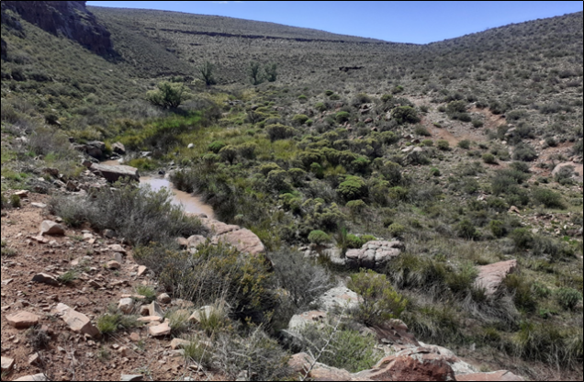
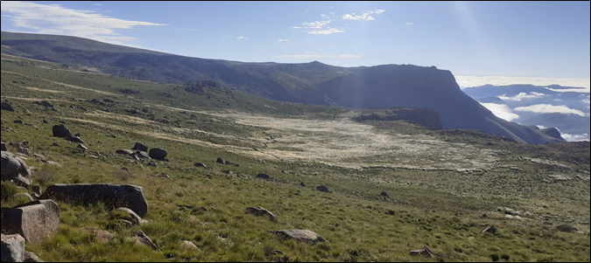
Study Area: Wetlands
Most wetlands occur in the Kei, Mbashe, Tsitsikamma and Fish catchments
Key trends of wetlands:
  Wetland occurrence in relation to the aridity gradient
  Extent of wetlands in the Mzimvubu compared to study area
  Present ecological state in relation to land-use and the aridity gradient

Slide 10
Study Area: Wetlands
Summary of wetland information per sub-catchment
Area | Size (ha) | PES | Type
Gamtoos | 1 274 | A or B | Channelled/ unchannelled valley bottom, depression Seepage-slope rare
Sundays | 899 | A or B | Depression and combination of channelled valley bottom and depression Seepage-slope rare
Fish | 3 296 | A or B | Depression or channelled valley bottom
Tsitsikamma | 3 236 | A-E | Depression and channelled valley bottom
Algoa | 2 357 | A, B, F | Depression and channelled valley bottom
Bushmans | 634 | A or B | Depression
Kei | 9 329 | A-C | Seepage-slope, channelled valley bottom
Amatola | 1 827 | A-C | Channelled valley bottom and seepage
Mbashe | 4 304 | B-E | Seepage and channelled valley bottom
Mtata | 1 102 | B, C, E | Channelled valley bottom
Wild Coast | 1 913 | C-D | Channelled valley bottom and unchannelled valley bottom

Slide 11
Study Area: Groundwater
Major aquifer systems associated with the Cape and Karoo Supergroups.
Mainly fractured type, where groundwater occurrence is as a result of secondary deformation relating to faults, fissures, fractures, bedding planes and joints.
Karoo Supergroup also constitutes a fractured and intergranular aquifer over widespread areas associated with intrusive and extrusive igneous rocks, i.e. dolerite sills and dykes and well as basalt.
The Quaternary sand and alluvium constitute limited intergranular aquifers where groundwater occurs as a result of pore spaces between sand particles.
Borehole yields in the fractured aquifers vary greatly.
Groundwater quality is generally good over most parts of the catchment except along parts of the coast and at some inland locations where the recharge is low and the geology is not favourable.
Several stressed quaternary catchments have been identified in the area where the estimated groundwater use exceeds the estimated groundwater recharge

Slide 12
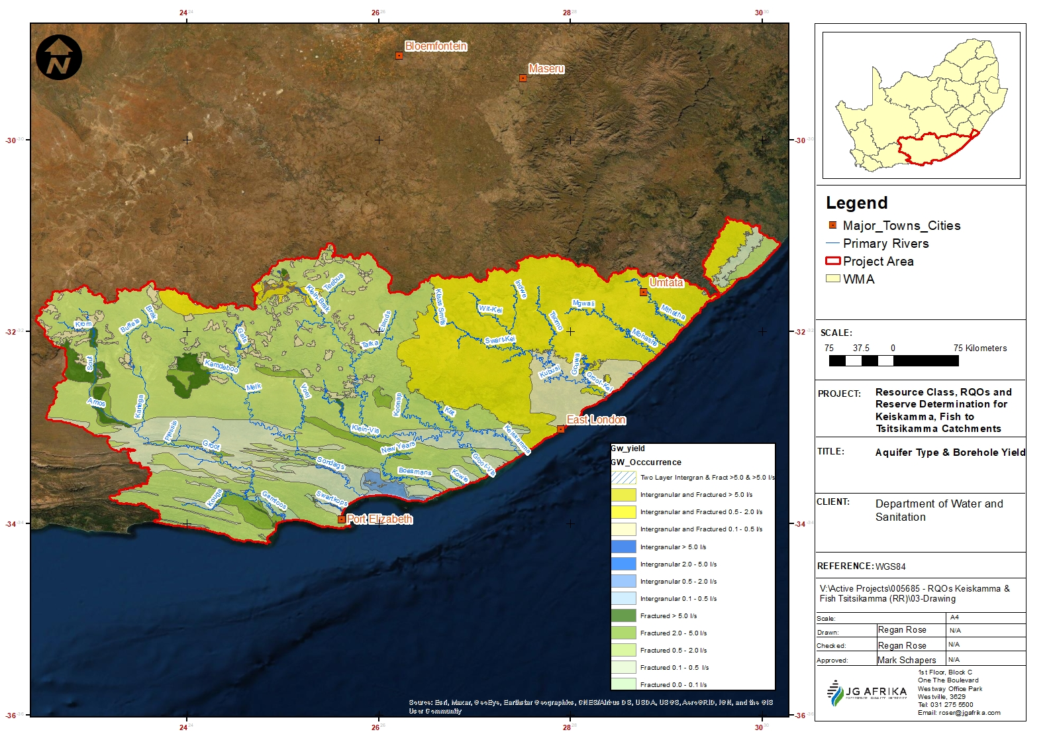
Study Area: Groundwater occurrence
N

Slide 13
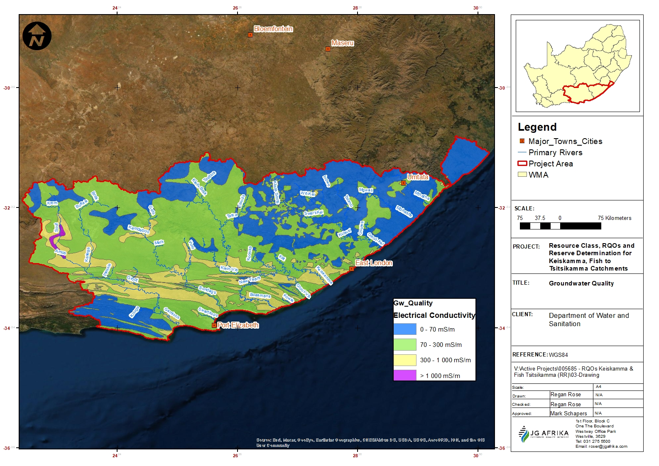

Study Area: Groundwater quality

Slide 14
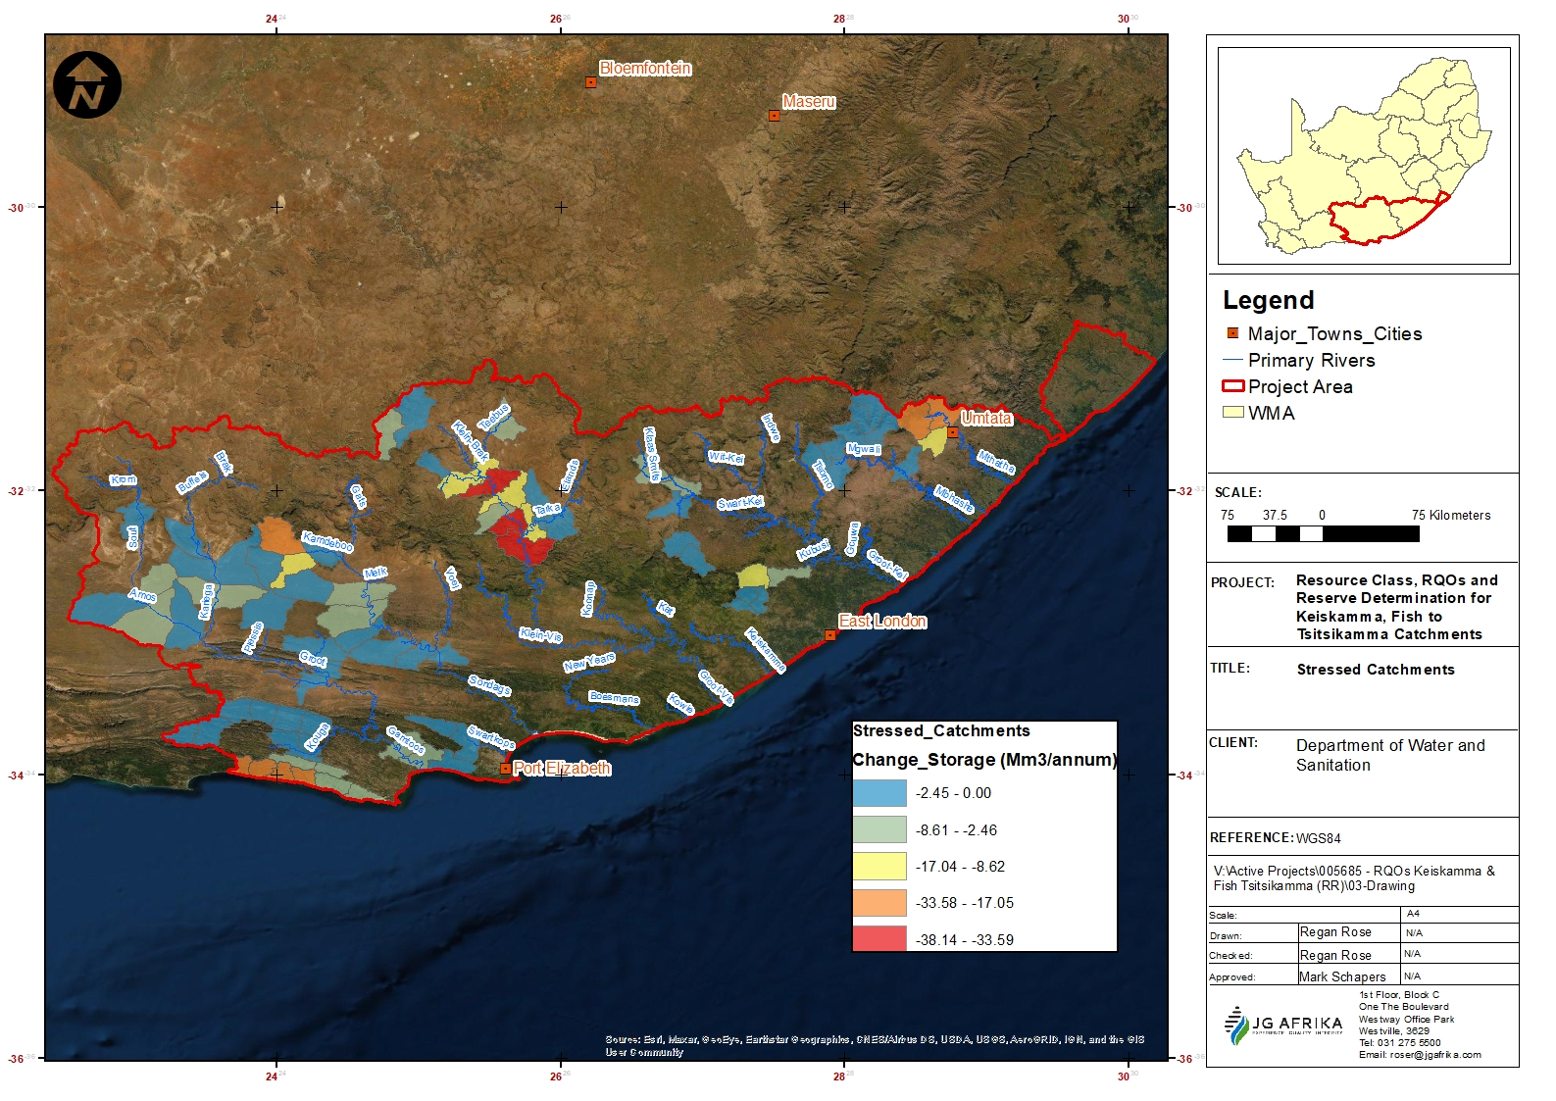
Study Area: Groundwater stressed areas

Slide 15
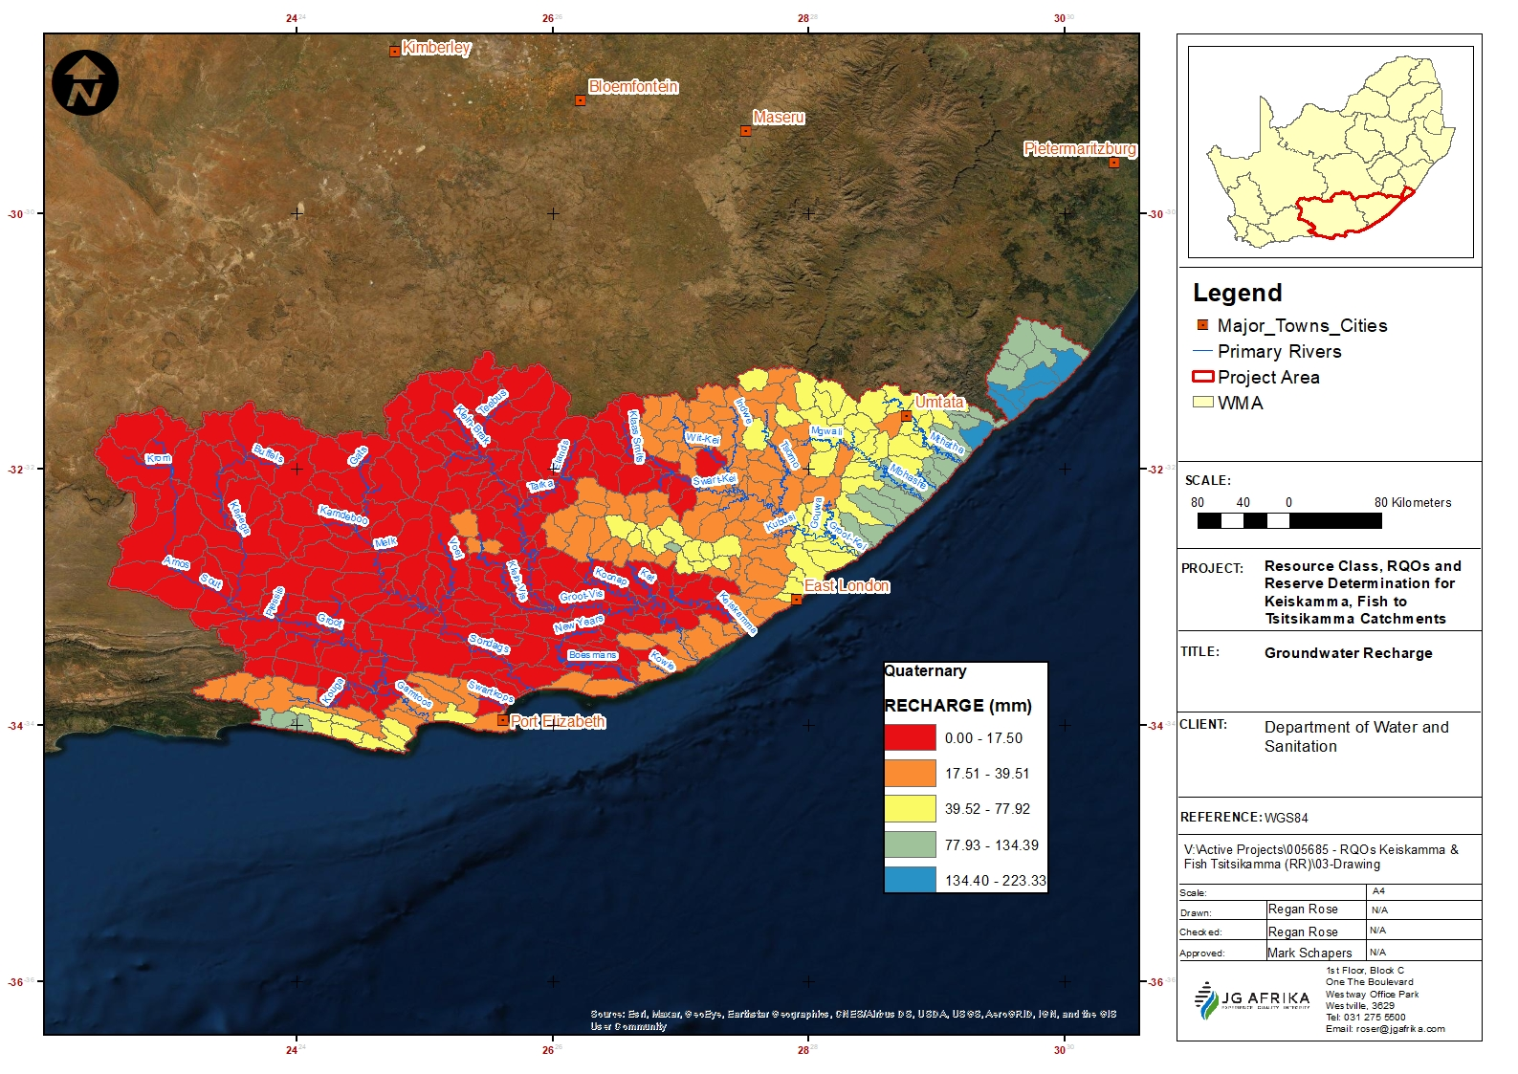
Study Area: Groundwater recharge

Slide 16
Study Area: Estuaries
  Either warm temperate or subtropical systems
Mostly small or large temporarily closed estuaries with some predominately open systems (Kromme, Gamtoos, Swartkops, Sundays, Great Fish, Keiskamma, Buffalo, Nahoon, Qora, Xora, Mtata, Msikaba, Mtentu, etc)
Only the Great Kei and Mbashe are large fluvial systems
Threat status range between:
  Least Concern and Vulnerable (south of Great Kei);
  Vulnerable and endangered (estuaries in the T catchments)
  Endangered – Mbashe
  Low to high cumulative pressures, high being on the Kromme, Seekoei, Swartkops and Buffalo
    Localised flow, quality impacts and some habitat loss
Biodiversity importance: low to average (75%); important (17) and high importance (8%)
Most estuaries are in a PES of A-B (79%), C-D (18%) and 4 estuaries <D (Seekoei, Baakens, Papkuils and Coega)

Slide 17
Study Approach
  Study is of a technical nature, supported by extensive stakeholder engagement.
  Water Resource Classification System published as Regulation 810 (Government Gazette 33541), September 2010 as the framework.
  Integrated framework from the Development of Procedures to operationalise Resource Directed Measures’ (DWS, 2017).
  Methodologies for Reserve determinations of rivers, wetlands, groundwater and estuaries and the determination of Resource Quality Objectives (RQO).

Slide 18
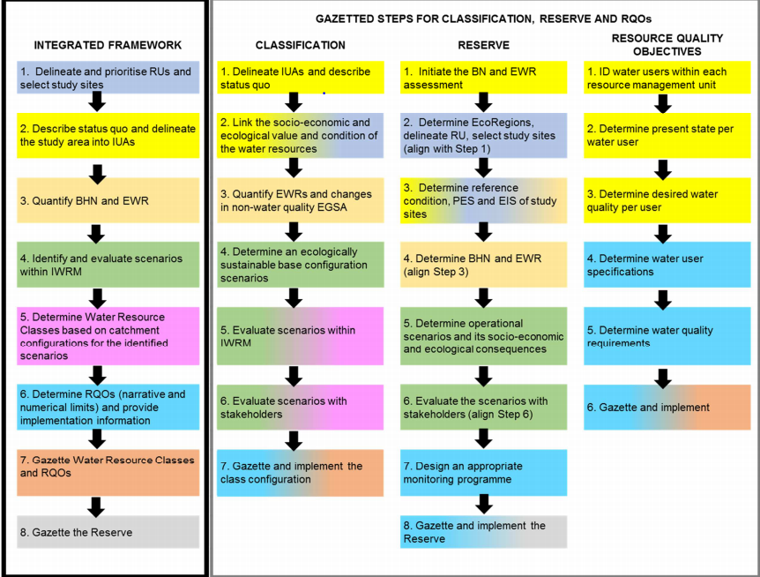
Study Approach
  The integrated steps for Classification, Reserve and RQOs will be guided by the “Development of Procedures to operationalise Resource Directed Measures (DWS, 2017).

Slide 19
Study Approach
  Evaluation of water use scenarios and ecological and socio-economic trade-offs to determine the water resource classes.
  Determine the RQOs (protection measures) to support the water resource classes.
  Prepare the templates for the gazetting of the classes and RQOs
  Once above is gazetted – the Reserve will be gazetted.

Slide 20
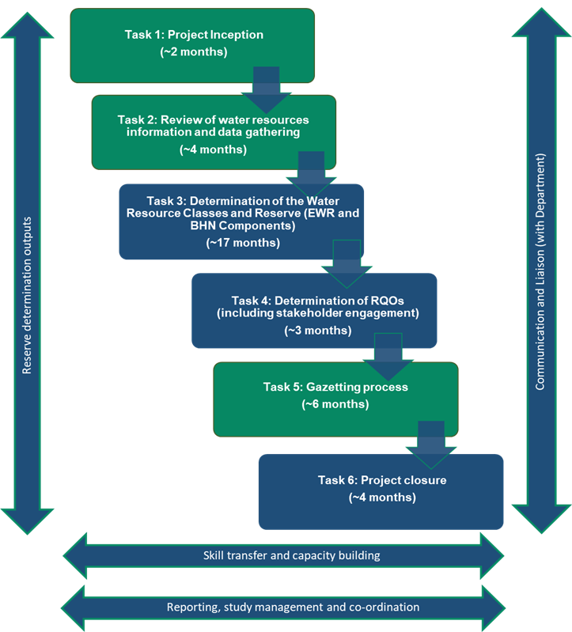
Main Tasks for the study

Slide 21
Task 1: Project Inception
Critical component of the project
Understanding the nature of the SoW and alignment with DWS expectations
Confirmation of study area, study team and approaches
Task 2: Data review, status quo & IUAs
Review of water resource information, models and data gathering
Describe status quo, identify hotspots/ stressed areas and gaps
Delineate IUAs (socio-economic, rivers, wetlands, groundwater, estuary, quantity and quality considerations) and identify priority Resource Units
1st round public meetings to introduce the study to stakeholders: Kei Mouth and Gqeberha

Slide 22
Task 3: Determine EWR, BHN & WR Classes
Quantify EWRs for rivers, estuaries and groundwater:
    Study site selection and prioritisation
    Surveys
    Ecoclassification and EWR quantification
    Ecological consequences of scenarios
    RQOs
Linking of socio-economic and ecological value
Establish Ecological Sustainable Base Configuration (ESBC)
Identify management and operational scenarios
Water Resource modelling of scenarios, taking into consideration system constraints
Evaluate ecological consequences of scenarios
Undertake socio-economic and ecological trade-offs
Establishing the Water Resource Classes by integration of the economic, social and ecological goals

Slide 23
Task 4: Determine RQOs
Identify sub-components per priority RU for RQOs (flows, quality, habitat, fish, etc.)
Provide narrative and numerical limits for each identified sub-component
Specify monitoring requirements
Develop implementation plan for RQOs
2nd round public meetings: Kei Mouth and Gqeberha
Tasks 5 & 6: Gazetting and study closure
Compile templates for gazetting of Water Resource Classes, RQOs and Reserve
Compile gazetting issues and response report
Final integrated and close-out reports

Slide 24
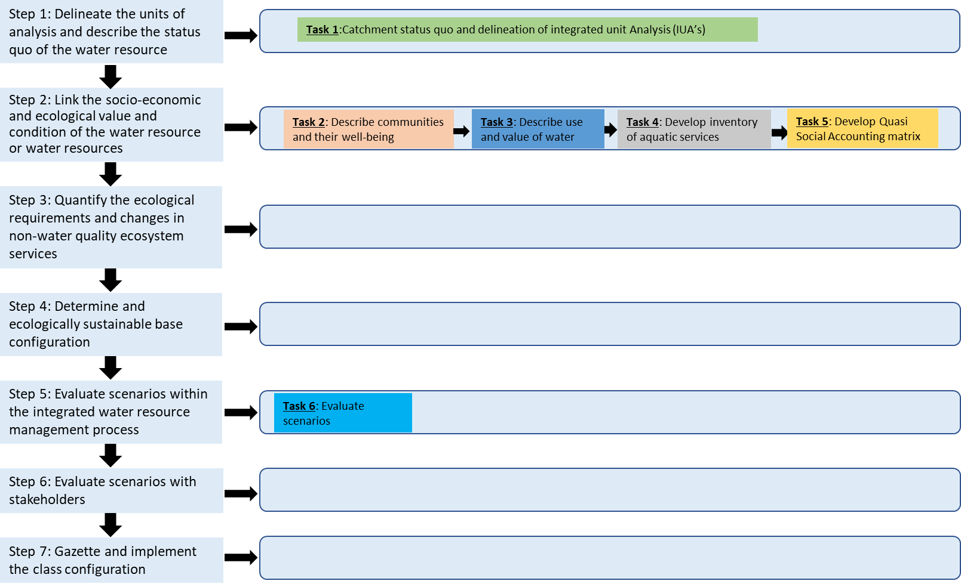
Socio-economics: Process
Step-wise process for identification and analysis of changes for various scenarios
Framework: assessing socio-economic and ecosystem services for this process

Slide 25
Socio-economics: Tasks
IUA delineation
Describe communities and their wellbeing
Describe use and value of water
  Water Accounting Module
Develop an inventory of aquatic Ecosystem services
  Ecosystem Services Module
Setting up Quasi-Social Accounting Matrix Module
Evaluate scenarios

Slide 26
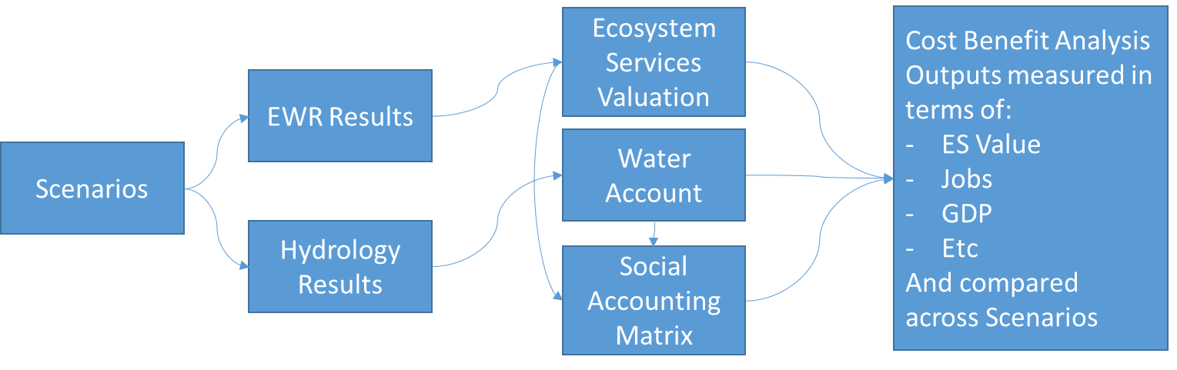
Socio-economics: Approach for scenario evaluation
Approach for the development of the Integrated Economic Model that demonstrates the Socio-Economic Linkages in the WRCS scenario process
Driver | Ecological Response | Integrated Economic Model | Socio-Economic Response

Slide 27
Water Resource Modelling
Water Resources Systems Models (WRYM or WRPM) for integrated water resource systems:
    Algoa water supply system for Gqeberha - local sources and transfer from Gariep to Fish and Sundays,
    Amatole water supply system for East London - Nahoon, Buffalo and Kubusi (Kei))
    Smaller systems (e.g. Mtata, Mbashee, etc.)
Linking of models, especially between catchments linked through transfers.
The hydrology within the models will be adjusted to the final selected EWR sites and priority estuaries.
Setup of the WRYM for selected smaller catchments (priority river and/ or estuary) to undertake future scenario simulation.
Where models not available, especially for the smaller coastal systems, results from the WR2012 study for natural and present-day flow time series (1920 - 2009) will be used.

Slide 28
Tea Break

Slide 29
Workings and Results

Slide 30
Information available: Rivers
  Various water resources assessment and feasibility studies undertaken in the catchment
  Various Reserve studies
  Desktop PES/EI/ES data (DWS, 2014)
  River Eco-status monitoring programme (REMP)
  WR2012 hydrology information
  Water Supply and Drought Operating Rules for Stand-Alone Dams or Schemes
  Various gauging stations (DWS)
  Validation and Verification (V&V) of Existing Lawful Water Use
  Reconciliation strategies for metropolitan areas of Algoa, Albany Coast and Amatole
  WRYM and WRPM configurations and data
  Early /historical aerial imagery
  SWSA (2021) refined from 2017

Slide 31
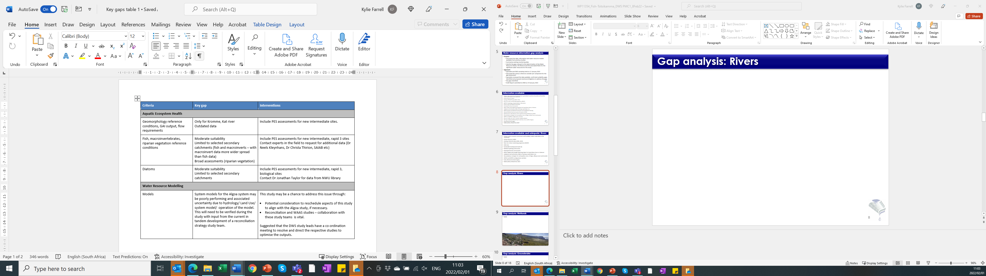
Key Gaps: Rivers

Slide 32
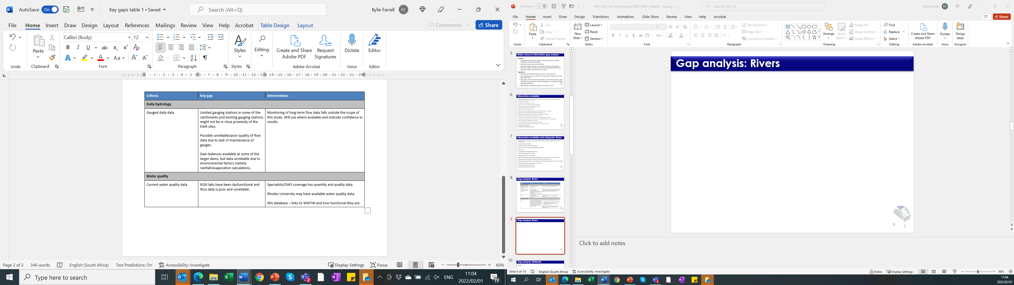
Key Gaps: Rivers

Slide 33
Key Gaps: Rivers
  The major gaps that will not be addressed during this study, as long-term monitoring is required are:
    Lack of adequate gauging weirs in the study area and the consequent lack of long-term flow data, especially daily data that is invaluable for the setting of EWRs; and
    Recent water quality data to determine the present state is not available. However, data available from various other sources and studies, coupled with the planned surveys forming part of this study, will assist with mitigating this gap.

Slide 34
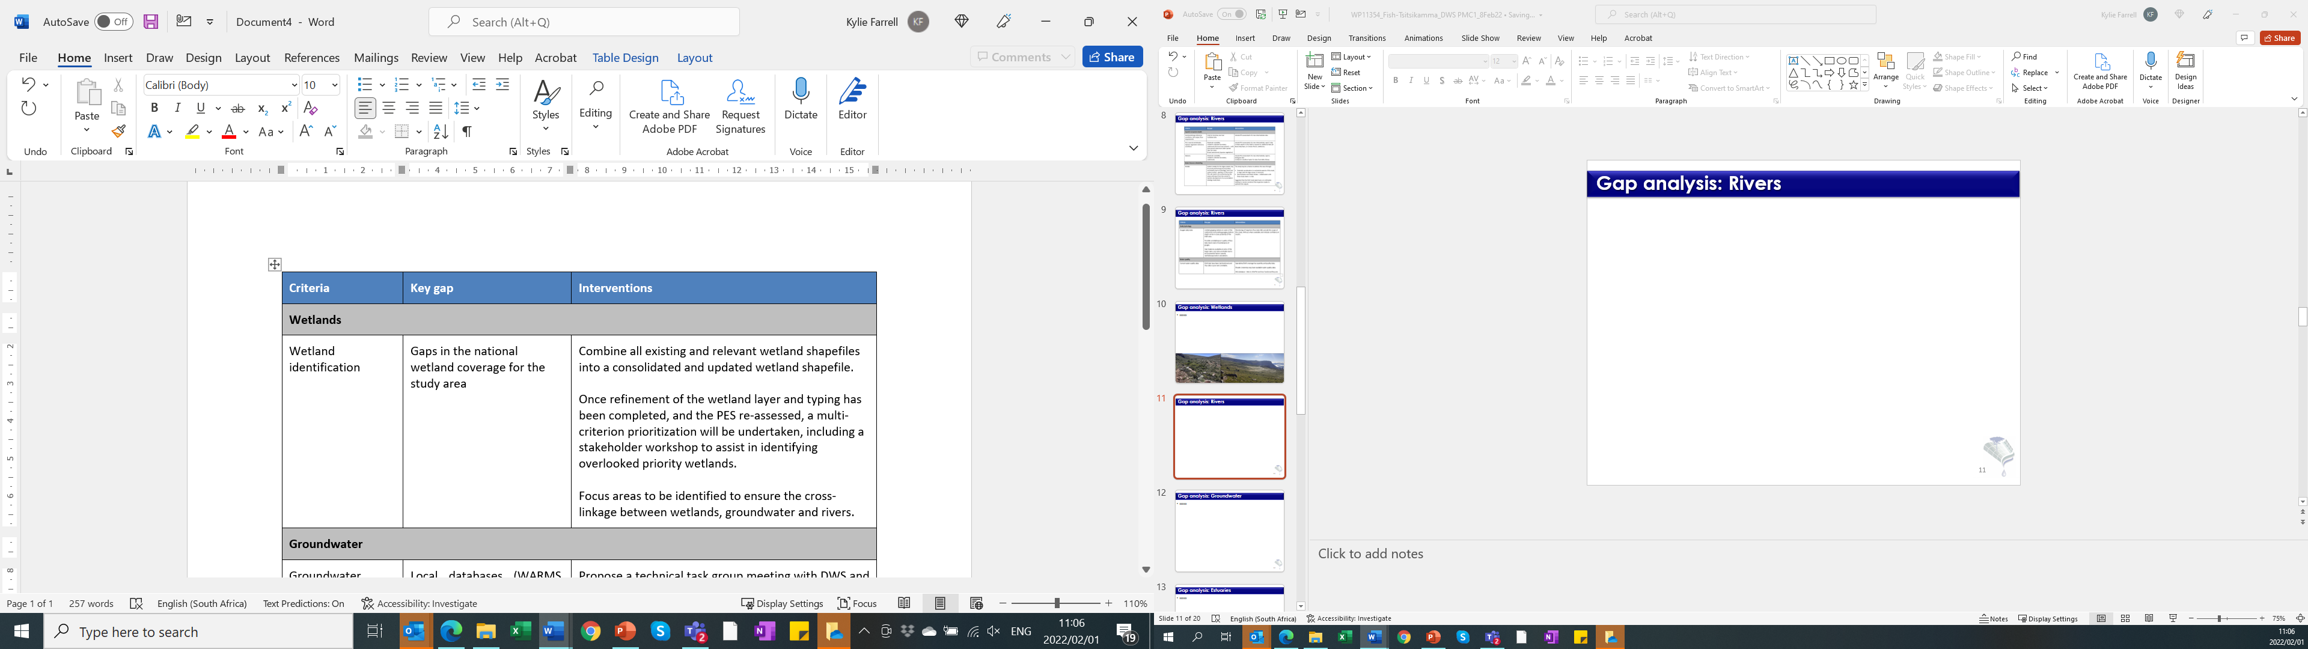
Information available and key gaps: Wetlands
  Various water resources assessment/feasibility studies
  NFEPA wetlands and Wetland Prioritization and rehabilitation Planning
  GIS layers (National Wetland Map 5, land cover, etc), satellite imagery
  WfWetlands Provincial Strategic planning
  Early /historical aerial imagery
  SWSA (2021) refined from 2017

Slide 35
Information available: Groundwater
  Various water resources assessment/ feasibility studies
  WARMS data
  WR2012 hydrology and groundwater information
  Eastern Cape Groundwater Masterplan
  Municipal Services Assessments
  Validation and Verification (V&V) of Existing Lawful Water Use
  National Census data (Stats SA, 2011) and General Household Survey (2016)
  ISP, reconciliation strategies
  All towns studies
  Reserve studies for groundwater
  Early /historical aerial imagery
  SWSA (2021) refined from 2017

Slide 36
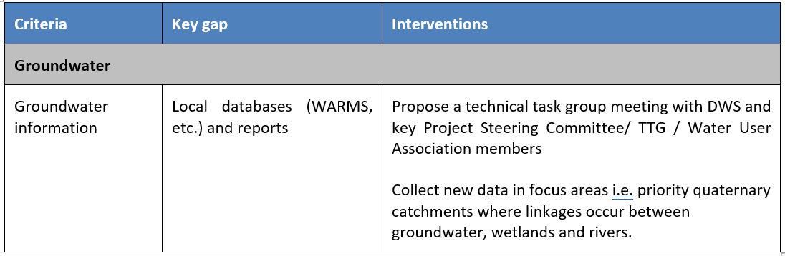
Key Gaps: Groundwater

Slide 37
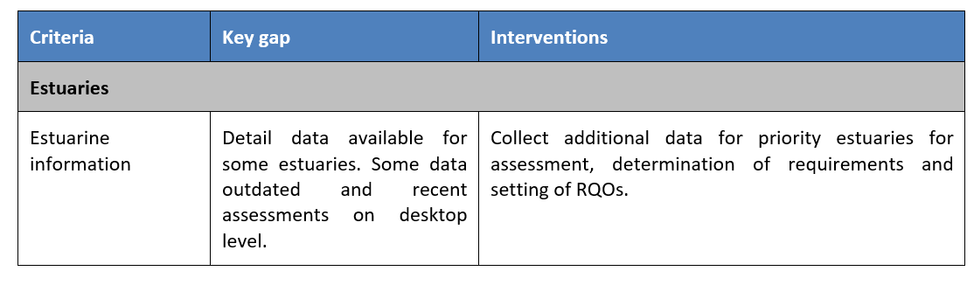
Information available and key gaps: Estuaries
  Various water resources assessment/ feasibility studies undertaken in the catchment
  Various Reserve studies for estuaries (20)
  National Biodiversity Assessment of estuaries (2018)
  Estuarine stations (DWS)
  SAEON aerial imagery
  Estuarine management plans
  SWSA (2021) refined from 2017

Slide 38
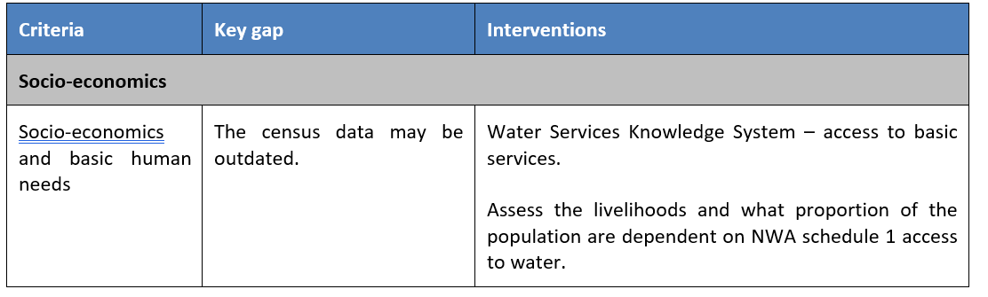
Information available and key gaps: Socio-economics
  Municipal Services Assessments
  Water Supply and Drought Operating Rules for Stand-Alone Dams or Schemes
  Department of Rural Development and Land Reform National Census data (Stats SA, 2011) and General Household Survey (2016)
  DEA (egis.environment.gov.za)
  Water boards annual reports
  Municipal reports
  Ecosystem Service Flow Data
  Satellite imagery
  National Quasi Social Accounting Matrix

Slide 39
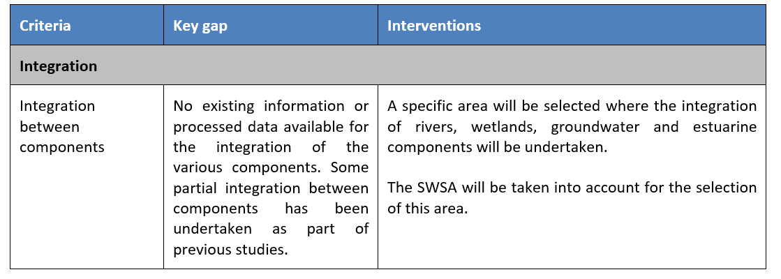
Key Gaps: Integrated
  Although not as such a gap
    Accessibility constraints to parts of the study area can prevent the site selection process.
    Permits to survey certain rivers might also be problematic.
    Liaison with stakeholders (farmers through irrigation boards and/ or Water User Associations), CapeNature and/or SANPark officials.

Slide 40
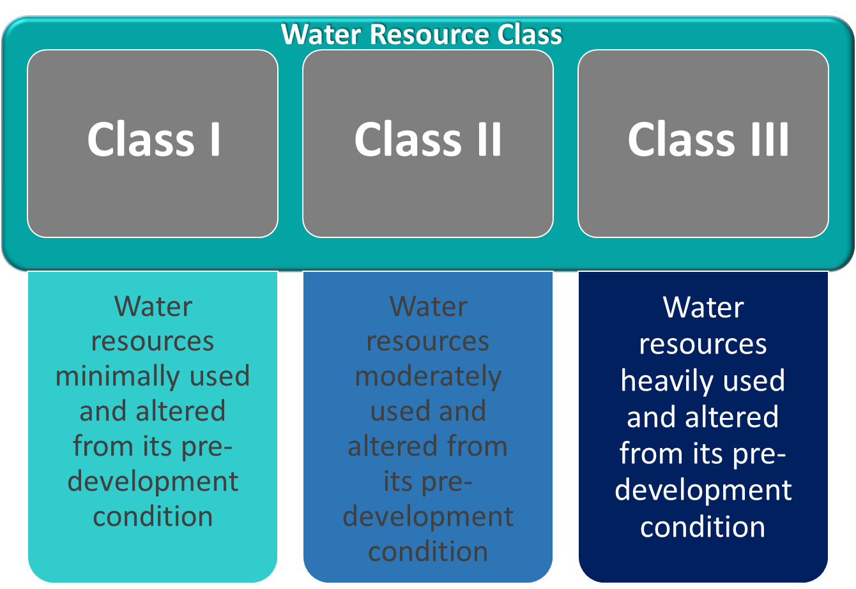
Integrated Units of Analysis (IUAs)
Step 2 from the integrated framework (Development of Procedures to operationalise Resource Directed Measures (DWS, 2017)).
What are IUAs
  Spatial units consisting of significant water resources for which water resource / management classes are determined
    Describes the desired condition of the resource and the degree to which it can be utilized
    Sets the boundaries for the volume, distribution and quality of the Ecological Reserve and RQOs and must be managed
  Based mainly on socio-economic zones, but further includes ecological conditions at a sub-catchment scale

Slide 41
Integrated Units of Analysis: Delineation
Irrigation/ Forestry
Economic Drivers
Protected/ conservation areas
Key drivers
(delineate)
Socio-economic zones
(SEZ)
Undertaken per primary catchment
Ecological infrastructure and beneficiaries
Social Characteristics
Major dams and transfers
Socio-economics
Land Use
SEZs
Ecological infrastructure
Describe aquatic ecosystems services
Beneficiaries

Slide 42
Integrated Units of Analysis: Delineation
Groundwater Resources
Similar to SW assessment
Define SW and GW interaction areas
Surface Water Resources
Water resource infrastructure (dams, channels, transfers)
Identify water users/sources/land-based activities
Identify water quality/problem areas
Significant resources
Conservation/ Protected Areas, Critical Biodiversity Areas
Rivers
Groundwater
Socio-economics
Wetlands
Estuaries

Slide 43
Integrated Units of Analysis: Criteria
Surface Water Resources
Water resource infrastructure (dams, channels, transfers)
Identify water users/sources/ land-based activities
Identify water quality/problem areas
Significant resources
Conservation/ Protected Areas, Critical Biodiversity Areas
Groundwater Resources
Similar to SW assessment
Define SW and GW interaction areas
Rivers
Describe PES/SQ
EI-ES
Identify pressures/impacts
Group similar rivers together
Vegetation (protected/invasives)
FEPAs/Fish sanctuaries/support areas/corridors
Geomorphology
SWSA
Groundwater
Aquifer type
Stressed areas
Hotspots
SWSA
Estuaries
Estuary functional zone
PES per estuary
Identify flow/non-flow related pressures
Group estuaries together (ecologically connected)
Socio-economics
Wetlands
Determine/describe wetland regions
Clusters
NFEPA wetlands/NWM5
HGM unit types
Ecosystem services
Dams downstream
SWSA
Delineated IUA with status quo description
Notes:
Criteria for IUA delineation

Slide 44
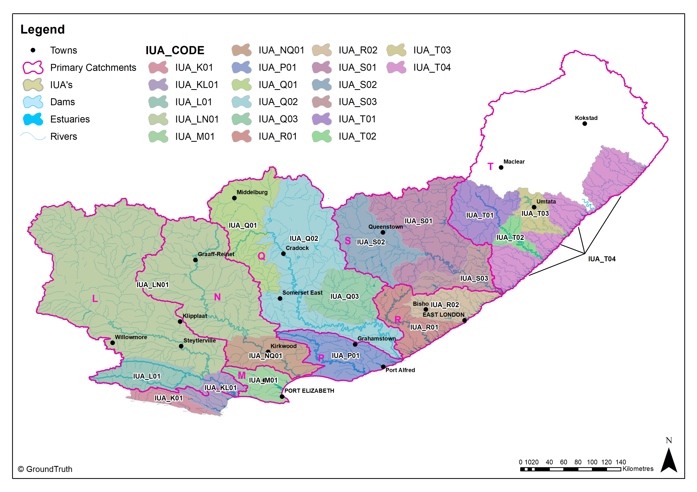
Delineated IUAs (19)

Slide 45
Delineated IUAs (19)
IUA | Description | Main rivers
IUA_K01 | Tsitsikamma and upper Kromme to Kromme Dam | Tsitsikamma, upper Kromme
IUA_KL01 | Kromme from Kromme Dam to estuary and Gamtoos | Kromme, Gamtoos
IUA_L01 | Kouga to Kouga Dam, Baviaanskloof | Kouga, Baviaanskloof
IUA_M01 | M primary catchment | Swartkops, Coega
IUA_LN01 | Groot to Kouga confluence, Upper Sundays to Darlington Dam | Sout, Kariega, Groot, Upper Sundays
IUA_N01 | Sundays downstream Darlington Dam | Lower Sundays
IUA_P01 | P primary catchment | Boesmans, Kowie, Kariega
IUA_Q01 | Fish | Little Brak, Upper Great Fish, Upper Little Fish
IUA_Q02 | Great Fish | Great Fish, Tarka, Baviaans, Lower Little Fish
IUA_Q03 | Koonap and Kat | Koonap, Kat
IUA_R01 | Keiskamma | Keiskamma, Tylomnqa
IUA_R02 | Buffalo/ Nahoon | Baffalo, Nahoon, Kwelera, Gqunube
IUA_S01 | Upper Great Kei | Indwe, White Kei, Tsomo, Great Kei
IUA_S02 | Black Kei | Klipplaat, Klaas Smits, Black Kei
IUA_S03 | Lower Great Kei | Kubusi, Great Kei
IUA_T01 | Upper Mbashe, Upper Mthatha | Xuka, Mgwali, Upper Mbashe, Upper Mthatha
IUA_T02 | Lower Mbashe | Lower Mbashe
IUA_T03 | Lower Mthatha | Lower Mthatha
IUA_T04 | Pondoland coastal | Mtentu, Msikaba, Mngazi, Mtakatye, Xora, Nqabara, Qhorha

Slide 46
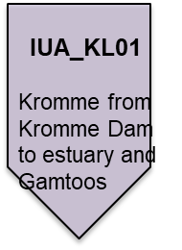
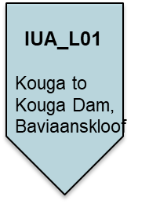

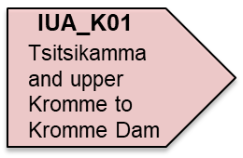
Delineated IUAs: IUA_K01, KL01, L01
  SWSA
  Mpofu Dam (lower Krom River) – major irrigation and transfers to Gqeberha
  Water quality impacts (irrigation)
  Wetlands: Some FEPA wetlands, CVB, depressions, hillslope seeps, PES D-F, floodplains 100% A/B
  GW: moderately stressed (57% irrigation, 26% municipal)
  Estuaries: Vulnerable. Kromme/ Gamtoos largest estuarine systems (open mouth). High pressure on Kromme and Seekoei (flow and quality impacts
  SWSA
  Kouga and Haarlem Dams – irrigation and domestic
  Water quality impacts (irrigation)
  Wetlands: No FEPA wetlands, CVB, Depression, UVB all mostly with a PES A/B
  GW: mildly stressed
  SWSA
  Kromriver Dam – major irrigation and transfers to Gqeberha
  Water quality impacts (WWTW, irrigation)
  Wetlands: 44% of CVB, PES D-F
  GW: moderately to highly stressed (78% use for irrigation)
  Estuaries: Localised flow and quality impacts

Slide 47
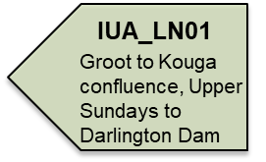
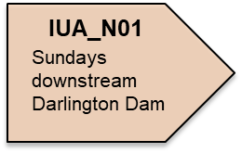
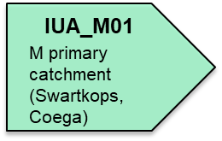
Delineated IUAs: IUA_LN01, M01, NQ01
  SWSA
  Fish corridor (Buffels, Kariega)
  NB biodiversity areas
  Darlington Dam – high irrigation
  Water quality fairly good – poor
  Wetlands: some FEPA wetlands, largely CVB. Depression, Hillslope seep, UVB and wetland flats largely categorised as A/B
  GW driven: mildly – moderately stressed (65% irrigation, 31% domestic)
  IUA_M01
  M primary catchment (Swartkops, Coega)
  SWSA
  Sensitive catchments/ conservation importance
  Water quality impacts on Sundays River (releases from Darlington Dam, extensive irrigation, WWTW)
  Wetlands: 6 FEPA wetlands (depressions – endangered status). CVB, depression, UVB and wetland flats categorised mostly at A/B
  Estuaries: vulnerable, moderate pressure (mainly quality)
  SWSA
  Part of WSS – therefore very high domestic water use
  Poor water quality (WWTW or salt pans)
  Wetlands: some FEPA wetlands (depressions), rest of wetlands categorized with a PES D-F
  GW: mildly stressed (51% irrigation, 41% domestic/industrial use)
  Estuaries: LC – vulnerable. High pressure on Baakens, Papkuils, Coega (flow, quality and habitat loss)

Slide 48
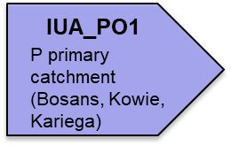
Delineated IUAs: IUA_P01
  IUA_P01
  SWSA
  NB conservation areas
  Various small dams throughout (irrigation, domestic)
  Poor water quality (WWTW)
  Wetlands: Some FEPA wetlands (depressions), CVB, depression, floodplain wetlands mostly categorized as A/B
  GW: low stress. 70% municipal, 15% irrigation (fairly good quality)
  Estuaries: LC – vulnerable, low-moderate pressure (flow, habitat loss and fishing/exotics)

Slide 49
Delineated IUAs: IUA_Q01, Q02, Q03
  IUA_Q01
  Water use mostly for irrigation and domestic
  Limited data on water quality, but what is available indicates poor
  Wetlands: a number of FEPA wetlands, CVB, depression and hillslope seeps mostly categorised as A/B, UVB D-F mostly UVB, PES D-F
  GW: highly stressed with 57% irrigation and 30% domestic
  IUA_Q02
  IUA_PO1
  Highly utilized/ stressed catchments
  Transfer scheme: Gariep Dam - Great Fish and lower Little Fish Rivers
  NB conservation areas
  Wetlands: FEPA wetlands (depressions – endangered threat status), CVB, depression, floodplain wetlands, hillslope seeks and UVB mostly categorised as A/B GW: stressed due to extensive irrigation and those areas not linked to the transfer schemes
  Estuaries: vulnerable, moderate pressure (fish - high exotics, fishing efforts, quality)
  P primary catchment (Bosans, Kowie, Kariega)
  IUA_Q03
  Local sources for irrigation down the entire Koonap and Kat Rivers
  Wetlands: FEPA wetlands (depressions/hillslope seep – endangered threat status), CVB, hillslope seeps mostly PES D-F, depression wetlands – A/B, UVB – PES C
  GW: no stressed areas, limited use

Slide 50
Delineated IUAs: IUA_R01, R02
  IUA_R02
  Stressed catchments
  Water transfers from Wiggleswade Dam
  (Kei River) -Amathola system
  SWSA
  Various dams on Buffalo and Nahoon Rivers (water supply to EL for domestic/ irrigation use)
  Water quality impacts (large urban/industrial areas)
  Wetlands: Wetlands: FEPA wetlands (depressions – endangered), CVB, depression and floodplains mostly PES A/B, hillslope seeps and UVB mostly PES D-F
  GW: mildly stressed areas although limited use
  Estuaries: LC – vulnerable, mostly low pressure except Buffalo, Blind, Hlaze which have high pressures (flow, quality and exotic fish – Buffalo)
  IUA_R01
  SWSA
  Various small dams (irrigation and municipal)
  Forestry in upper reaches of IUA
  Wetlands: Wetlands: FEPA wetlands (hillslope seep – importance for their intactness), UVB, CVB, floodplains, hillslope seeps, depressions, mostly PES D-F
  GW: no stressed areas, use is limited
  Estuaries: LC to vulnerable, low pressure, although high fishing effort on Keiskamma

Slide 51
Delineated IUAs: IUA_S01, S02, S03
  IUA_S01
  SWSA
  Highly rural
  Various small dams (mostly domestic and some irrigation)
  High alien vegetation
  Hydropower associated with the Ncora Dam
  Water transfers –upper Mbashe River
  Quality impacts (WWTW)
  Forestry in upper reaches of IUA
  Wetlands: some FEPA wetlands (depressions, C/UVB in the Groot-Rei River catchment.
  GW: no stressed areas, domestic/rural use
  IUA_S02
  SWSA
  Various small dams (irrigation and domestic)
  Forestry in upper reaches of IUA
  Wetlands: various FEPA wetlands due to crane breeding/feeding sites, CVB and depressions mostly PES A/B, floodplain D-F and UVB mostly A-C
  GW: low to moderately stressed, limited use, but some areas stressed where there is use
  IUA_S03
  SWSA
  Various large dams (mostly irrigation and some domestic)
  Forestry and alien vegetation
  Transfers from Wriggleswade Dam to the Buffalo River in IUA_R02
  Wetlands: FEPA wetlands (depression or hillslope seeps) – endangered threat status
  GW: moderately stressed although limited use
  Estuaries: Vulnerable and important systems - only large fluvially and permanently open moth estuary in the water temperate bioregion. Great Kei, moderate pressures (flow, fish – exotics and fishing effort)

Slide 52
Delineated IUAs: IUA_T01, T02, T03, T04
  IUA_T03
  The most developed IUA in T catchment
  Mthatha Dam with hydropower releases resulting in artificial flows
  Quality/ quantity concerns
  Wetlands: FEPA wetlands (C/UVB) located within IBA and endangered threat status
  GW: moderately stressed, but limited use
  Estuaries: Endangered, moderate pressures (quality, fish – fishing effort and high exotics)
  IUA_T01
  Fish corridor
  Mabeleni Dam
  Water use largely for forestry (58%) with some domestic and irrigation use
  Wetlands: FEPA wetlands (crane breeding/feeding sites located in key water supply areas in this catchment).
  GW: moderate to highly stress but with limited use
  IUA_T02
  IUA_T04
  SWSA
  Transfers from Ncora Dam (Kei system)
  Hydropower scheme at Colly Wobbles in the Mbashe River
  Water use mainly forestry (28%) and domestic (39%)
  Wetlands: FEPA wetlands (depressions) – endangered threat status
  GW: mildly stressed, limited use
  Estuaries: Endangered - Low pressures
  SWSA
  Flagship free-flowing rivers
  Wetlands: depressions, PES D-F
  GW: limited use
  Estuaries: Various sensitive estuaries categorized as endangered

Slide 53
Next steps…
Resource Units and prioritization of all components
    Nested in an IUA
    Linear stretches of rivers which require different EWRs (due to different flow patterns, reaction of habitat and biota to stress, management and operational structures)
    Can also be priority wetland areas / dams / estuaries / important GW systems
    RQOs to be set per priority RU
Resource Units Report
Preparation for in-field verification/field surveys:
    Wetlands: August 2022
    Groundwater: July 2022
    Rivers & Estuaries: September 2022
    Request from stakeholders for access to properties where survey sites are located

Slide 54
Next steps…
    Rivers & Estuaries:
      Eco-classification
      Ecological Water Requirements quantification
    Wetland Reserve Report, including assessment and condition
    Groundwater Reserve Report, including assessment, quantification and requirements
    Scenarios: Socio-Ecological consequences and trade-offs
    Socio-economics assessments
    Determine Water Resource Classes / IUA
    Determinate RQOs / RU
    Public meeting round 2… ~2024

Slide 55
    Professional Service Provider:
    Stakeholder Engagement Specialist
    Ms Fonda Lewis
    082 707 4061
    Stakeholder.fish@groundtruth.co.za
    Project Director
    Dr Mark Graham
    mark@groundtruth.co.za
    Project Manager
    Mrs Kylie Farrell
    083 686 4212
    Kylie.farrell9@gmail.com
    Department of Water and Sanitation:
    Project Manager
    Mr Lawrence Mulangaphuma
    083 496 1916 / 012 336 8956
    mulangaphumaL@dws.gov.za
    Scientific Manager
    Ms Rendani Mudzanani
    012 336 8934
    MudzananiR@dws.gov.za
THANK-YOU
Notes:
ranking of the priorities is from 1 (highest ranking) to 3 (lowest ranking).

