Slide 1
LETABA RIVER CLASSIFICATION-
GROUNDWATER RQOs
Presented by:
K. Sami
WSM Leshika Consulting Engineers
April 2014

Slide 2
Determining RQOs for Groundwater
Assess groundwater use applied high resolution validation information
Detail assessment of groundwater resources and contribution to baseflow – fully account for groundwater-surface interaction
Express groundwater use relative to resources and impacts on baseflow
Express in terms of Present status and water resource category
Determine additional available groundwater resources with respect to the EWR per catchment and per scenario.
Develop the RQOs

Slide 3
Process
Irrigation use
Stress index
Caclulate present status
Domestic use
Impact on baseflow
Other uses
WRSM2000 monthly model
recharge
Impacts
Climate data
Natural + Present baseflow
Input data
Calibration vs
Recharge data
Gauging weirs
dams
Groundwater cycle
Consequences
EWR requirement from scenarios
Groundwater quality
Borehole yields
Allocatable groundwater
Develop RQO

Slide 4
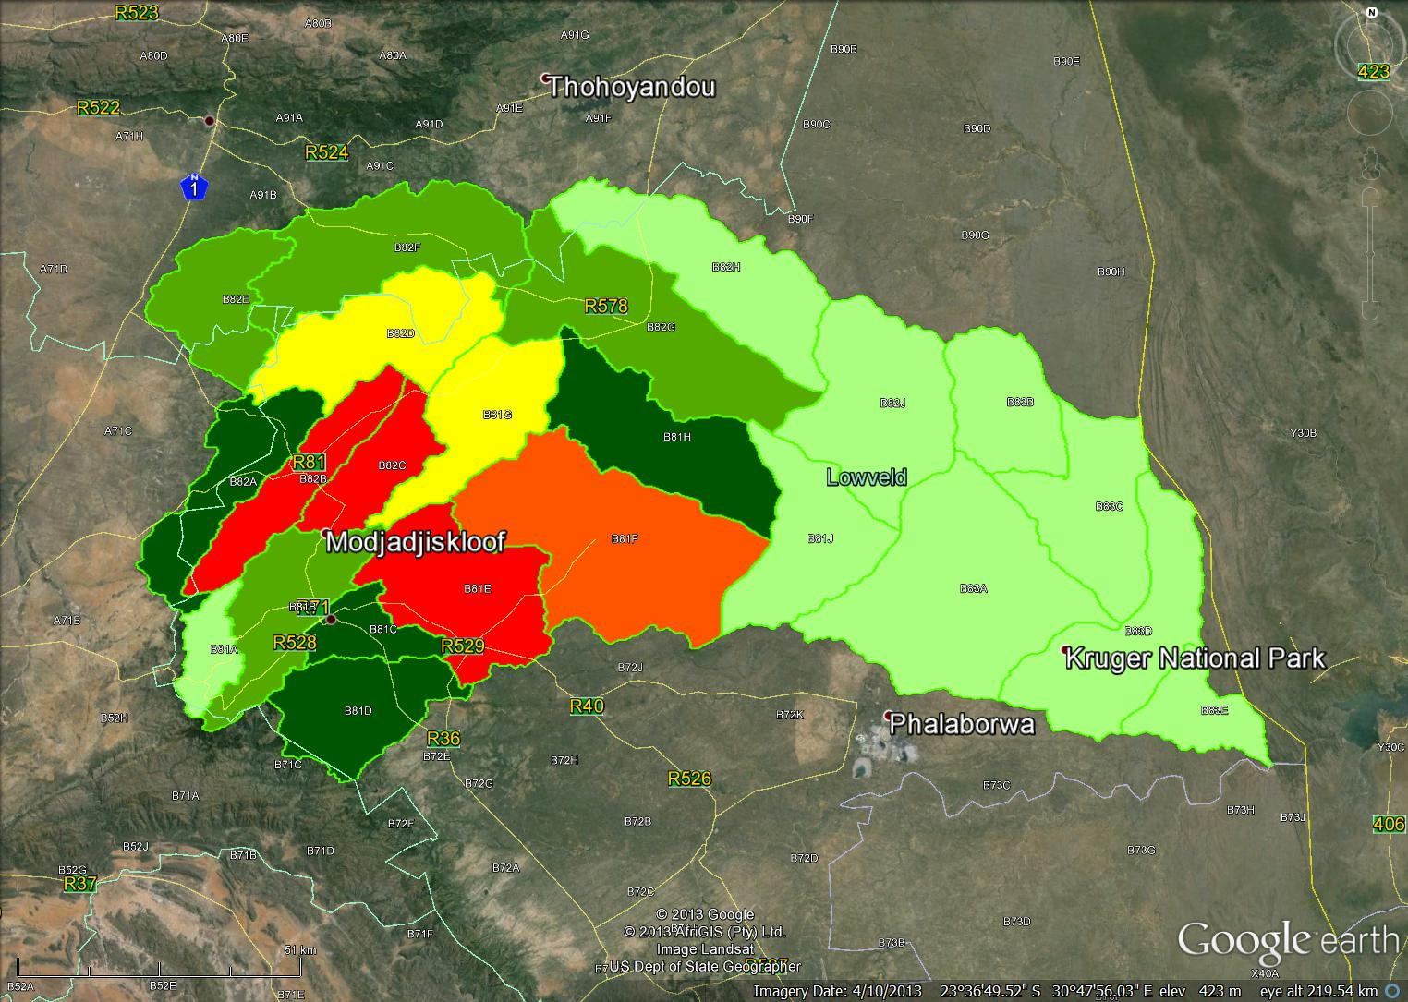
Demand - Aquifer Recharge & Harvest Potential
How much groundwater is still available?
Use/ Aquifer recharge
>95% Critically modified
>65% Seriously modified
>40% Largely modified
>20% Moderately modified
>5% Largely natural
<5% Unmodified
10.62
8.31
4.94
10.41
5.59
1.72
6.42
3.51
4.44
-6.25
5.35
-13.81
6.46
4.74
5.40
-14.51
12.08
1.93
6.64
2.57
-0.81
3.69
2.48

Slide 5
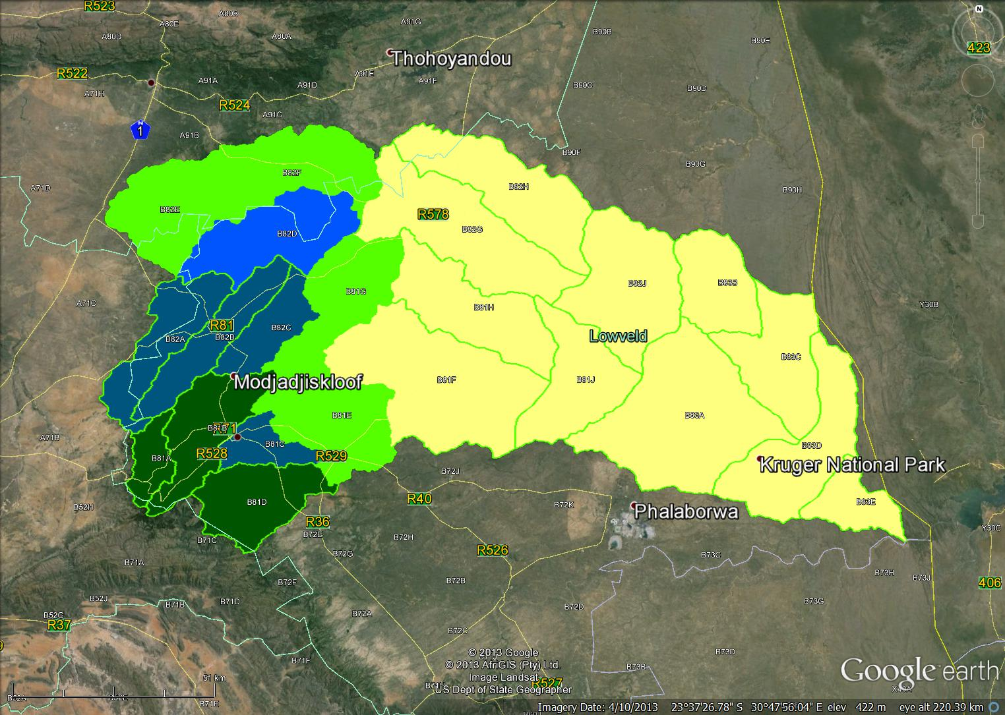
Water Balance – What happens to recharge?
How will abstraction affect baseflow?
Interflow Dominant – Impact low
Interflow and groundwater baseflow - moderate
Groundwater baseflow dominant – Impact high
Evapotranspiration dominant – Impact low
Evapotranspiration – no impact

Slide 6
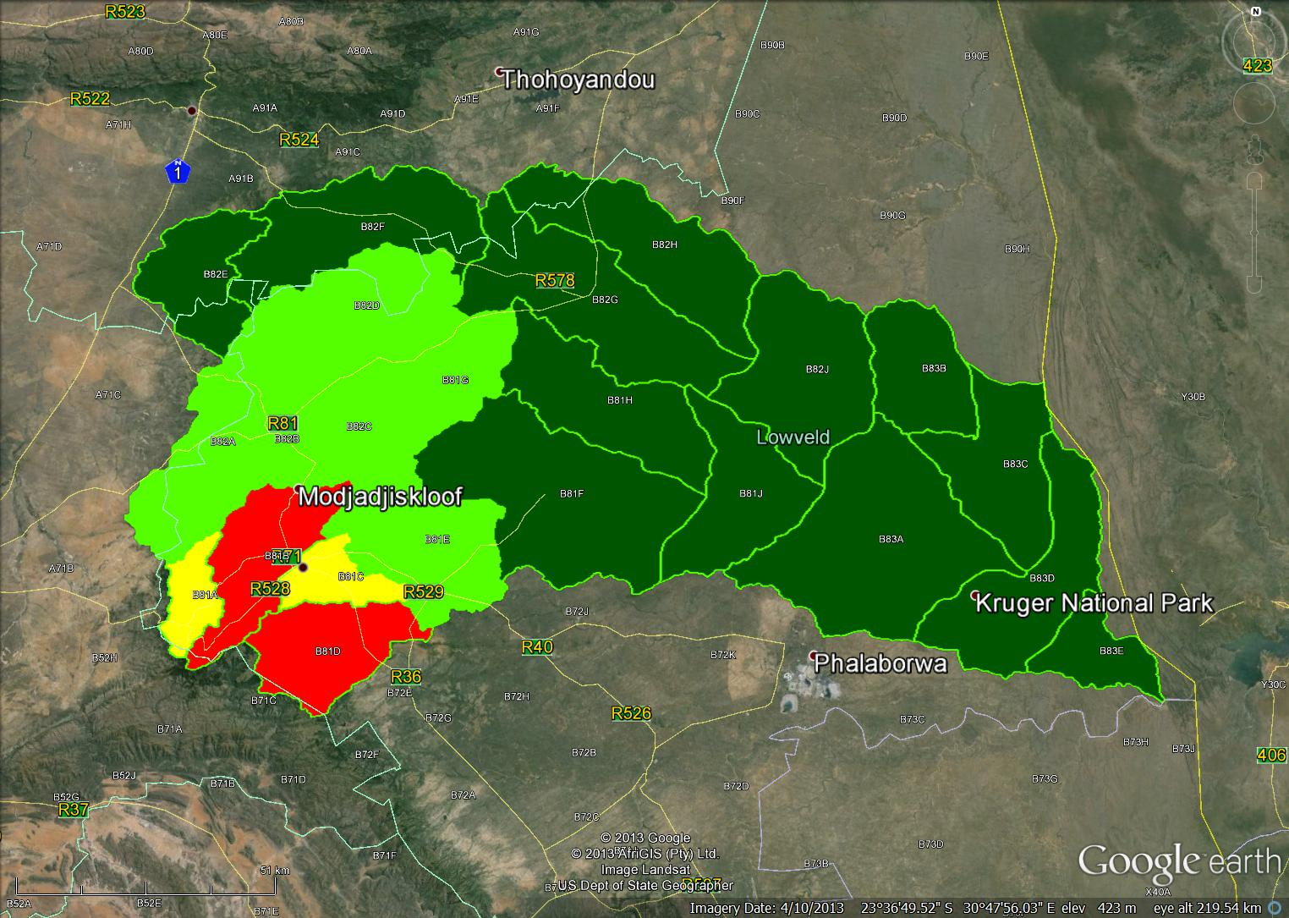
Baseflow Generation
Total = 273.79 Mm3/a
<1%
1-5%
5-20%
>20%
Where does baseflow originate?

Slide 7
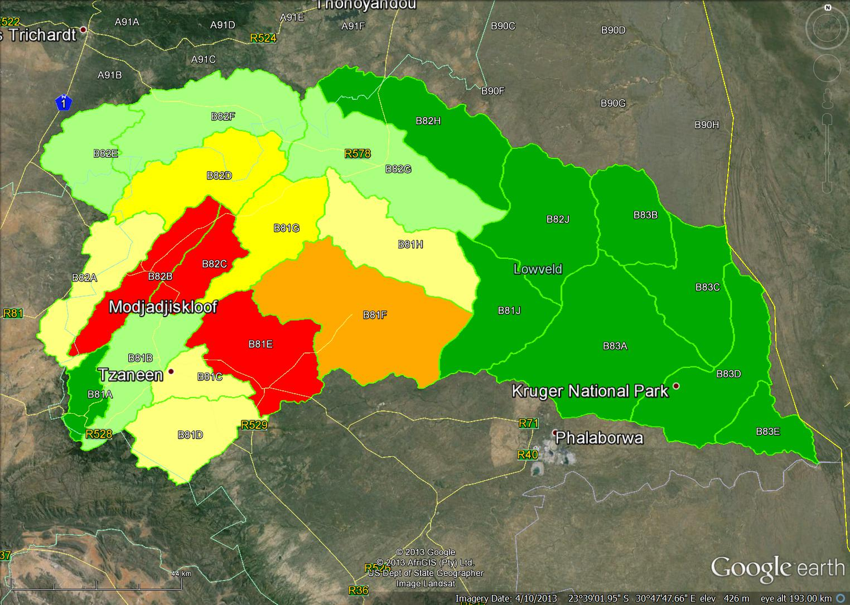
Groundwater – Present state and recommended
Use/aquifer recharge
A <5% largely unmodified
B 5-20% largely natural
C
C 20-20% largely modified
D
B
E
D
B
D
E
D
D
C
B
D
D
D
C
D
C
C
B
D 40-65% largely modified
D
E 60-95% Seriously modified
F >95% critically modied
D Scenario 10

Slide 8
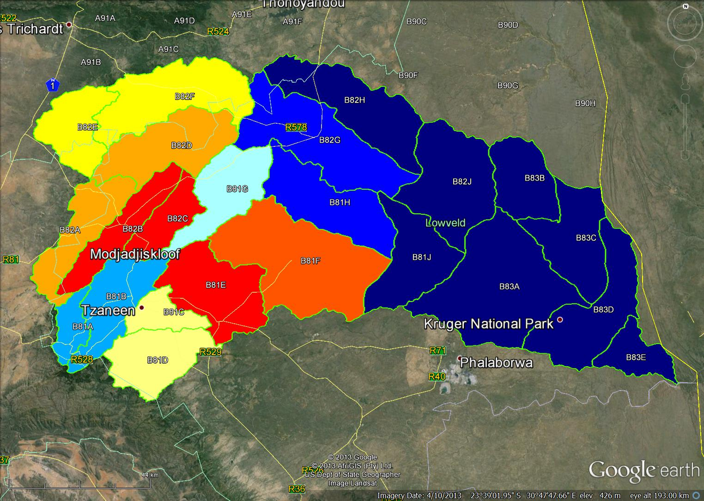
Groundwater – RQOs
Stress Index
Groundwater contribution to baseflow
Baseflow contribution to MAR

Slide 9
Narrative Groundwater – RQOs
 | River | RQO
 | Letaba lower Gr + klein Letaba Nsama | Groundwater is underutilised and can be utilised up to the Harvest Potential with little to no impact on baseflow
 | Klein letaba Molototsi | Groundwater use is low and can be utilised up to the Harvest Potential with little to no impact on baseflow
 | Molototsi | Groundwater is moderately utilised. Abstraction can be increased up to the Harvest Potential with little or limited impact on baseflow.
 | Gr letaba | Groundwater is underutilised. Abstraction impacts signifcantly on baseflow and this region is one of the most significant sources of baseflow in the Letaba system. Hence further investigations as to the impact of abstraction are required before any significant increase takes place.
 | Gr letaba Letsitele | Groundwater is moderately to heavily utilised. Abstraction impacts signifcantly on baseflow and this region is one of the most significant sources of baseflow in the Letaba system. Further investigations as to the impact of abstraction are required before any additional abstraction takes place.
 | Klein letaba | Groundwater is underutilised. Abstraction impacts signifcantly on baseflow locally as the region is not a significant source of baseflow to the letaba system. Abstraction can be increased depending on low flow requirements in the klein letaba

Slide 10
Narrative Groundwater – RQOs
 | River | RQO
 | Middle letaba | Groundwater is moderately utilised. Abstraction impacts signifcantly on baseflow locally and on inflows into the middle letaba dam. Increases in abstraction should consider the impacts on the yield of the middle letaba dam.
 | Groot letaba | Groundwater is significantly utilised. Abstraction can be marginally increased up to the Harvest Potential with little to no impact on baseflow
 | Koedoes Brandboontjies | Groundwater is over exploited and has resulted in significant reduction in inflows into the Middle letaba dam. No further groundwater abstraction should be permitted.
 | Groot letaba | Groundwater is over exploited and has resulted in significant baseflow depletion from the catchment. No further groundwater abstraction should be permitted.

