Slide 1
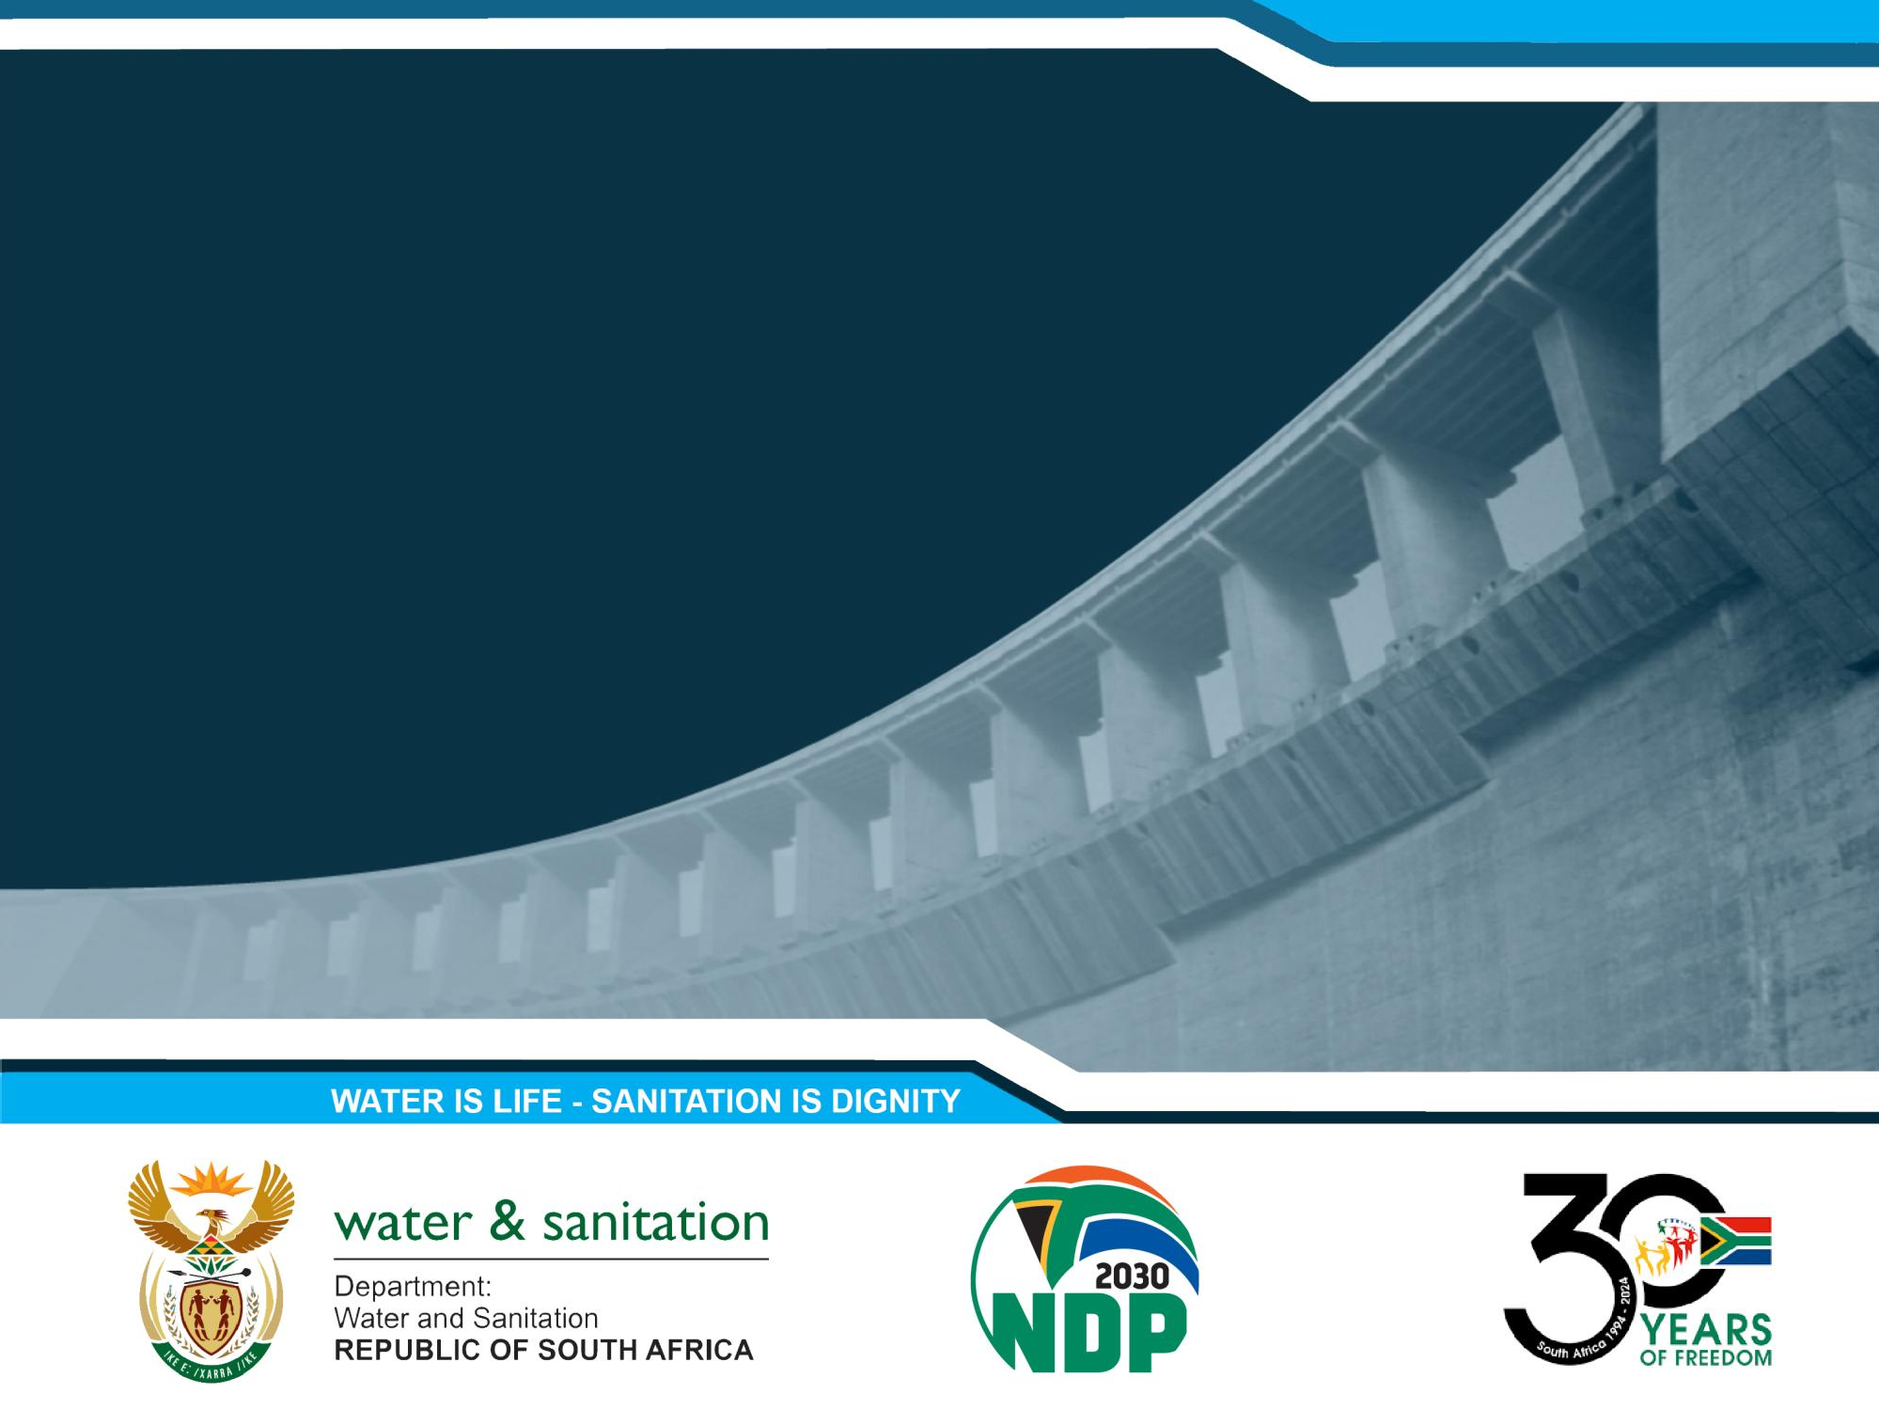
REFINEMENT OF STRATEGIC GROUNDWATER SOURCE AREAS OF SOUTH AFRICA
Project Steering Committee Meeting 03
Presented by:
Date:
Umvoto
16 July 2025

Slide 2


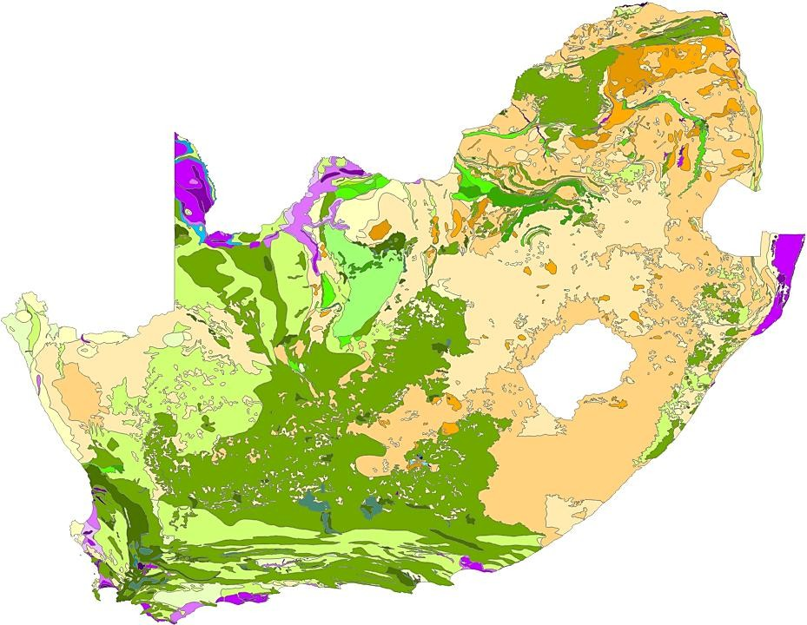
PRESENTATION OUTLINE
Umvoto South Africa (Pty) Ltd
Quick Recap
  Project Objectives
  Project Status
Status Quo Report
  Summary of Status Quo Report
  Example of selected SWSA-gw
Refined Methodology Report
  Unpacking SWSA-gw 2018 Methodology
  Refined Methodology
    Definitions & International Perspective
    Spatial Framework
    Evaluation Framework
Discussion

Slide 3

PROJECT OVERVIEW
REFINEMENT OF STRATEGIC GROUNDWATER SOURCE AREAS OF SOUTH AFRICA
Initiation
Initiated by:
PSP:
DWS Chief Directorate: Water Ecosystems Management (CD: WEM). Umvoto South Africa (Pty) Ltd.
Project Focus
Focus:
Goal:
Refine South Africa's Strategic Groundwater Source Areas (SWSA-gw) Improve the spatial accuracy SWSA-gw for South Africa and refine delineations to be aquifer-specific.
Guide management and protective measures.
Purpose:
Implementation
Approach:
Framework:
To facilitate collaboration among government and non-government stakeholders.
Integrated Water Resource Management (IWRM) as per the National Water Act (NWA; Act No. 36 of 1998) and National Water Recourse Strategy III (NWRS III, 2023).

Slide 4
PROJECT PHASES & PROGRESS TO DATE
REFINEMENT OF STRATEGIC GROUNDWATER SOURCE AREAS OF SOUTH AFRICA
Phase 0: Project Management, Administration, Communication and Capacity Building |  |  | Progress
P0 | P0.1 General Project Management |  | ONGOING
 | P0.2 PMC Meetings
 | P0.3 PSC Meetings
 | P0.4 PS Meetings
 | P0.5 Ad Hoc Meetings
 | P0.6 Monthly Progress Reports
 | P0.7 Capacity Building
Phase 1: Project Inception
P1 | D1.1: Inception Report | T1.1.1: Lit Review | COMPLETE
Phase 2: Information and Data Gathering
P2 | D2.1: Gap Analysis Report | T2.1.1: Data and Information Assessment T2.2.1: Inventory of Water Resource Tools | COMPLETE
Phase 3: Refinement of SWSA-gw
P3 | D3.1: Status Quo SWSA-gw Report | T3.1.1: Status Quo SWSA-gw Assessment | COMPLETE
 | D3.2: Refined Methodology Report | T3.2.1: Refined Methodology Assessment | IN PROGRESS
 | D3.3: Delineation of Refined SWSA-gw Report | T3.3.1: Delineation of Refined SWSA-gw T3.3.2: Groundwater Quality T3.3.3: Transboundary Aquifers T3.3.4: Updated Status Quo of SWSA-gw | NOT STARTED
 | D3.4: SWSA-gw Protection and Management Report | T3.4.1: SWSA-gw Protection and Management | NOT STARTED
Phase 4: Project Closure
P4 | D4.1: Refined SWSA-gw of South Africa Report | T4.1.1: Report Integration | NOT STARTED
 | D4.2: External Review Summary Report |  | NOT STARTED
 | D4.3: Electronic Database |  | NOT STARTED
 | D4.4: Close Out Report |  | NOT STARTED

Slide 5
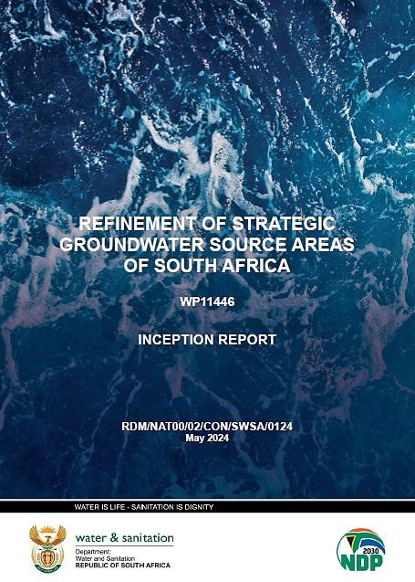
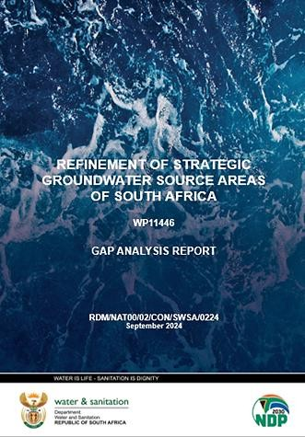
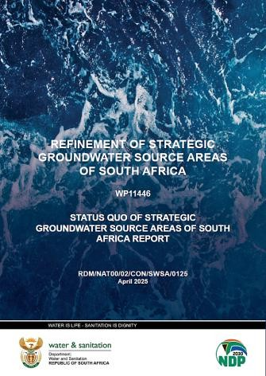
COMPLETED DELIVERABLES
REFINEMENT OF STRATEGIC GROUNDWATER SOURCE AREAS OF SOUTH AFRICA
INCEPTION REPORT
Project's scope
Overview of the evolution of SWSA-gw of South Africa
Stakeholder engagement plan
Capacity-building and mentorship program
GAP ANALYSIS REPORT
Existing data catalogue
Gap analysis and Technical feasibility assessment
Recommendations on incorporating new data
Recommendations and strategic prioritization
STATUS QUO REPORT
Motivation and legislative context
Assessment of the current status of the 37 current SWSA-gw
Maps, tables & charts to support findings
https://www.dws.gov.za/wem/currentstudies/default.aspx
5

Slide 6

SUMMARY OF STATUS QUO REPORT
REFINEMENT OF STRATEGIC GROUNDWATER SOURCE AREAS OF SOUTH AFRICA

Slide 7
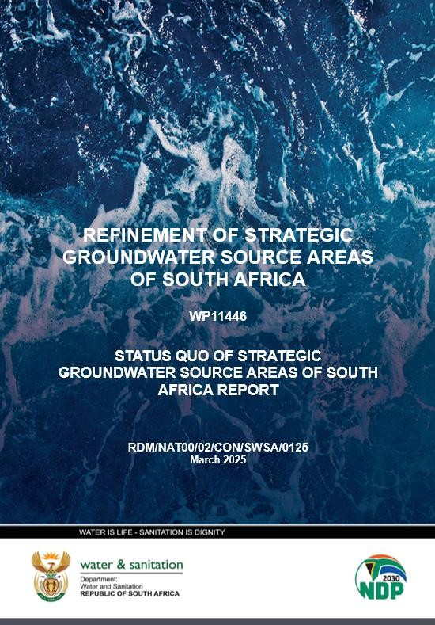
STATUS QUO REPORT
REFINEMENT OF STRATEGIC GROUNDWATER SOURCE AREAS OF SOUTH AFRICA
The primary objective was to establish a comprehensive and updated Status Quo Assessment of the 37 existing SWSA-gw areas delineated by Le Maître et al. (2018).
REPORT STRUCTURE
Motivation & Legislative Context
Role of SWSA-gw in South Africa
Key legislation: NWA (1998) & NWRS III (2023)
Why the SWSA-gw delineations are being refined
Summary of Previous Methodology
Overview of criteria used for SWSA-gw (2018)
Summary of Previous Status Quo for SWSA-gw (2018)
Current Status Assessment
Developing the Assessment Framework
Detailing the methodologies, datasets & analytical techniques
Developing the Current Status Matrix
Status Quo
Evaluation
Findings supported by maps, tables & charts

Slide 8
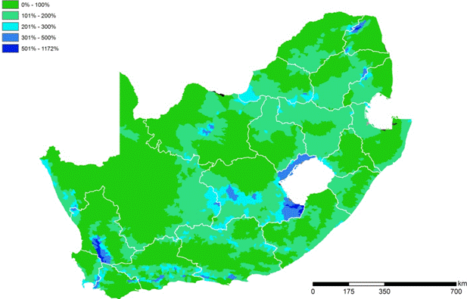
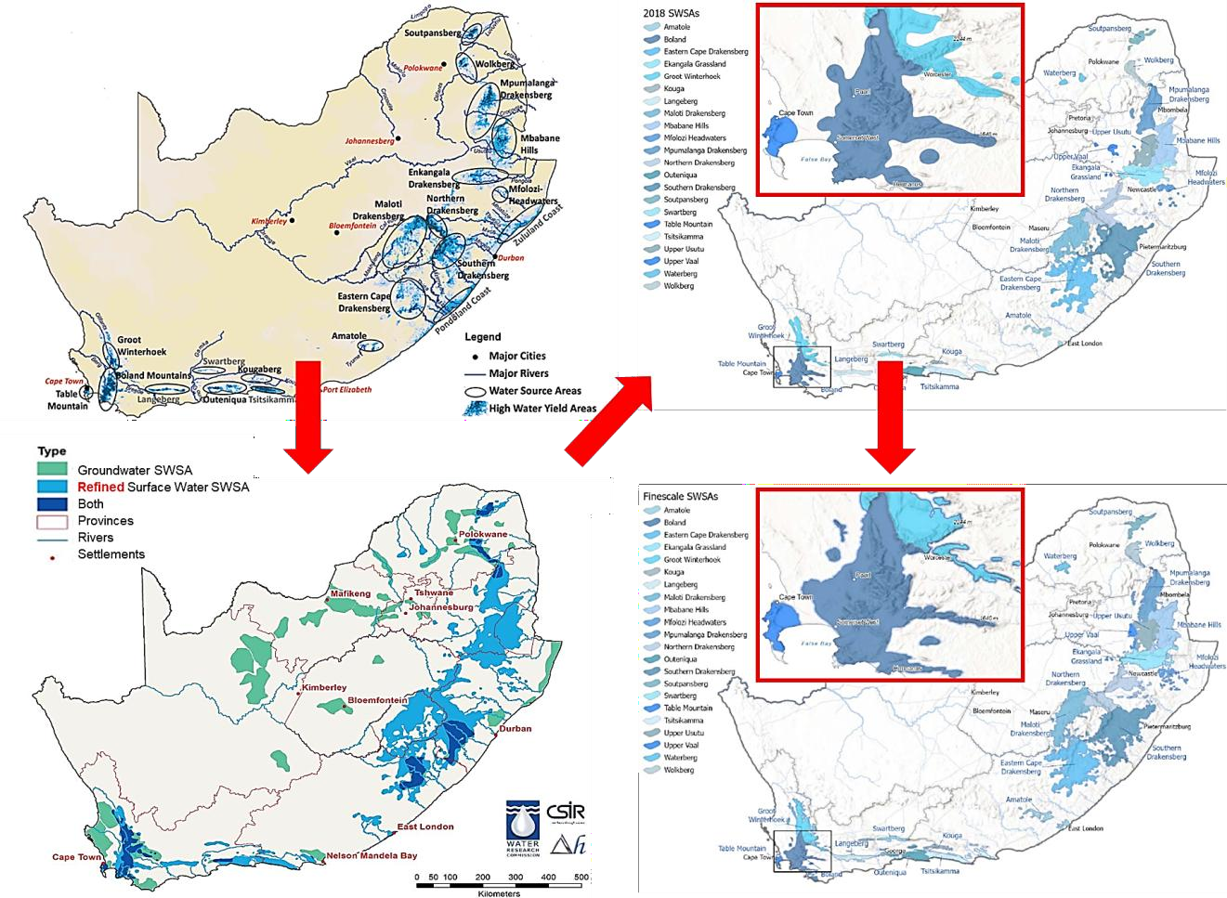



EVOLUTION OF SWSA-GW
REFINEMENT OF STRATEGIC GROUNDWATER SOURCE AREAS OF SOUTH AFRICA
Nel et al., 2011/2013
21 general areas Identified based on sub- quaternary catchment data
Lotter and Le Maître 2021
From “Refined” (2018)
Le Maître et al., 2018
To
“Fine-Scale”
(2021)
National
22 SWSA-sw
37 SWSA-gw
Only done for 22 Surface Water SWSAs
Transboundary
SWSA-sw
  Lesotho
  Eswatini
SWSA-gw
  None

Slide 9
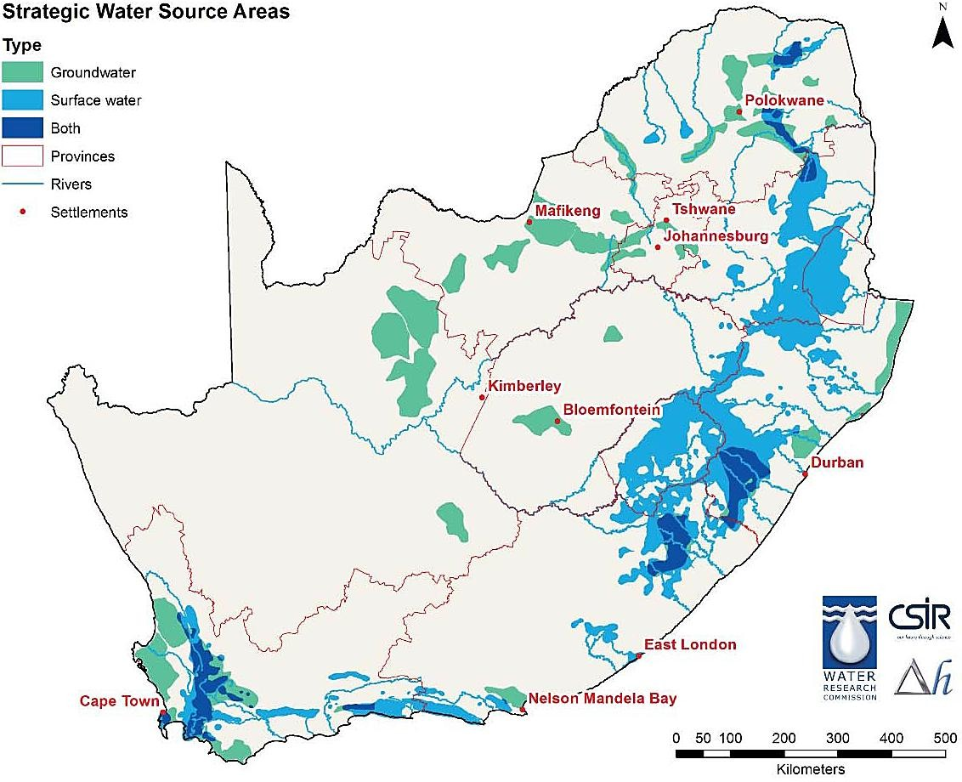
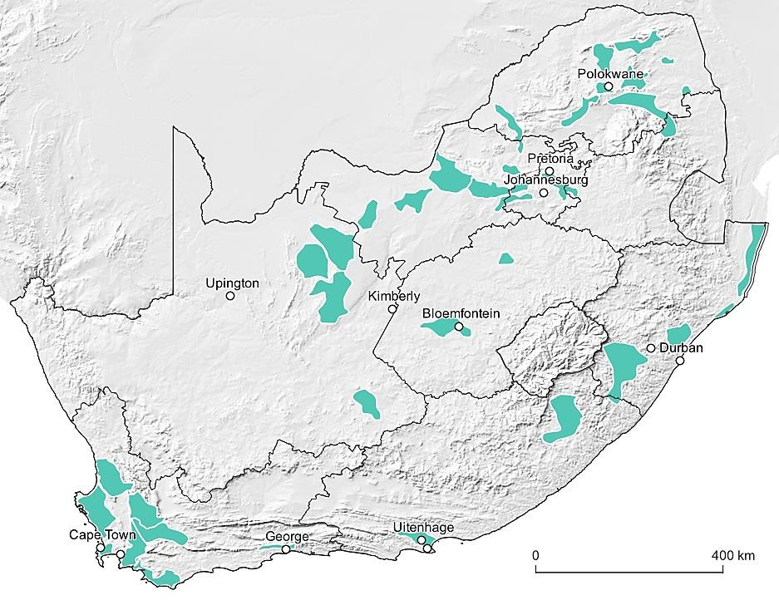
STATUS QUO FOCUS
REFINEMENT OF STRATEGIC GROUNDWATER SOURCE AREAS OF SOUTH AFRICA
The assessment focuses on the 37 existing SWSA-gw areas delineated by Le Maître et al. (2018) and serves as a baseline for the refinement and delineation process
Strategic Water Source Areas for groundwater and surface water as delineated by Le Maître et al. (2018).
The 37 SWSA-gw viewed as a single set of groundwater-focused areas (after Le Maître et al. (2018).

Slide 10
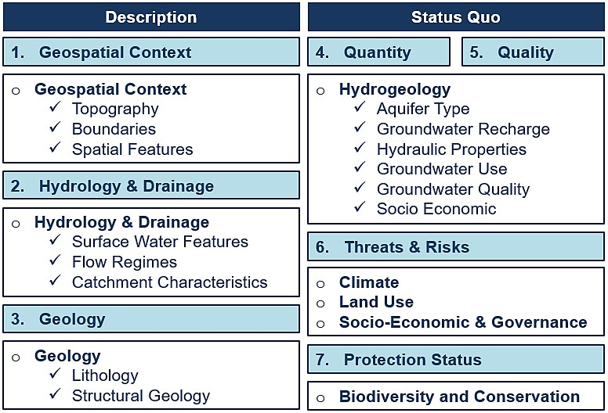
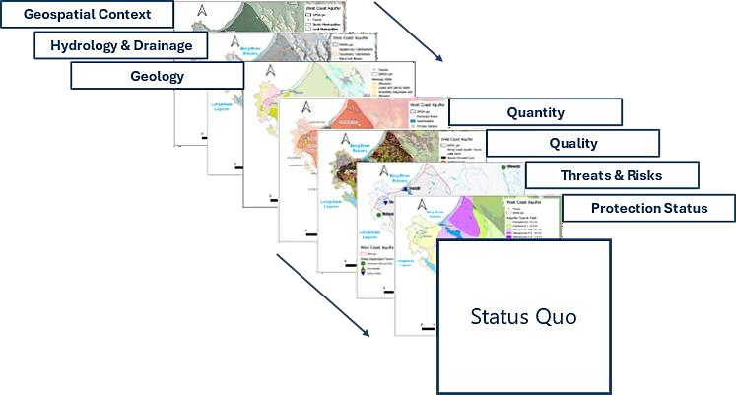
STATUS QUO DEVELOPMENT APPROACH
REFINEMENT OF STRATEGIC GROUNDWATER SOURCE AREAS OF SOUTH AFRICA
This Status Quo assessment focused on two key components to facilitates a side-by-side comparison of different SWSA-gw:
1) Description: Establishes the geospatial and hydrogeological context of each SWSA-gw, covering the Geospatial Context,
Hydrology, Drainage, and Geology. 2) Current Status: Evaluates the functional conditions of groundwater resources,
including Groundwater Quantity, Groundwater Quality, Threats and Risks, and Protection Status.
Summary of the data categories and components used in the Description and Current Status subsections of the Status Quo assessment framework..
Conceptual illustration of how different components contribute to the development of a Status Quo assessment for each SWSA-gw.

Slide 11
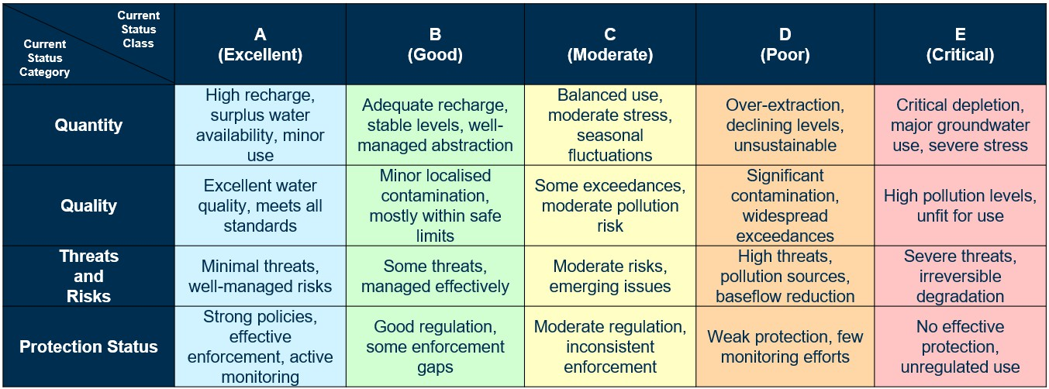
CURRENT STATUS MATRIX
REFINEMENT OF STRATEGIC GROUNDWATER SOURCE AREAS OF SOUTH AFRICA
A Current Status Matrix was developed to systematically assess and compare groundwater conditions within each
SWSA-gw. The matrix integrates key hydrogeological, geospatial, and socio-environmental factors to provide a structured evaluation of groundwater availability and sustainability. It considers the four primary aspects of the Current Status:
(1) Groundwater Quantity, (2) Groundwater Quality, (3) Threats & Risks, and (4) Protection Status.
Current Status Matrix used for assessing the groundwater conditions of each SWSA-gw.
11

Slide 12
METRICS AND CLASS
REFINEMENT OF STRATEGIC GROUNDWATER SOURCE AREAS OF SOUTH AFRICA
Current Status Matrix & associated metrics used for assessing the groundwater conditions of each SWSA-gw.
Current Status Category | Description | Metric | Current Status Class
Groundwater Quantity | Groundwater Use vs Recharge (%) | <10 | A | Excellent
 |  | 10 to 30 | B | Good
 |  | 30 to 60 | C | Moderate
 |  | 60 to 80 | D | Poor
 |  | 80 to 100 | E | Critical
Groundwater Quality | Outliers & Contamination Indicators | Natural / DWQ standard | A | Excellent
 |  | Natural | B | Good
 |  | Pollution Indicators | C | Moderate
 |  | Pollution Trends / Knowledge | D | Poor
 |  | Wide Spread Pollution | E | Critical
Threats and Risks | % Area Land Use of Built-up Areas & Mines/Quarries | Mostly natural | A | Excellent
 |  | Cultivation & Limited Built-Up <10% | B | Good
 |  | Mining >10 km², Built-up >10% | C | Moderate
 |  | Mining >30 km², Built-up >20% | D | Poor
 |  | Mining > 40 km² | E | Critical
 | Climatic Zone, Based on Köppen-Geiger and MAP | Humid | A | Excellent
 |  | Semi-Humid | B | Good
 |  | Moderate | C | Moderate
 |  | Semi-Arid | D | Poor
 |  | Arid | E | Critical
 | Climate Change, based on change in recharge | N/A | A | Excellent
 |  | Increase in Recharge | B | Good
 |  | No to Small Change | C | Moderate
 |  | Decrease in Recharge | D | Poor
 |  | N/A | E | Critical
 | Population Growth, based on annual growth (%) | < 0 | A | Excellent
 |  | 0 to 0.5 | B | Good
 |  | 0.5 to 2 | C | Moderate
 |  | 2 to 4 | D | Poor
 |  | ≥ 4 | E | Critical
Protection Status | Based on % Area Protected | Fully Protected | A | Excellent
 |  | Good Protection & SGWCA | B | Good
 |  | Scattered Protection | C | Moderate
 |  | Limited Protection | D | Poor
 |  | No Protection | E | Critical

Slide 13
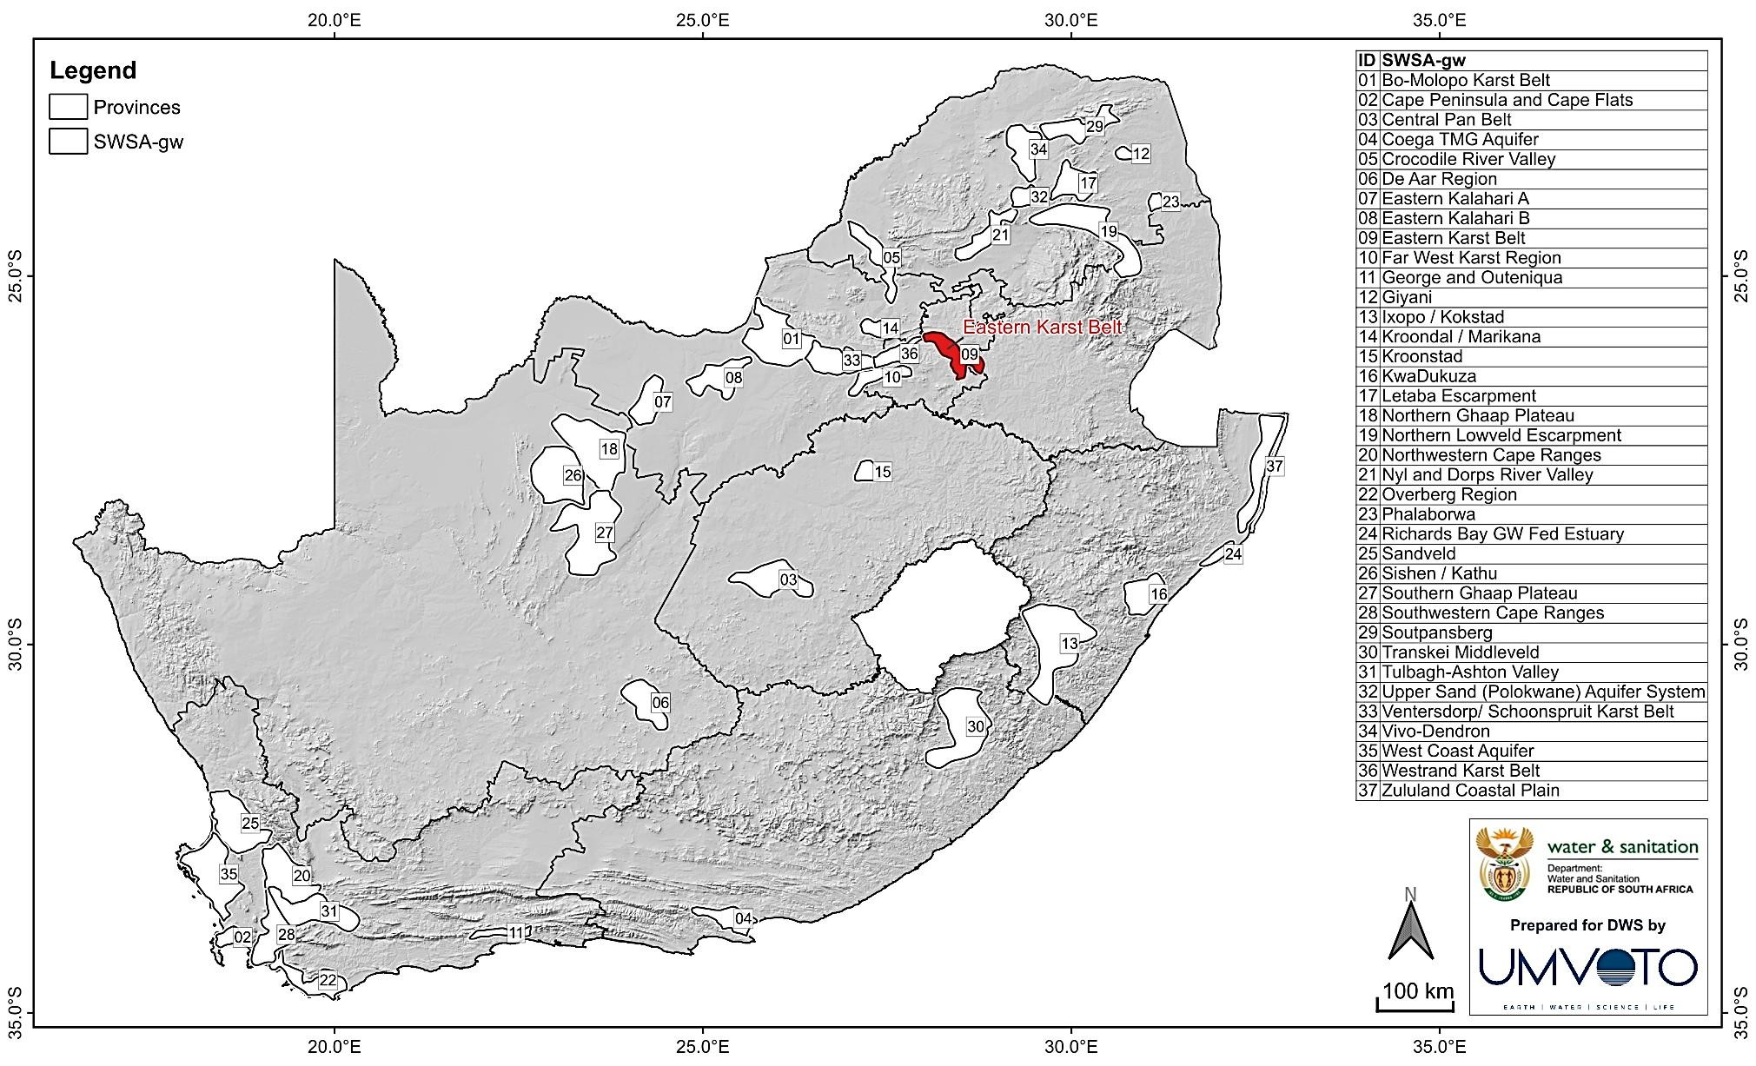
REFINEMENT OF STRATEGIC GROUNDWATER SOURCE AREAS OF SOUTH AFRICA
EXAMPLE
EASTERN KARST BELT

Slide 14

REFINEMENT OF STRATEGIC GROUNDWATER SOURCE AREAS OF SOUTH AFRICA
DESCRIPTION

Slide 15
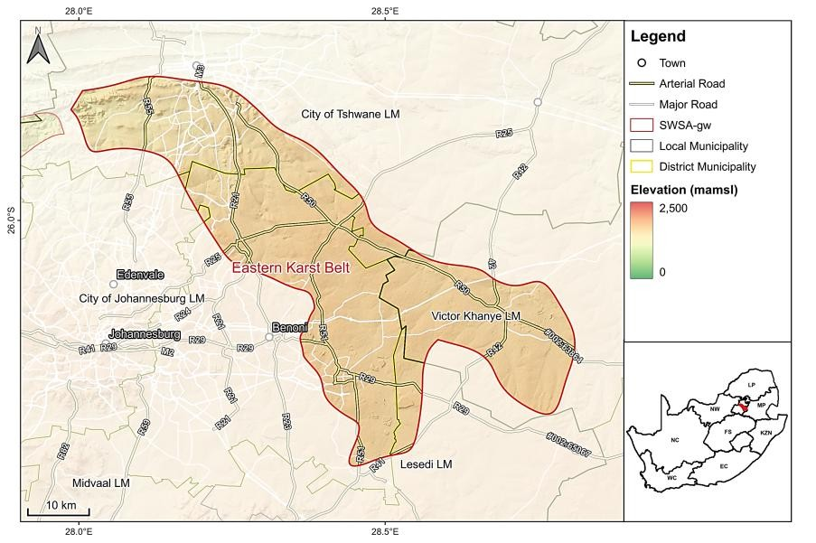
DESCRIPTION
GEOSPATIAL CONTEXT
Topography:
Elevation, slope & landform characteristics from COP 30m DEM (ESA, 2024) – critical for surface water flow & groundwater recharge potential.
Administrative Boundaries:
Provinces, DMs, LMs, & major towns identified (MDB, 2018) – essential for groundwater governance.
Key Infrastructure:
Transport networks (NGI, 2022) & water supply infrastructure (bulk water schemes, pipelines, reservoirs) – vital for groundwater management & utilisation.

Slide 16
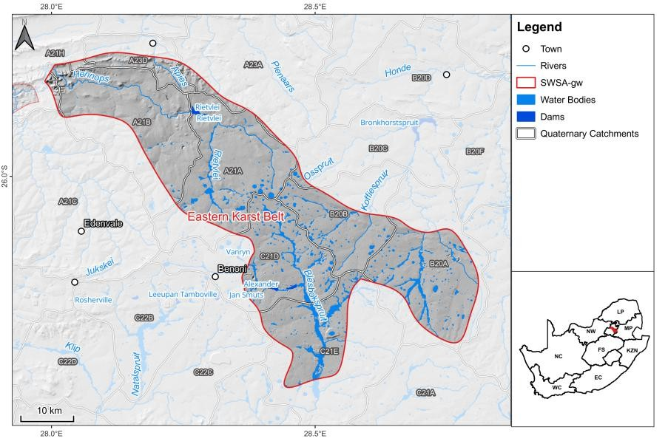
DESCRIPTION
HYDROLOGY & DRAINAGE
River Systems:
Major perennial & non-perennial rivers
from NGI (2018) & NFEPA (2011)
classified by flow regime, source catchments & hydrological significance.
Surface Water Bodies:
Wetlands, lakes, reservoirs & major dams (SANBI, 2018; WRC, 2012) – key
for groundwater recharge, baseflow & regional water balance.
Catchment Classification:
Secondary, tertiary & quaternary catchments (WRC, 2012) – influence drainage patterns & groundwater recharge.
Water Management Areas (WMA):
Defined by DWS (2023a) to link groundwater systems to hydrological governance structures.

Slide 17
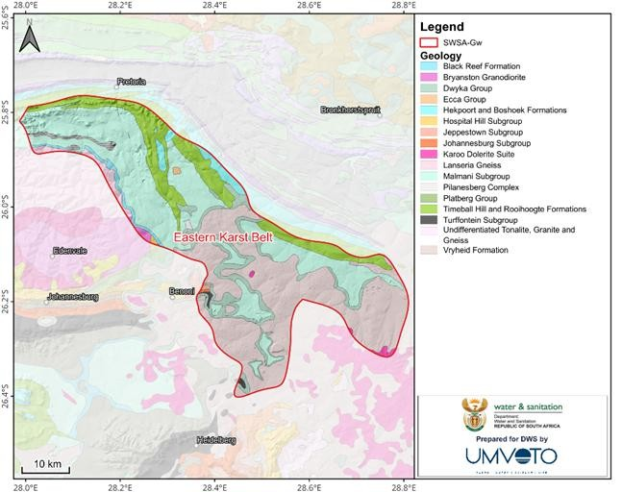
DESCRIPTION
GEOLOGY
Geological Mapping:
Lithological units & geological formations from CGS 1:250,000 dataset & Johnson et al. (2006) – key for groundwater occurrence & hydrostratigraphy.
Structural Features:
Faults, folds & fractures (Johnson et al., 2006) – critical for aquifer properties, groundwater flow & recharge potential.
Hydrostratigraphy:
Geological formations classified by groundwater-bearing properties (Johnson et al., 2006) – supports aquifer characterization & regional water supply assessments.

Slide 18
REFINEMENT OF STRATEGIC GROUNDWATER SOURCE AREAS OF SOUTH AFRICA
CURRENT STATUS
18

Slide 19
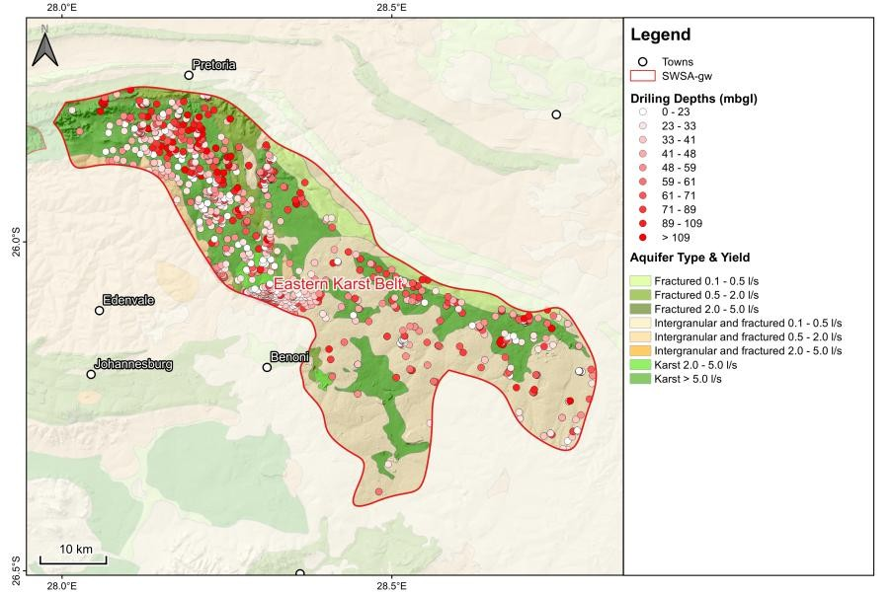
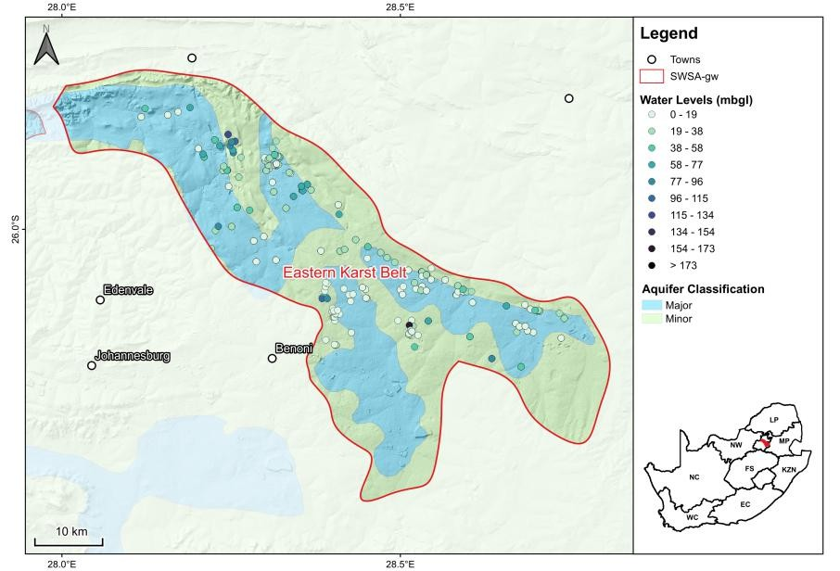
CURRENT STATUS
QUANTITY
Aquifer Classification
Aquifer Class & Type:
Based on DWS 1:500k Hydrogeological Map series (DWS, 2012) – includes Aquifer Type (fractured, intergranular, karst), Aquifer Class (minor, major, sole- source), & Aquifer Yield (L/s or m³/day) (DWS, n.d.).
Groundwater Targets:
Derived from NGA (Feb 2025) – assessed long-term water level trends & borehole depths (25-year dataset) to evaluate groundwater availability & accessibility. Percentile distributions defined primary & secondary groundwater targets, while statistical analysis provided insights into regional fluctuations & long-term trends.

Slide 20
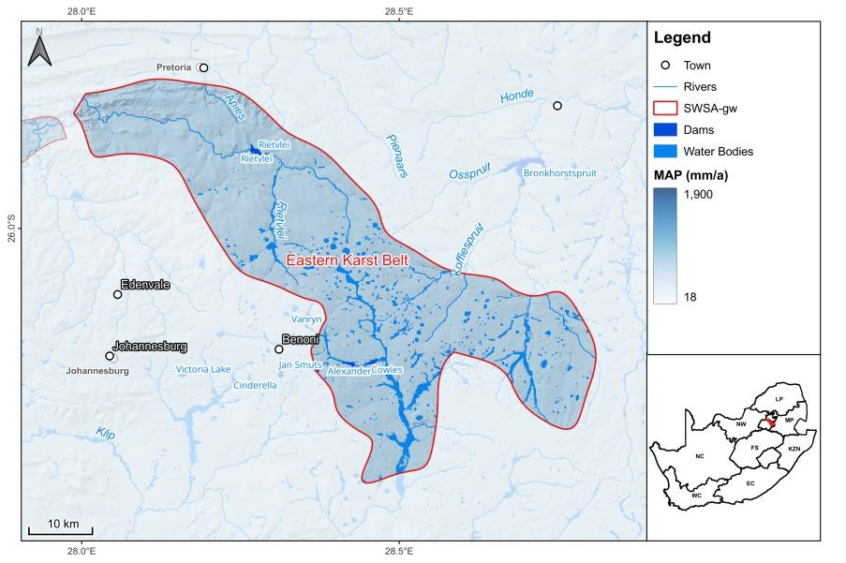
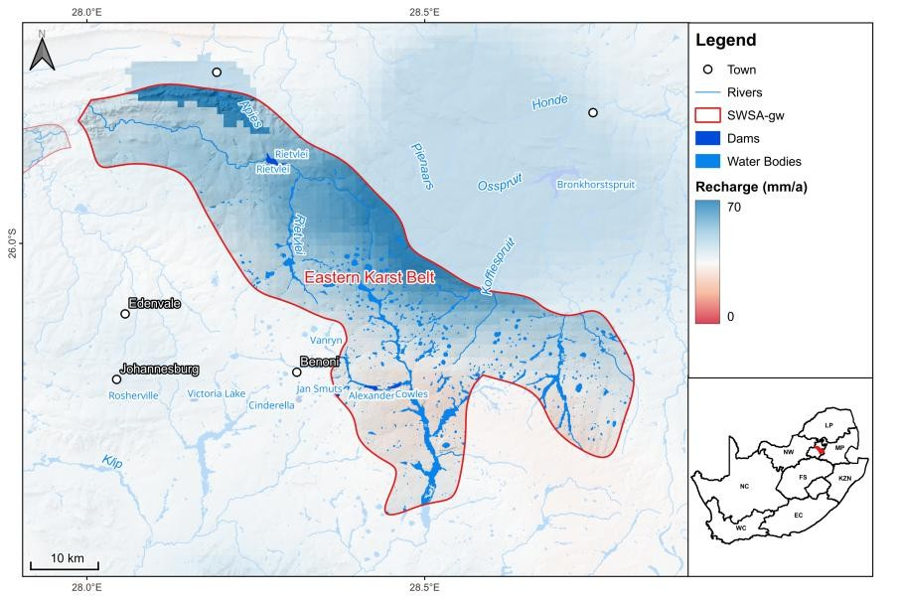
CURRENT STATUS
QUANTITY
Rainfall & Recharge Assessment
Data Sources:
WR2012 study (Bailey et al., 2015), WR2005 (Middleton & Bailey, 2008), & SA Atlas of Climatology & Agrohydrology (Schulze, 2009) – includes MAP, MAR, water quality, & groundwater parameters.
MAP Dataset:
WR2012 MAP layer (validated up to 2010) is widely used in water resource modelling & remains relevant for recharge estimations despite 14 years since its last update.
MAP Comparison:
Analysis using 10+ & 30+ year weather station records showed MAP differences of 2%–24% (mean 12%) from WR2012, confirming its applicability for first-order recharge estimations.

Slide 21
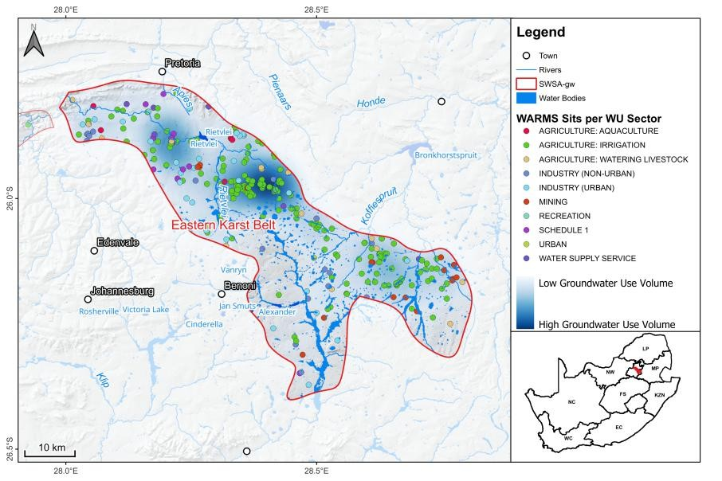
CURRENT STATUS
QUANTITY
Groundwater Use in SWSA-gw
Data Source:
WARMS (Apr 2024) – records registered groundwater users & abstraction volumes (Mm³/a) per sector (domestic, industrial, agricultural, etc.).
Analysis Focus:
Dataset filtered for groundwater use only, identifying abstraction trends & water use hotspots across SWSA-gw.
Groundwater-Dependent Towns:
Identified using the Water Source Dependent Towns Map (DWS, 2024) – provides a spatial understanding of municipalities reliant on groundwater.

Slide 22
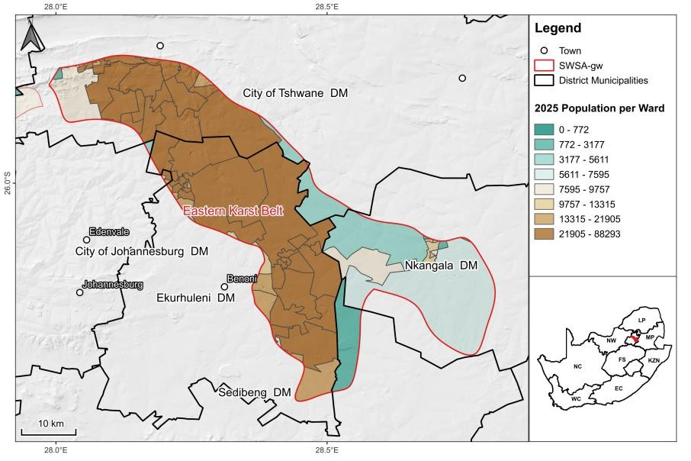
CURRENT STATUS
QUANTITY
Socio-Economic and Governance in SWSA-gw
Population Growth:
Assessed using Stats SA Census (2011, 2022) – annual growth rates calculated for each LM and applied to wards within SWSA-gw, with projections extended to 2025 for population distribution analysis.
Groundwater Dependence:
Evaluated in relation to NWRS (2023), considering CMAs, WUAs, WMAs, WSAs, & WSPs to understand governance frameworks.
Estimation Approach:
Growth rates per LM applied to Wards within SWSA-gw, estimating 2025 groundwater-dependent population across regional schemes, groundwater, & surface water.
Data Limitations:
Informal settlements & rural areas may be underrepresented due to household-level reporting and overlap in water sources, leading to potential underestimation of groundwater reliance.

Slide 23
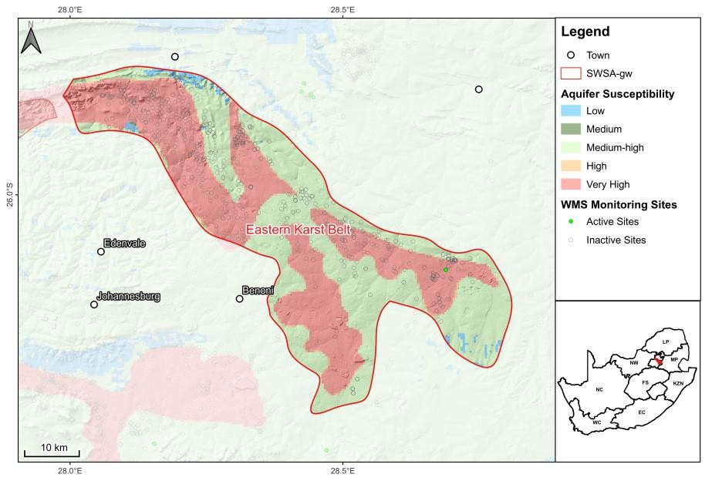
CURRENT STATUS
QUALITY
Groundwater Quality
Groundwater Quality Assessment:
Data from WMS (Apr 2024) – key parameters: pH, EC, fluoride, sulphates, nitrate + nitrite nitrogen.
Long-term trends (2000–2024) analysed, with
focus on agriculture & industry-impacted regions.
Spatial analysis compared with Groundwater Geosites Map (Oct 2024) – identified contamination hotspots (nitrate, fluoride, sulphate) linked to pollution or aquifer degradation.
Groundwater susceptibility:
Groundwater susceptibility was assessed using the WMS and NLC datasets (DFFE, 2022 – 73 classes). Urban, industrial, mining, and agricultural activities were analysed to determine pollution risks affecting groundwater quality. Focus was placed on sites overlapping the most susceptible portions of the aquifer.

Slide 24
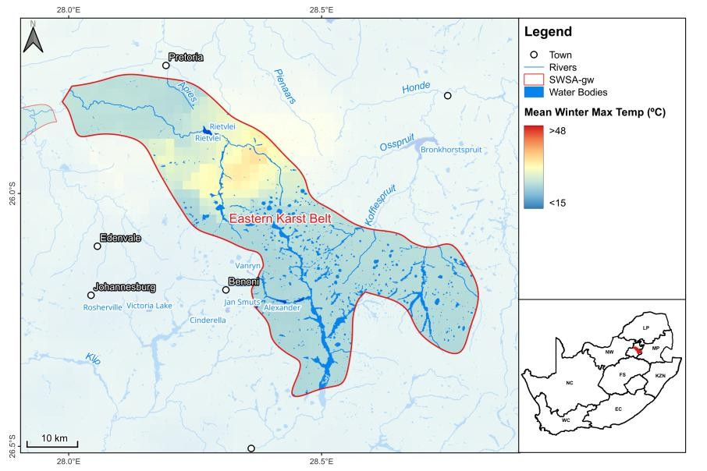
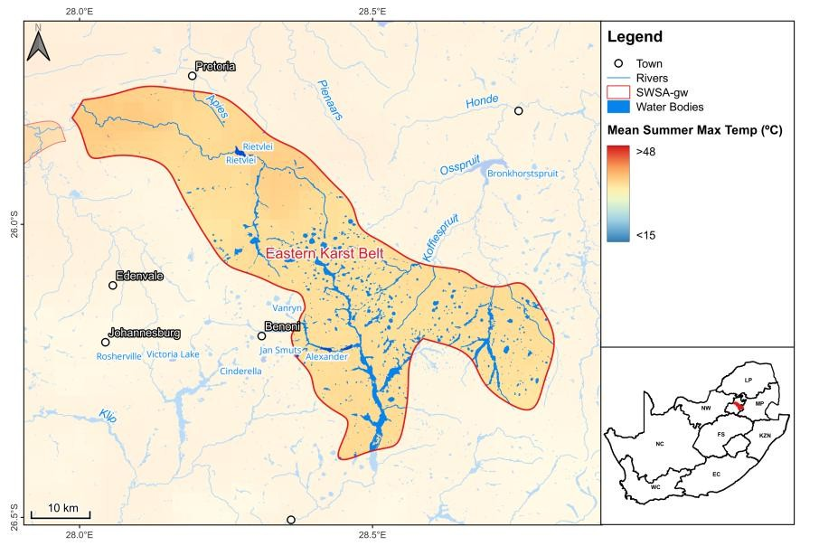
CURRENT STATUS
THREATS AND RISKS
Climate Vulnerability:
Climate:
Classification based on Köppen-Geiger Climate Data (Beck et al., 2018).Temperature extremes & evapotranspiration rates from SA Atlas of Climatology & Agrohydrology (Schulze, 2009) – key for groundwater recharge dynamics.
Climate Change:
Climate change predictions (DART Index: Depth to Water Level Change, Aquifer Type, Recharge, & Transmissivity) from Dennis & Dennis (2012) assessed for recharge impacts.

Slide 25
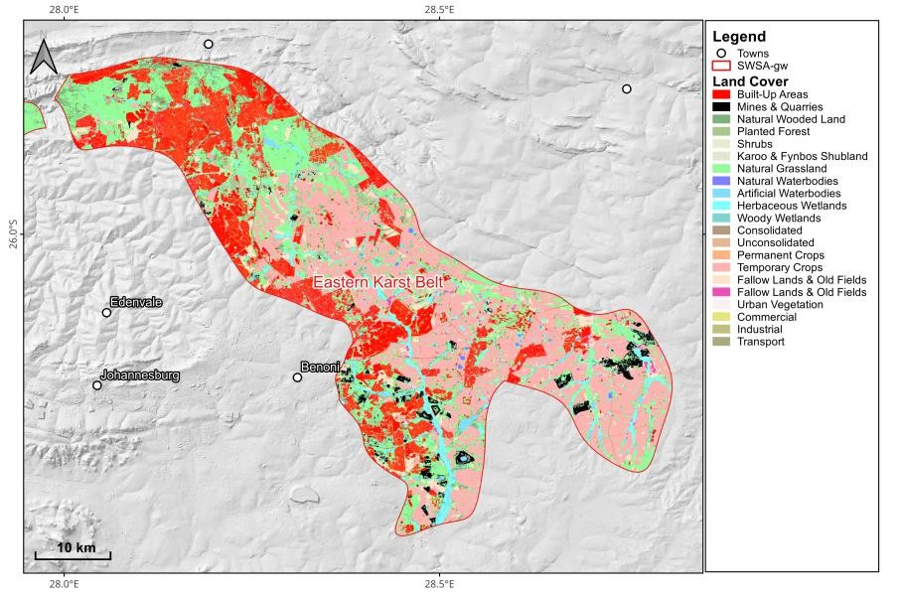
CURRENT STATUS
THREATS AND RISKS
Land Use Impacts:
Evaluated using NLC 73-class dataset (DFFE, 2022).
Agricultural, industrial, urban & conservation areas mapped relative to SWSA-gw.
Key groundwater stressors:
  urban expansion,
  mining operations,
  intensive agriculture.

Slide 26
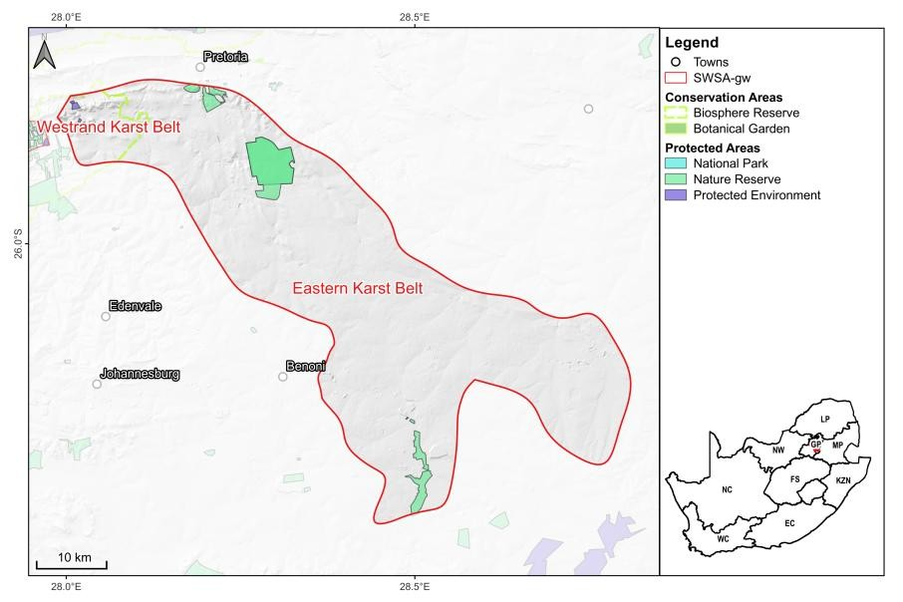
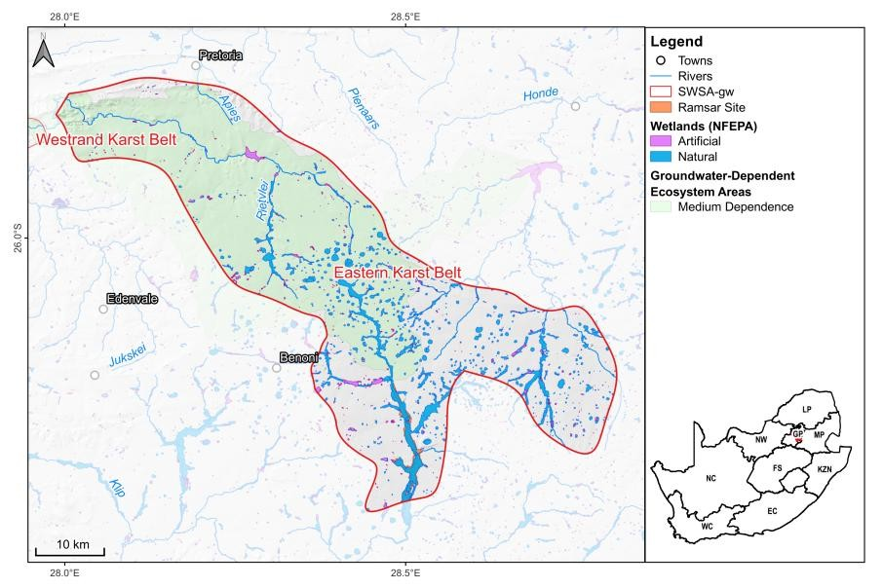
CURRENT STATUS
PROTECTION STATUS
Biodiversity & Conservation Areas:
Mapped using DFFE Conservation Data (DEA, 2018; DFFE, 2024).Includes National Parks, Nature Reserves, Biosphere Reserves, Marine Protected Areas (MPAs), & SGWCA (CSIR, 1998).
Groundwater-Dependent Ecosystems:
Identified wetlands, estuaries & other GDEs reliant on groundwater (CSIR, 2011), Ramsar Sites (DFFE, 2024).

Slide 27
STATUS QUO ASSESSMENT
REFINEMENT OF STRATEGIC GROUNDWATER SOURCE AREAS OF SOUTH AFRICA

Slide 28
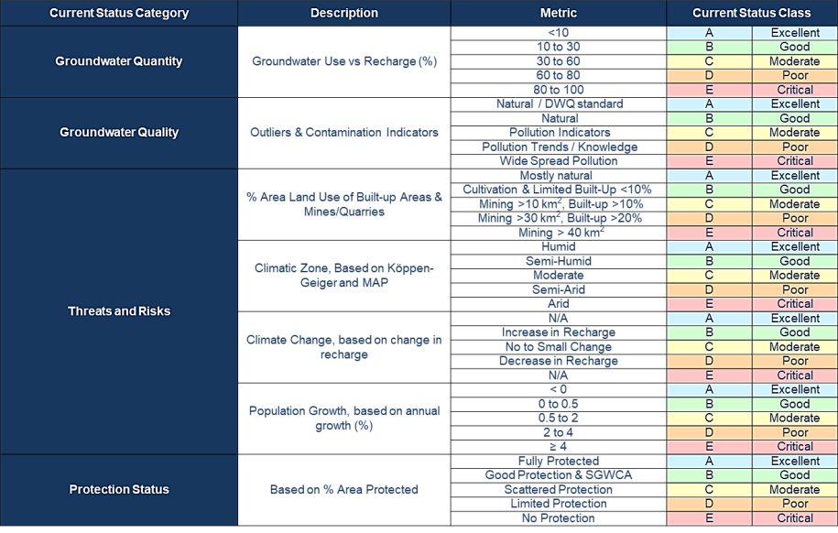
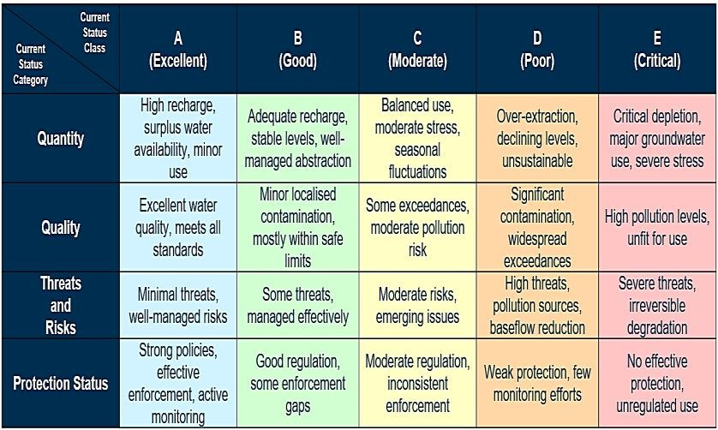
REFINEMENT OF STRATEGIC GROUNDWATER SOURCE AREAS OF SOUTH AFRICA
LOGIC AND WORKFLOW

Slide 29
REFINEMENT OF STRATEGIC GROUNDWATER SOURCE AREAS OF SOUTH AFRICA
CURRENT STATUS SCORE
SWSA-gw |  | Current Status Category
 |  | Quantity | Quality | Threats & Risks | Protection Status
01 | West Coast Aquifer | B | C | D | C
02 | Sandveld | E | C | B | C
03 | Cape Peninsula and Cape Flats | C | D | E | C
04 | Northwestern Cape Ranges | C | A | B | B
05 | Coega TMG Aquifer | C | D | C | B
06 | Overberg Region | B | A | B | C
07 | Zululand Coastal Plain | A | A | C | C
08 | Central Pan Belt | E | C | B | D
09 | Southern Ghaap Plateau | E | A | D | D
10 | Eastern Kalahari A | E | C | B | E
11 | Eastern Kalahari B | B | B | B | E
12 | Westrand Karst Belt | D | C | B | B
13 | Eastern Karst Belt | D | B | D | D
14 | Crocodile River Valley | E | C | C | B
15 | Kroondal / Marikana | E | D | D | B
16 | Nyl and Dorps River Valley | C | C | B | B
17 | Upper Sand (Polokwane) Aquifer System | E | C | D | D
18 | Vivo-Dendron | E | D | B | B
19 | Giyani | D | C | C | E
20 | Phalaborwa | E | D | E | C
21 | Kroonstad | A | C | B | D
22 | Transkei Middleveld | A | C | B | E
23 | Northern Lowveld Escarpment | A | B | C | C
24 | Tulbagh-Ashton Valley | C | C | B | C
25 | Soutpansberg | B | C | D | C
26 | Letaba Escarpment | B | C | B | D
27 | Northern Ghaap Plateau | B | C | B | D
28 | Sishen / Kathu | C | C | D | D
29 | De Aar Region | B | C | C | D
30 | Far West Karst Region | E | B | C | D
31 | Ventersdorp/Schoonspruit Karst Belt | C | C | B | B
32 | Bo-Molopo Karst Belt | C | D | C | B
33 | George and Outeniqua | A | C | B | C
34 | Ixopo / Kokstad | A | A | D | D
35 | KwaDukuza | A | C | D | E
36 | Southwestern Cape Ranges | B | B | B | B
37 | Richards Bay GW Fed Estuary | A | B | D | D

Slide 30
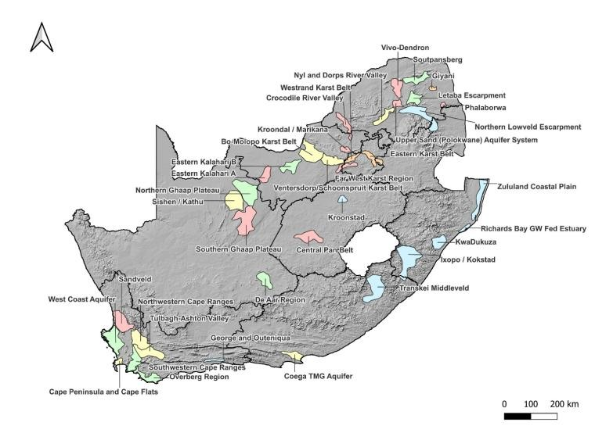
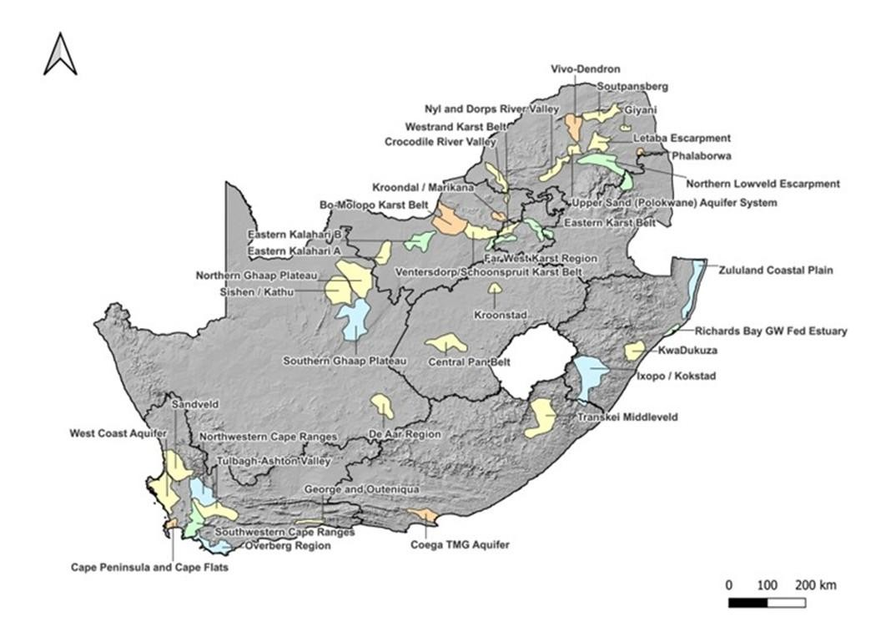
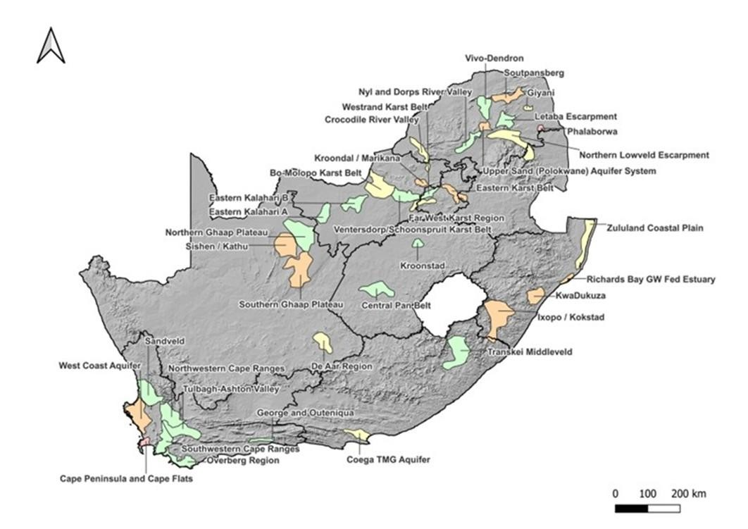
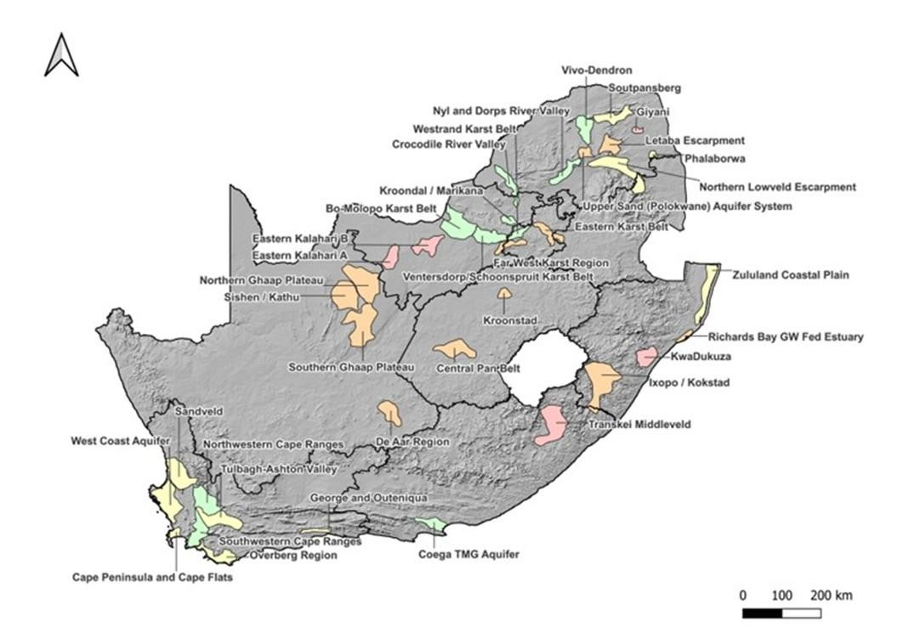
REFINEMENT OF STRATEGIC GROUNDWATER SOURCE AREAS OF SOUTH AFRICA
CURRENT STATUS SCORE

Slide 31

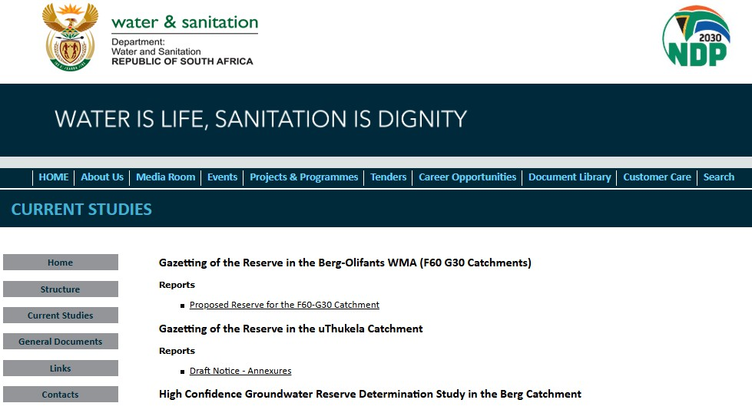
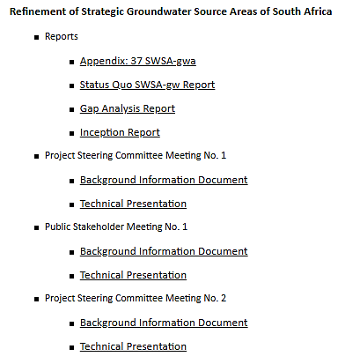
REFINEMENT OF STRATEGIC GROUNDWATER SOURCE AREAS OF SOUTH AFRICA
https://www.dws.gov.za/we m/currentstudies/doc/Statu s%20Quo%20SWSA_gw%2 0Report.pdf
https://www.dws.gov.za/we
m/currentstu
dies/doc/Appe
ndix_%2037%20SWSA_gw. pdf
31

Slide 32
DISCUSSION & QUESTIONS
REFINEMENT OF STRATEGIC GROUNDWATER SOURCE AREAS OF SOUTH AFRICA

Slide 33
REFINED METHODOLOGY APPROACH
REFINEMENT OF STRATEGIC GROUNDWATER SOURCE AREAS OF SOUTH AFRICA

Slide 34
OBJECTIVES OF THE REFINED METHODOLOGY REPORT
REFINEMENT OF STRATEGIC GROUNDWATER SOURCE AREAS OF SOUTH AFRICA
The objective of the Refined Methodology Report is to develop a scientifically robust and defensible approach for identifying SWSA-gw. This refined approach incorporates additional criteria, such as groundwater quality, transboundary aquifer systems, and potential groundwater contributions to baseflow. It also considers key components of groundwater systems, including vulnerability to quantity and quality threats, surface-groundwater interactions, hydraulic connectivity, artesian conditions, recharge areas, storage capacity, and the broader environmental and socio-economic context.
REPORT STRUCTURE
Motivation & Legislative Context
Role of SWSA-gw in South Africa
Key legislation: NWA (1998) & NWRS III (2023)
Why the SWSA-gw delineations are being refined
International Insights
Conceptual & Methodological Frameworks
Guiding Principles
Refined Methodology
Definition of SWSA
Developing the framework
Data inputs & analytical techniques
Criteria and threshold establishment
Iterations & considerations

Slide 35
REFINEMENT OF STRATEGIC GROUNDWATER SOURCE AREAS OF SOUTH AFRICA
UNPACKING THE SWSA-GW (2018)
METHODOLOGY

Slide 36



UNPACKING THE SWSA-GW 2018 METHODOLOGY
REFINEMENT OF STRATEGIC GROUNDWATER SOURCE AREAS OF SOUTH AFRICA
SPATIAL FRAMEWORK
EVALUATION FRAMEWORK
Grid 1 x 1 km
Hydrogeological Category & Associated Parameters
Modelled Data Analysis & Interpretation
Threshold Testing
& Specialist Input
Criteria Set
The 2018 SWSA-gw methodology is structured around 2 core components:
The Spatial Framework applies a uniform 1 km x 1 km grid to ensure consistent spatial
resolution across the study area.
The Evaluation Framework follows a stepwise process, beginning with the identification of relevant hydrogeological categories and subcategories. This is followed by modelled data analysis and interpretation, which informs threshold testing, and concludes with the application of a defined criteria.

Slide 37
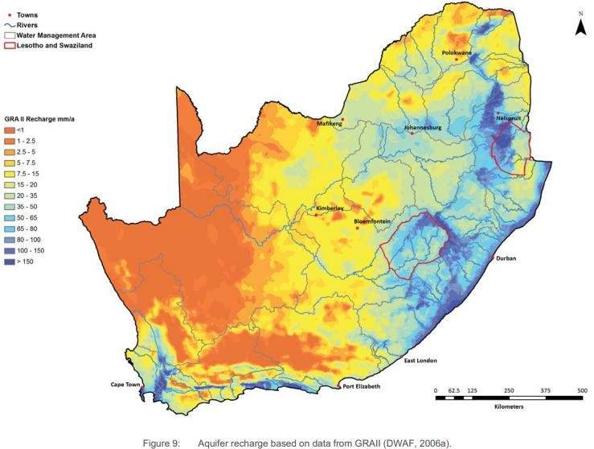
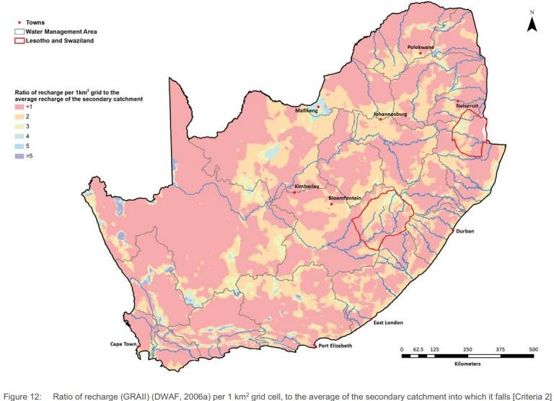
UNPACKING THE SWSA-GW 2018 METHODOLOGY
REFINEMENT OF STRATEGIC GROUNDWATER SOURCE AREAS OF SOUTH AFRICA
Category | Recharge
Sub-Category | Absolute Recharge | Relative Recharge
Modelled Data | GRAII Recharge (mm/a/km²) | Mean Recharge per Secondary Catchment (mm/a/km²)
Analysis | Determined the recharge rate that contributes ~ 50% of the national recharge volume | Recharge per Grid Cell vs Catchment Mean
Threshold Tested | 1. >150 2. >=100 3. >=65 4. >=35 | 1.0 (at least catchment average) 1.5 (>= 150% of catchment average) 2.0 (>= 200% of catchment average) 2.5 (>= 250% of catchment average)
Criteria | Recharge >= 65 mm/a/km2 | Recharge Ratio = 1.5

Slide 38
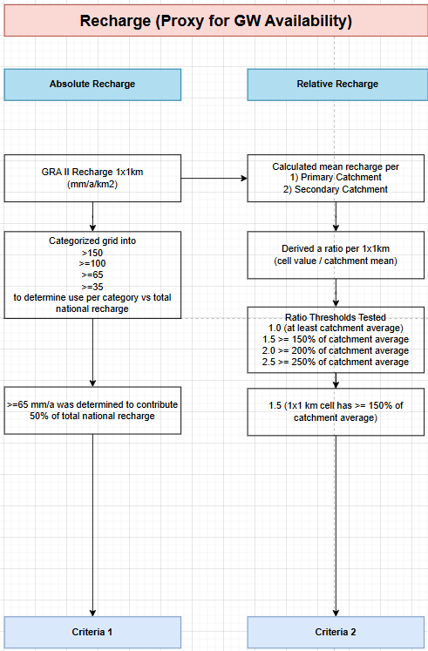

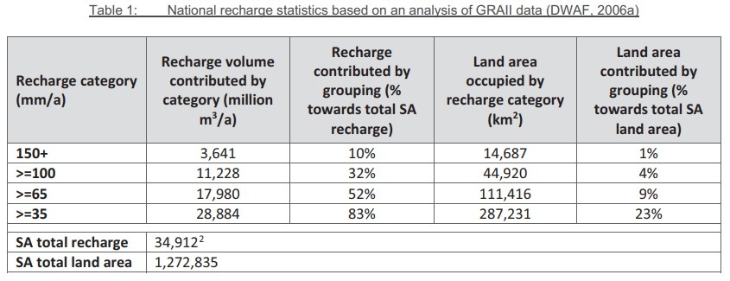
UNPACKING THE SWSA-GW 2018 METHODOLOGY
REFINEMENT OF STRATEGIC GROUNDWATER SOURCE AREAS OF SOUTH AFRICA
Absolute Recharge
“Recharge values greater than 65 mm/a were selected as significant for use as a SWSA-gw (criterion 1), based on a calculation showing that the areas with >65 mm/a contribute more than 50% of the national recharge volume (Table 1). The areas with >65 mm/a cover 9% of the land surface.”
Le Maître et al., 2018

Slide 39

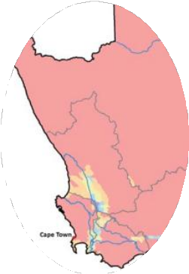
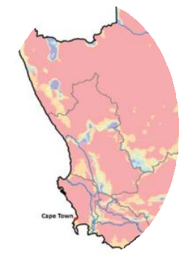



UNPACKING THE SWSA-GW 2018 METHODOLOGY
REFINEMENT OF STRATEGIC GROUNDWATER SOURCE AREAS OF SOUTH AFRICA
Relative Recharge
“As recharge is so dominated by high rainfall areas large portions of the country are not captured by criterion 1. An additional recharge criterion is considered necessary, which is not based on absolute values in mm/a. This can be achieved through mapping the recharge ratio of a particular area compared to a larger area.”
Le Maître et al., 2018
Ratio in Quaternary
Ratio in Secondary

Slide 40
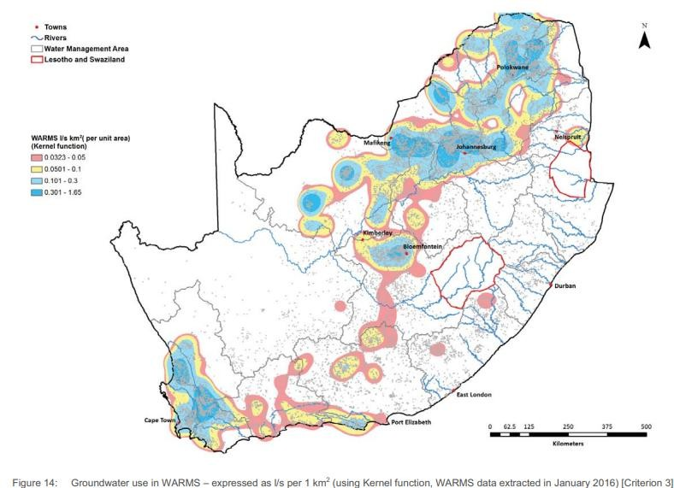
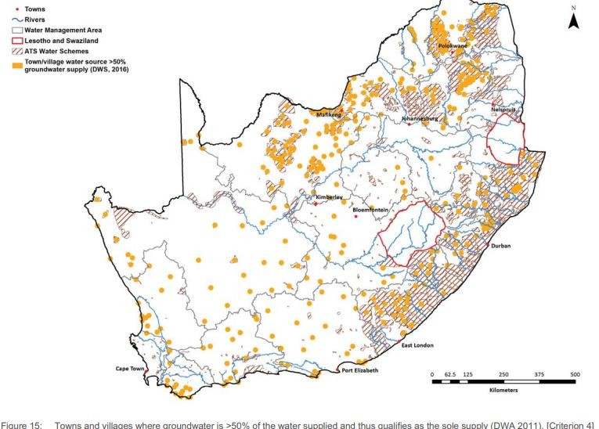
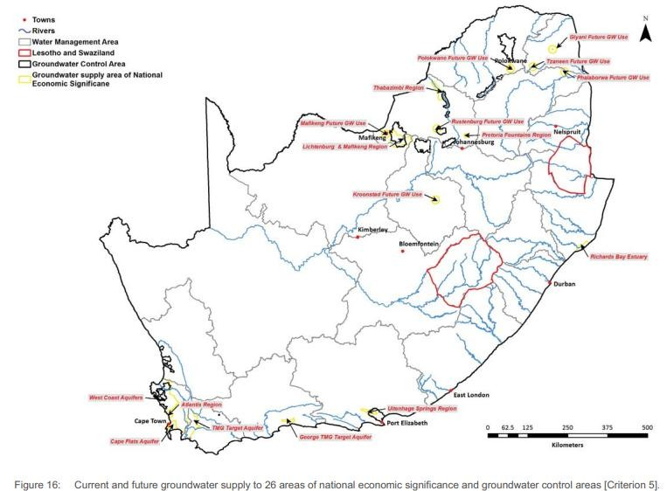
UNPACKING THE SWSA-GW 2018 METHODOLOGY
REFINEMENT OF STRATEGIC GROUNDWATER SOURCE AREAS OF SOUTH AFRICA
Category | Groundwater Use
Sub-Category | Licenced Use | Domestic Supply | Strategic & Future Use
Modelled Data | WARMS | DWS All Towns (2012 & 2016) | NWRS II (2013) Towns & SGWCA
Analysis | Converted licensed volumes (m³/a) to a flow rate (l/s) and then used a Kernal Density Function to estimate l/s/km². | Towns with > 50% Groundwater was considered Sole Supply towns. | 26 Areas of National Economic Significance listed in NWRS II
Threshold Tested | 0.1 l/s/km² 0.3 l/s/km² 0.5 l/s/km² | 1. Buffer 10km Radius | If Aquifer Model Boundary Exists If no Aquifer Boundary, Buffer Town with 10km Radius If 10km Buffer was deemed insufficient, then SGWCA taken
Criteria | Licenced use = 0.3 l/s/km² | None (i.e. all areas included) | None (i.e. all areas included)

Slide 41
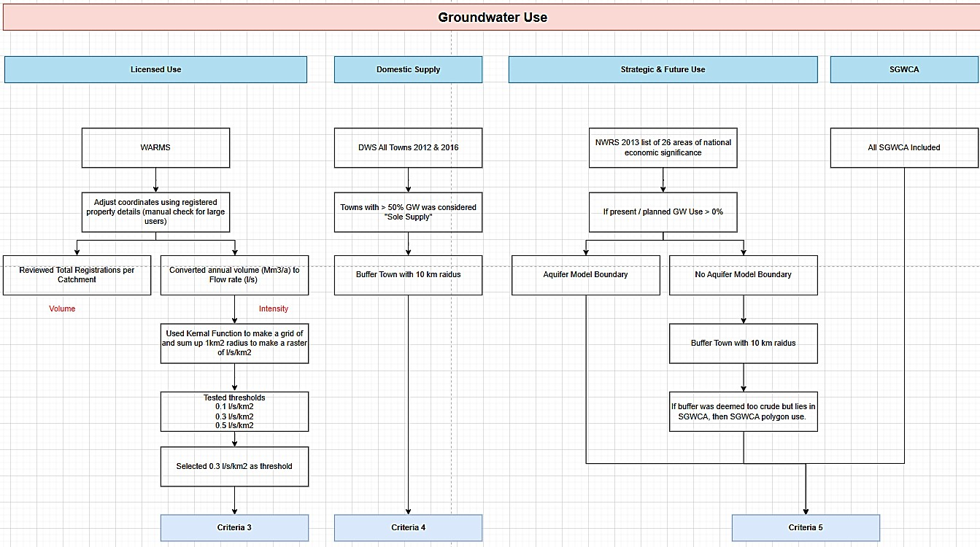
UNPACKING THE SWSA-GW 2018 METHODOLOGY
REFINEMENT OF STRATEGIC GROUNDWATER SOURCE AREAS OF SOUTH AFRICA

Slide 42
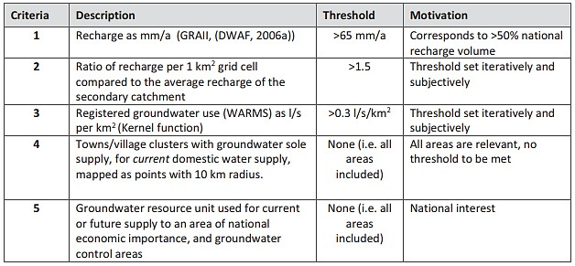
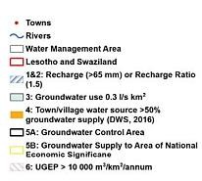
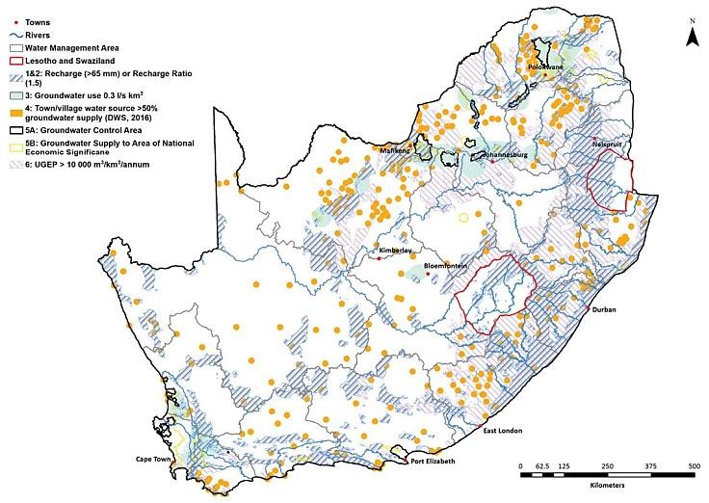


UNPACKING THE SWSA-GW 2018 METHODOLOGY
REFINEMENT OF STRATEGIC GROUNDWATER SOURCE AREAS OF SOUTH AFRICA

Slide 43
SHORTCOMINGS OF THE SWSA-GW 2018 METHODOLOGY
REFINEMENT OF STRATEGIC GROUNDWATER SOURCE AREAS OF SOUTH AFRICA
Recharge As Proxy For Availability
Recharge from GRA II (2006) is carried over from Nel et al. (2013) as the main indicator of groundwater availability. The report concedes that recharge is not the same as sustainable yield, yet argues it is broadly proportional to natural discharge and therefore adequate for a national-scale evaluation.
Groundwater-Use Density As Second Proxy
Abstraction data from WARMS licences and the All-Towns studies are used as a second indicator, on the assumption that heavy use signals productive aquifers. High abstraction, however, can equally reflect a lack of reliable surface- water supplies rather than intrinsic aquifer productivity.
Subjective Threshold Selection
The recharge threshold of 65 mm/a was chosen because grid cells above this value together provide about 52 % of South Africa’s natural groundwater recharge. This “half-of-the-resource” benchmark deliberately mirrors the surface- water SWSA criterion, which flags areas with mean annual runoff (MAR) over 135 mm that likewise supply roughly 50 % of national runoff.
Manual Spatial Delineation
Final SWSA-gw polygons were hand-drawn to outline zones where criteria overlap. Some boundaries track surface geology or lithostratigraphic contacts; others are smoothed, interpolation-based shapes.

Slide 44
REFINED METHODOLOGY & FRAMEWORK
REFINEMENT OF STRATEGIC GROUNDWATER SOURCE AREAS OF SOUTH AFRICA

Slide 45

CHALLENGES AND METHODOLOGICAL CONSIDERATIONS
REFINEMENT OF STRATEGIC GROUNDWATER SOURCE AREAS OF SOUTH AFRICA
What We Know
The SWSA-gw delineations must be aquifer-specific.
The delineation required an updated set of hydrogeological categories (and associated parameters) to be incorporated to improve accuracy and relevance of the SWSA-gw delineations.
Key Challenges Shaping the Methodology
Aquifer boundaries based solely on surface geology are inadequate.
Groundwater behaviour is influenced by more complex hydrogeological conditions
GRUs must be clearly defined based on hydrogeological functioning.
Current threshold values may not apply uniformly across all aquifers and GRUs.

Slide 46
REFINEMENT OF STRATEGIC GROUNDWATER SOURCE AREAS OF SOUTH AFRICA
DEFINITION OF SWSA
Le Maître et al. (2018) Define Strategic Water Source Areas (SWSAs) as areas of land that either:
Supply a disproportionate quantity of mean annual surface water runoff in relation to their size and are considered nationally important; or
Have high groundwater recharge and where the groundwater
forms a nationally important resource; or
Areas that meet both criteria (a) and (b).

Slide 47
REFINEMENT OF STRATEGIC GROUNDWATER SOURCE AREAS OF SOUTH AFRICA
DEFINITION OF SWSA
The proposed NWA amendment has the following definition:
A strategic water source area means areas of land that either supplies a disproportionately large quantity of mean annual surface water runoff in relation to the land areas and is scientifically considered nationally important or has high groundwater recharge and where the groundwater forms a nationally important resource, or a land area that meets both criteria”

Slide 48
REFINEMENT OF STRATEGIC GROUNDWATER SOURCE AREAS OF SOUTH AFRICA
DEFINITION OF SWSA
StatsSA (2023) Define Strategic Water Source Areas (SWSAs) as:
SWSAs are natural source areas for water that supply disproportionately large volumes of water per unit area and that are considered of strategic significance for water security from a national planning perspective, either for surface water, groundwater or both.

Slide 49
REFINEMENT OF STRATEGIC GROUNDWATER SOURCE AREAS OF SOUTH AFRICA
DEFINITION OF SWSA
Vision of the NWRS III (2013)
“The protection and management of water resources to enable equitable and sustainable access to water and sanitation services in support of socio-economic growth, development and sustained ecosystem functioning for the well-being of current and future generations.”
Supply a disproportionate quantity of mean annual surface water runoff in relation to their
size and are considered nationally important; or
Have high groundwater recharge and where the
groundwater forms a nationally important resource; or
Areas that meet both criteria (a)
and (b).
SWSAs are natural source areas for water that supply disproportionately large volumes of water per unit area and that are considered of strategic significance for water security from a national planning perspective, either for surface water, groundwater or both.
A strategic water source area means areas of land that either supplies a disproportionately large quantity of mean annual surface water runoff in relation to the land areas and is scientifically considered nationally important or has high groundwater recharge and where the groundwater forms a nationally important resource, or a land area that meets both criteria
Aspect | Le Maître et al. (2018) | Stats SA (2023) | NWA Draft (2024/2025)
Subject | “areas of land” | “natural source areas for water” (signals an ecological lens) | “areas of land”
Surface Water Clause | “disproportionate quantity of mean annual surface-water runoff in relation to their size” | “disproportionately large volumes of water per unit area” (drops “mean annual” metric, broader phrasing) | Same as Le Maître.
Groundwater Clause | “high groundwater recharge … nationally important resource” | Simply says “either for surface water, groundwater or both” (no recharge metric) | Same as Le Maître.
Qualifier of National Importance | “considered nationally important” | “of strategic significance for water security from a national planning perspective” (planning emphasis) | “scientifically considered nationally important” (adds evidentiary qualifier).
Logical Structure | Lists three mutually exclusive options (a, b, or both). | Single sentence; combines surface- and groundwater in one clause. | Lists three mutually exclusive options (a, b, or both).

Slide 50
REFINEMENT OF STRATEGIC GROUNDWATER SOURCE AREAS OF SOUTH AFRICA
DEFINITION OF SWSA
WATER SOURCE (AREA) | STRATEGIC
Google search Water sources refer to the origins from which water is obtained for various uses, including drinking, irrigation, and other human activities. A water source refers to any location or body of water where water originates or is available for use. Water source areas are defined by their ability to produce significant volumes of water per unit area, contributing disproportionately to the overall water supply of a region. Not defined in NWA or regulations | Vision of the NWRS III (2013): “The protection and management of water resources to enable equitable and sustainable access to water and sanitation services in support of socio- economic growth, development and sustained ecosystem functioning for the well-being of current and future generations.” Water Security & Sustainability

Slide 51
REFINEMENT OF STRATEGIC GROUNDWATER SOURCE AREAS OF SOUTH AFRICA
INTERNATIONAL PERSPECTIVE
Country | Key Insights
Namibia | Water Protection Areas are legally declared under 2013 Water Act, where “Strategic Aquifers” were delineated based mainly on Geophysical & Borehole Data. Protection Zoning is implemented but still need to be formalized.
Botswana | Three-tier wellfield protection zones (defined in the 1990s but never officially formalized in law). Vulnerability mapping used, but reform efforts underway; active in transboundary aquifer projects
Zimbabwe | Catchment-based management with no formal protection zones. Policy supports wellhead/capture zone protection Draft strategy proposes formal groundwater zoning
Mozambique | Groundwater protection zones enabled by Water Law and policy Wellfield zoning applied in urban areas (e.g. Maputo)
Lesotho | No legal protection zones; Water Act supports general protection Groundwater safeguarded indirectly via wetland conservation Basic mapping of lowland aquifers for future use
Eswatini | No formal zoning under Water Act; permit system used Groundwater potential mapping highlights high-yield areas
Country | Key Insights
European Union | Water Framework Directive delineate groundwater bodies based on ecological value or abstraction size using geological/hydraulic boundaries Linked to river basins; allows for internal protection zones
Poland | Major Groundwater Boundaries are designated using high yield and vulnerability criteria, Protection levels defined by groundwater travel time Legally enforced for supply and pollution prevention
Denmark | Hydrogeological mapping followed by source identification Motivated by land-use restrictions Site-specific and risk-based approach
Western Australia | Potential Drinking Water Supply Areas proclaimed by law (zones by priority) Strictest control in Priority 1 managed risk in Priority 3 Includes wellhead protection near vulnerable boreholes
China | Functional Zoning classifies groundwater by resource, ecological, and geohazard function Supports balanced development and environmental protection
USA | Sole Source Aquifers are designated as aquifers supplying >50% of regional drinking water Petition-based with hydrogeological proof of risk in recharge zones

Slide 52
REFINEMENT OF STRATEGIC GROUNDWATER SOURCE AREAS OF SOUTH AFRICA
DEFINITION OF SWSA
Proposed Definition of Strategic Water Source Areas (SWSAs) for Groundwater:
SWSA-gw are natural source areas (aquifers) for water
that can supply disproportionately large volumes of
groundwater per unit area and
that are considered of strategic significance for water security and sustainability from a national planning
perspective.

Slide 53
DISCUSSION & QUESTIONS
REFINEMENT OF STRATEGIC GROUNDWATER SOURCE AREAS OF SOUTH AFRICA

Slide 54
RECAP OF METHODOLOGICAL CONSIDERATIONS
REFINEMENT OF STRATEGIC GROUNDWATER SOURCE AREAS OF SOUTH AFRICA
Key Challenges Shaping the Methodology
Aquifer boundaries based solely on surface geology are inadequate.
Groundwater behaviour is influenced by more complex hydrogeological conditions
GRUs must be clearly defined based on hydrogeological functioning.
Current threshold values may not apply uniformly across all aquifers and GRUs.

Slide 55


REFINED METHODOLOGY
REFINEMENT OF STRATEGIC GROUNDWATER SOURCE AREAS OF SOUTH AFRICA
SPATIAL FRAMEWORK
EVALUATION FRAMEWORK
Aquifer specific
Updated Hydrogeological and Strategic Criteria & Parameters
Groundwater Resource Unit (GRU)
Modelled Data Analysis & Interpretation
Threshold Testing & Ranking
Criteria Set
The refined methodology introduces:
An Enhanced Spatial Framework, structured around fine-scale aquifer-specific Groundwater Resource Units (GRU). This enables a more meaningful delineation and integration at both aquifer and resource scales.
An Updated Evaluation Framework, incorporating updated hydrogeological and strategic categories and parameters to improve granularity. This is followed by modelled data analysis and interpretation, which informs threshold testing and ranking. The refined criteria is applied to the spatial framework.

Slide 56
DEFINING THE SPATIAL FRAMEWORK
REFINEMENT OF STRATEGIC GROUNDWATER SOURCE AREAS OF SOUTH AFRICA

Slide 57








DEFINING THE SPATIAL FRAMEWORK
REFINEMENT OF STRATEGIC GROUNDWATER SOURCE AREAS OF SOUTH AFRICA
AQUIFER TYPE AND YIELD
Scale 1:500K
Merged Layer
  Aquifer Yield
  Aquifer Type
Scale 1:1M
Merged Layer
Yield Class
Water Quality
Sole Source
AQUIFER TYPE & YIELD (1:500K)
AQUIFER CLASSIFICATION
GEOLOGY (1:250K)
AQUIFER CLASSIFICATION (1:1M)

Slide 58









REFINEMENT OF STRATEGIC GROUNDWATER SOURCE AREAS OF SOUTH AFRICA
AQUIFER TYPE AND YIELD
(1:500K)
AQUIFER YIELD (1:250K)
Disaggregated, Downscaled and Updated using Geology (250K)
AQUIFER TYPE (1:250K)
GEOLOGY (1:250K)
58

Slide 59








REFINEMENT OF STRATEGIC GROUNDWATER SOURCE AREAS OF SOUTH AFRICA
1:250K AQUIFER YIELD
1:250K AQUIFER CLASSIFICATION

Slide 60




REFINEMENT OF STRATEGIC GROUNDWATER SOURCE AREAS OF SOUTH AFRICA
GEOLOGY (1:250K)
AQUIFER YIELD (1:250K)
AQUIFER TYPE (1:250K)
AQUIFER CLASS (1:250K)

Slide 61





REFINED METHODOLOGY
REFINEMENT OF STRATEGIC GROUNDWATER SOURCE AREAS OF SOUTH AFRICA
SPATIAL FRAMEWORK
GROUNDWATER AVAILABILITY
EVALUATION FRAMEWORK
Fine-scale Grid (90m x 90m)
Updated Hydrogeological Category & Associated Parameters
Modelled Data Analysis & Interpretation
Zonal Statistical Analysis of Groundwater Availability Parameters
STRATEGIC SIGNIFICANCE
EVALUATION FRAMEWORK
Updated Strategic Categories &
Associated Parameters
Aquifer specific Groundwater Resource Unit (GRU)
Threshold Testing & Ranking
Additional Consideration Criteria & Associated Parameters
Criteria Set

Slide 62
REFINEMENT OF STRATEGIC GROUNDWATER SOURCE AREAS OF SOUTH AFRICA
DEFINING THE GROUNDWATER AVAILABILITY EVALUATION FRAMEWORK

Slide 63


GROUNDWATER AVAILABILITY
REFINEMENT OF STRATEGIC GROUNDWATER SOURCE AREAS OF SOUTH AFRICA
Recharge
  Recharge (mm/a)
  Recharge (% MAP)
  Recharge Ratio
Baseflow
Baseflow (mm/a)
Baseflow (% Rech)
Baseflow Ratio
SANBI
Fine-scale
Grid
(90m x 90m)
Storage Capacity
  Aquifer Thickness
  Aquifer Storage
Potential Yield
  Aquifer Yield
  Aquifer Class
  Groundwater Exploitation Potential (GEP)

Slide 64






REFINEMENT OF STRATEGIC GROUNDWATER SOURCE AREAS OF SOUTH AFRICA
Mean Annual Precipitation
Groundwater Recharge

Slide 65


REFINEMENT OF STRATEGIC GROUNDWATER SOURCE AREAS OF SOUTH AFRICA
GROUNDWATER AVAILABILITY

Slide 66













REFINEMENT OF STRATEGIC GROUNDWATER SOURCE AREAS OF SOUTH AFRICA
CLIMATE ZONES
ARID DESERT
ARID
ARID STEPPE
TEMPERATE WINTER RAIN
TEMPERATE SUMMER RAIN
TEMPERATE
COLD
TEMPERATE ALL YEAR RAIN
The Köppen and Geiger climate zone classification has been defined for current (1991 – 2020) and future (2071 – 2100) period.
TUNDRA
TROPICAL

Slide 67



REFINEMENT OF STRATEGIC GROUNDWATER SOURCE AREAS OF SOUTH AFRICA

Slide 68






REFINEMENT OF STRATEGIC GROUNDWATER SOURCE AREAS OF SOUTH AFRICA
Multi Criteria Overlay
Normalization and Ranking
Recharge | Baseflow | Potential Yield | Storage Capacity
mm/a | mm/a | Mm3/a | Mm3
<30
30-40
40-50
50-60
>60
Low | Low | Low | Low
Low-Mo derate | Low-Mo derate | Low-Mo derate | Low-Mo derate
Moderate | Moderate | Moderate | Moderate
Moderate -Hig h | Moderate -Hig h | Moderate -Hig h | Moderate -Hig h
Hig h | Hig h | Hig h | Hig h
1 | 1 | 1 | 1
2 | 2 | 2 | 2
3 | 3 | 3 | 3
4 | 4 | 4 | 4
5 | 5 | 5 | 5
GEOLOGY (1:250K)
AQUIFER YIELD (1:250K)
AQUIFER TYPE (1:250K)
AQUIFER CLASS (1:250K)
AQUIFER SPECIFIC GROUNDWATER RESOURCE UNIT

Slide 69
REFINEMENT OF STRATEGIC GROUNDWATER SOURCE AREAS OF SOUTH AFRICA
DEFINING THE STRATEGIC SIGNIFICANCE
EVALUATION FRAMEWORK

Slide 70
REFINED METHODOLOGY
REFINEMENT OF STRATEGIC GROUNDWATER SOURCE AREAS OF SOUTH AFRICA
SPATIAL FRAMEWORK
GROUNDWATER AVAILABILITY
EVALUATION FRAMEWORK
Fine-scale Grid (90m x 90m)
Updated Hydrogeological Category & Associated Parameters
Modelled Data Analysis & Interpretation
Zonal Statistical Analysis of Groundwater Availability Parameters
STRATEGIC SIGNIFICANCE
EVALUATION FRAMEWORK
Updated Strategic Categories &
Associated Parameters
Aquifer specific Groundwater Resource Unit (GRU)
Threshold Testing & Ranking
Additional Consideration Criteria & Associated Parameters
Criteria Set

Slide 71

STRATEGIC SIGNIFICANCE EVALUATION FRAMEWORK
REFINEMENT OF STRATEGIC GROUNDWATER SOURCE AREAS OF SOUTH AFRICA
STRATEGIC SIGNIFICANCE
ADDITIONAL CONSIDERATIONS
Current Demand
  Groundwater Use
  Level of Dependence
  Domestic Sole Supply
Environmental & Ecological Significance
  GDE
  Ecological Significant Sites
Socio-Economic & Development Context
  Economic Importance
  Water Services Backlog
  Strategic And Future Use
  Special Economic Zones
Governance & Policy
  SGWCA
  Transboundary Treaty Obligations
Current Status Quo
  Stressed, over-allocated Aquifers
  Pollution
Groundwater Quality
  Natural water quality
  Fit for use
Future Development Options
  Potential for Artificial Recharge
  Groundwater as mitigation measure for Climate Change impacts

Slide 72







REFINEMENT OF STRATEGIC GROUNDWATER SOURCE AREAS OF SOUTH AFRICA
WARMS 2025
DWS 2024
Dependent Towns
CSIR Water Source Settlements
CSIR Water Population Per Settlement

Slide 73





REFINEMENT OF STRATEGIC GROUNDWATER SOURCE AREAS OF SOUTH AFRICA
NSDP 2016
CSIR Total GVA per Settlement
Special Economic Zones

Slide 74
STRATEGIC SIGNIFICANCE
 | Current Demand |  |  | Enviro & Eco Significance |  | Socio-Economic & Development Context |  |  |  | Governance & Policy |  | Total Score
 | GW Use | Level of Dependence | Domestic Sole Supply | GDE | Ecological Significant Sites | Economic Importance | Water Services Backlog | Strategic And Future Use | Special Economic Zones | SGWCA | Transboundary Treaty Obligations
 | 1 |  |  | 1 |  | 1 |  |  |  | 1 |  | 1
 | 2 |  |  | 2 |  | 2 |  |  |  | 2 |  | 2
 | 3 |  |  | 3 |  | 3 |  |  |  | 3 |  | 3
 | 4 |  |  | 4 |  | 4 |  |  |  | 4 |  | 4
 | 5 |  |  | 5 |  | 5 |  |  |  | 5 |  | 5
GRU 1
GRU 2
ADDITIONAL CONSIDERATIONS
 | Current Status Quo |  | Groundwater Quality |  | Future Development Options |  | Total Score
 | Stressed, over-Allocated Aquifers | Pollution | Natural Water Quality | Fit for Use | Potential for Artificial Recharge | Potential for Climate Change Mitigation
 | E & F | E |  |  | Low | Low
 | D | D
 | C | C | Class III |  | Medium | Medium
 | B | B | Class II
 | A | A | Class I |  | High | High
 | 1 | 1 | 1 | 1 | 1 | 1 | -1
 | 2 | 2 | 2 | 2 | 2 | 2
 | 3 | 3 | 3 | 3 | 3 | 3 | 0
 | 4 | 4 | 4 | 4 | 4 | 4
 | 5 | 5 | 5 | 5 | 5 | 5 | +1
GRU 1
GRU 2
74

Slide 75
EVALUATION FRAMEWORK – FINAL SCORING SYSTEM
REFINEMENT OF STRATEGIC GROUNDWATER SOURCE AREAS OF SOUTH AFRICA
 | GW Availability | Strategic Significance | Additional Considerations | TOTAL OUT OF 10
 | Ranking of 4 Parameters | Maximum of 4 Criteria | Adjustment based on 4 Criteria
 | Recharge | Current Demand | Status Quo
 | Baseflow | Ecological | Groundwater Quality
 | Storage | Socio-economic | Artificial Recharge Potential
 | Yield | Governance & Policy | Climate Change Mitigation Potential
 | Low | Low
 | Low-Moderate | Low-Moderate
 | Moderate | Moderate
 | Moderate-High | Moderate-High
 | High | High
 | 1 | 1 | -1
 | 2 | 2
 | 3 | 3 | 0
 | 4 | 4
 | 5 | 5 | +1
GRU 1 | 2 | 3 | -1 | 4
GRU 2 | 3 | 4 | +1 | 8
GRU 3 | 5 | 5 | 0 | 10
GRU 4 | 2 | 1 | -1 | 2
GRU 5 | 1 | 3 | +1 | 5
GRU 6 | 5 | 5 | +1 | 11

Slide 76
DISCUSSION & QUESTIONS
REFINEMENT OF STRATEGIC GROUNDWATER SOURCE AREAS OF SOUTH AFRICA

Slide 77
PROJECT PROGRAMME
REFINEMENT OF STRATEGIC GROUNDWATER SOURCE AREAS OF SOUTH AFRICA

Slide 78
CAPACITY BUILDING
REFINEMENT OF STRATEGIC GROUNDWATER SOURCE AREAS OF SOUTH AFRICA
Date: Held on 10th July 2025
Participants:
Objective:
Validate and refine the draft SWSA-GW delineation methodology, integrating aquifer specific parameters such as yield, recharge, water quality, etc. into a single workflow.
Key Activities:
Quantify, normalise and group datasets into a relevant and repeatable scoring system.
Finalise “working criteria” for mapping significant
groundwater systems.
Address spatial scale, uncertainty and alignment.
Outcome:
Shared, streamlined methodology and criteria ready for pilot testing, supporting the Capacity- Building objectives in the Inception Report (Deliverable 1.1).
Associated Task | Capacity Building Details | Date Scheduled | Type of Training
T2.1.1 | Data and Information Assessment | 16th Jul 2024 | Type: Workshop (CPT) Face-to-Face Session: 1 Day
T3.1.1 | Status Quo SWSA- gw Assessment | 13th Feb 2025 | Type: Workshop (CPT) Face-to-Face Session: 1 Day
T3.2.1 | Refined Methodology Assessment | 10th July 2025 | Type: Workshop (CPT) Hybrid Session: 1 Day
T3.3.1 | Delineation of Refined SWSA-gw | Oct 2025 | Type: Workshop (CPT) Face to Face Session: 2 Days
T.3.3.4 | Updated Status Quo SWSA-gw | Jan 2026 | Type: Workshop (CPT) Face to Face Session: 2 Days
T3.4.1 | SWSA-gw Protection and Management | Jul 2026 | Type: Workshop (CPT) Hybrid Session: 1 Day
78

Slide 79
PROGRAMME OF UPCOMING EVENTS
REFINEMENT OF STRATEGIC GROUNDWATER SOURCE AREAS OF SOUTH AFRICA
Phase 3 Deliverables
P3 | Refinement of SWSA for Groundwater (SWSA-gw) | 2024 |  |  |  |  |  |  |  |  | 2025 |  |  |  |  |  |  |  |  |  |  |  | 2026 |  |  |  |  |  |  |  |  |  |  |  | 2027
 |  | Apr | May | Jun | Jul | Aug | Sep | Oct | Nov | Dec | Jan | Feb | Mar | Apr | May | Jun | Jul | Aug | Sep | Oct | Nov | Dec | Jan | Feb | Mar | Apr | May | Jun | Jul | Aug | Sep | Oct | Nov | Dec | Jan | Feb | Mar
T3.1.1 | Status Quo SWSA Assessment
D3.1 | Status Quo SWSA Report |  |  |  |  |  |  |  |  |  |  |  | X
T3.2.1 | Refined Methodology Assessment
D3.2 | Refined Methodology Report |  |  |  |  |  |  |  |  |  |  |  |  |  |  |  | X
T.3.3.1 | Delineation of Refined SWSA-gw
T.3.3.2 | Groundwater Quality
T.3.3.3 | Transboundary Aquifers
T.3.3.4 | Updated Status Quo SWSA Assessment
D3.3 | Delineation of refined SWSA-gw Report |  |  |  |  |  |  |  |  |  |  |  |  |  |  |  |  |  |  |  |  |  |  | X
T3.4.1 | SWSA-gw Protection and Management
D3.4 | SWSA-gw Protection and Management Report |  |  |  |  |  |  |  |  |  |  |  |  |  |  |  |  |  |  |  |  |  |  |  |  |  |  |  |  | X

Slide 80
REFINEMENT OF STRATEGIC GROUNDWATER SOURCE AREAS OF SOUTH AFRICA
PMC-05 held on 25th June 2025
CB-03 Held on the 10th July
PSC-03 held on 16th July 2025
Next CB (CB-04) scheduled for October 2025
Next PMC (PMC-06) scheduled for November 2025
Next PS/PSC (PS-02) scheduled for December 2025
 | 2024 |  |  |  |  |  |  |  |  | 2025 |  |  |  |  |  |  |  |  |  |  |  | 2026 |  |  |  |  |  |  |  |  |  |  |  | 2027
 | 1 | 2 | 3 | 4 | 5 | 6 | 7 | 8 | 9 | 10 | 11 | 12 | 13 | 14 | 15 | 16 | 17 | 18 | 19 | 20 | 21 | 22 | 23 | 24 | 25 | 26 | 27 | 28 | 29 | 30 | 31 | 32 | 33 | 34 | 35 | 36
Task / Deliverable | Apr | May | Jun | Jul | Aug | Sep | Oct | Nov | Dec | Jan | Feb | Mar | Apr | May | Jun | Jul | Aug | Sep | Oct | Nov | Dec | Jan | Feb | Mar | Apr | May | Jun | Jul | Aug | Sep | Oct | Nov | Dec | Jan | Feb | Mar
PMC Meetings | 1 |  | 1 |  |  | 1 |  |  | 1 |  |  | 1 |  |  | 1 |  |  |  |  | 1 |  |  | 1 |  |  |  | 1 |  | 1 |  |  | 1 |  |  | 1
PSC Meetings |  |  |  | 1 |  |  |  |  |  |  | 1 |  |  |  |  | 1 |  |  |  |  |  |  |  |  |  |  |  | 1 |  |  |  |  | 1
PS Meetings |  |  |  |  | 1 |  |  |  |  |  |  |  |  |  |  |  |  |  |  |  | 1 |  |  |  |  |  |  |  |  |  |  |  |  | 1
Capacity Building |  |  |  | 1 |  |  |  |  |  |  | 1 |  |  |  | 1 |  |  |  | 1 |  |  | 1 |  |  |  |  |  | 1

Slide 81
QUESTIONS
REFINEMENT OF STRATEGIC GROUNDWATER SOURCE AREAS OF SOUTH AFRICA

